Slide 1
West Orange FL-802
Semi-Weekly Brief
C/ Staff Sergeant Eliud Cruz-Garcia
7 December 2023
Lead,
Serve,
Dream
Unit Motto:

Slide 2
AFJROTC Mission
Develop citizens of character dedicated to serving their nation and community
Mission:
Goals:
Instill Values Of Citizenship,
Service To The United States,
Personal Responsibility/Sense Of Accomplishment

Slide 3
Chain of Command
Commander in Chief:
Sec Def:
Sec AF:
CSAF:
AETC CC:
AU CC:
Holm Center CC:
Director, AFJROTC:
SASI:
Group CC:
Deputy Group CC:
President Joseph R. Biden Jr.
Honorable Lloyd Austin
Honorable Frank Kendall
Gen David Allvin
Lt. Gen Brian S. Robinson
Lt. Gen Andrea D. Tullos
Brig Gen Houston R. Cantwell
Col Johnny R. McGonigal
Lt. Colonel Micheal Carrizales
C/ Captain Agrafena Ritz
C/ Captain Elias Lopez

Slide 4
Athletic Clearance
These Cadets below are missing the Athletic Clearance:
Aguilar - Bravo Mezime - Delta Saint Franc-Golf
Bermudez - Alpha Osoria - Charlie
Ceballos - Charlie Palacios - Foxtrot
Damuth - Alpha Parboo - Alpha
DeSilva - Charlie Rosario - Delta
Doyle - Alpha Vazquez- Charlie
James- Golf Almodovar-Charlie
Madera - Bravo Saint Franc-Alpha
https://athleticclearance.fhsaahome.org/

Slide 5
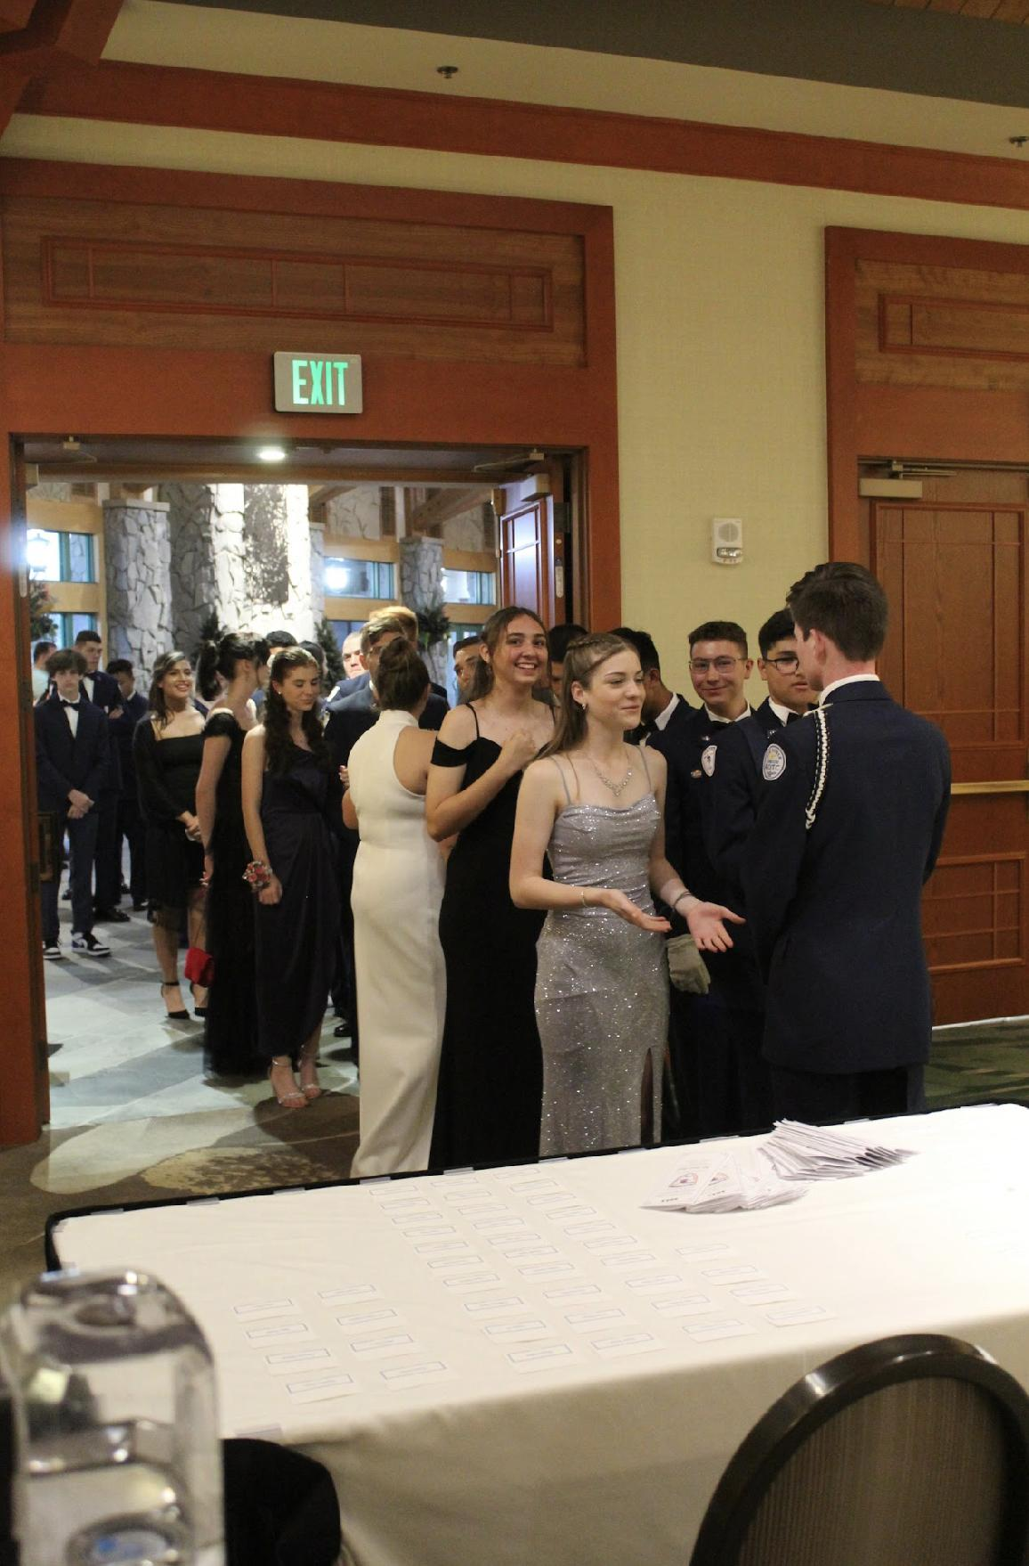
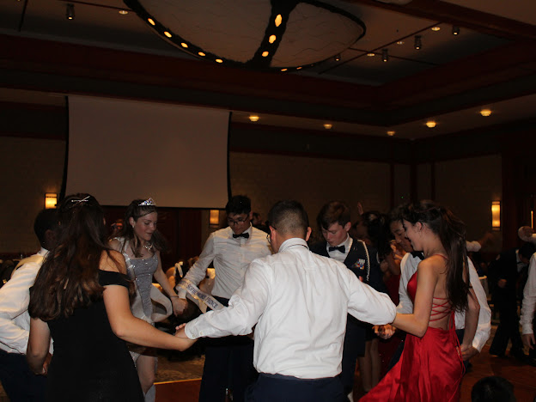
FL-802 Air Force Ball
Air Force Ball is our unit’s very own dance! It is a fun filled night with ceremonies, food, and lots of dancing! This years AFB is 10 February 2024 at Rosen Plaza from 1800 to 2200!
https://www.schoolpay.com/pay/for/Air-Force-Ball-Tickets-2324/SbGcCl
Ticket prices are as follows:
Cadets: $45
Guests: $50
If you have any questions or concerns, please contact C/ 1st Lt Sara Mattox @ 4072423829 or at 4804154679@students.ocps.net

Slide 6
Bataan Death March
TAKE A PICTURE!
Who: Our Cadet Corps, Dr. Phillips and Ocoee Cadet Corps
What: 14.4 Mile March on the West Orange Trail
When: 16 December, from 0730-1330
Where: Killarney Station to Chapin Station (Round Trip)
Why: To Honor Prisoners of War
Uniform: Combo 4 (PT Clothes)
Sign Up: Sheet on the Board
If you have any questions, please contact C/ MSgt Noah Abney @ 407-961-2474 or 4804172400@students.ocps.net.

Slide 7
Maxey Elementary Winter Concert
December 12th , 5:30pm - 7:30pm
5 - 7 volunteers needed.
December 14th, 5:30pm - 7:30pm
5 - 7 volunteers needed.
You MUST be ADDitions approved.
https://tinyurl.com/maxeyadditons
SIGN UP FOR EVENT HERE v
https://tinyurl.com/maxsign1
For any questions, please contact c/Kei Seddon at (321) 888-1698
You will be helping backstage, such as with moving risers and instruments and escorting students.
602 E Story Rd, Winter Garden, FL 34787

Slide 8
Toy Drive
The Winter Garden Police Department is hosting a toy drive! You can donate holiday gifts to children (unopened and new). There should be a bin or box in room 950 to drop your item(s) off as well as a sheet to sign what you have brought. This ends 14 DECEMBER!
Max hours: 3
1 item=1 hour
If you have any questions or concerns, please contact C/ Princess Tolbert at 4804191858@students.ocps.net

Slide 9
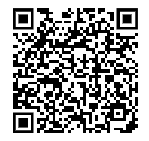
KHHS Unit Wide Holiday Party
Kitty Hawk Honor Society invites you to join us after school 21 December from 1430 to 1630 for our annual holiday party!!
If there is anything specific anyone would like to have at the party, please fill out the form linked below!
We hope to see you there :D
https://tinyurl.com/KittyHawkParty23
If you have any questions or concerns, please contact C/ 1st Lt Sara Mattox @ 4072423829 or at 4804154679@students.ocps.net

Slide 10
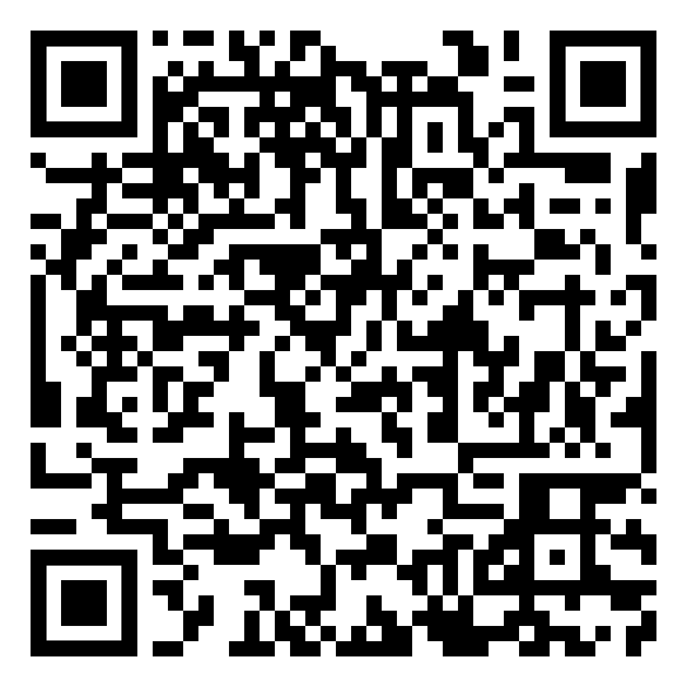
Color Guard School
Want to learn how to do Color Guard?
A Color Guard school will take place after school from 1430-1600 on 14 & 15 December and 1330-1500 on 20 December.
You will learn all ceremonial color guard commands, making you eligible to be on color guard teams.
Please sign up using the QR code or the link:
https://tinyurl.com/mrdtnhpv
If you have any questions, please contact C/ CMSgt Diego Cuevas at 4804178140@students.ocps.net or 407-575-3811.

Slide 11
Chief’s Quote of the Week
"I start with the premise that the function of leadership is to produce more leaders, not more followers."
– Ralph Nader

Slide 12
Military Knowledge
What is the highest ribbon that can be worn on your uniform?
The Gold Valor Award

Slide 13
Summary
Upcoming Events
Maxey Winter Concert (12/12 & 12/14)
Bataan Death March (12/16)
KHHS Holiday Party (12/21)
Notes
Athletic Clearances
AFB
Toy Drive
Color Guard School
Chief's Quote

Slide 14
Briefing Slides
If you have a slide for the briefing, contact C/ Cruz-Garcia at 4804173126@students.ocps.net
If you want something in the briefing, you must contact C/ Cruz-Garcia by Monday 1700 for the Tuesday brief and Wednesday 1700 for the Thursday brief

