Slide 1
West Orange FL-802
Semi-Weekly Brief
C/ Staff Sergeant Eliud Cruz-Garcia
5 September 2023
Lead,
Serve,
Dream
Unit Motto:

Slide 2
AFJROTC Mission
Develop citizens of character dedicated to serving their nation and community
Mission:
Goals:
Instill Values Of Citizenship,
Service To The United States,
Personal Responsibility/Sense Of Accomplishment

Slide 3
Chain of Command
Commander in Chief:
Sec Def:
Sec AF:
CSAF:
AETC CC:
AU CC:
Holm Center CC:
Director, AFJROTC:
SASI:
Group CC:
Deputy Group CC:
President Joseph R. Biden Jr.
Honorable Lloyd Austin
Honorable Frank Kendall
Gen Charles Q. Brown Jr.
Lt. Gen Brian S. Robinson
Lt. Gen Andrea D. Tullos
Brig Gen Houston R. Cantwell
Col Johnny R. McGonigal
Lt. Colonel Michael Carrizales
C/ Major Aidan Bernhard
C/ 1st Lieutenant Antonio Torre

Slide 4
Orange Rope
Flight Commanders, please remember to award Orange Rope to the upperclassman and first-year with the highest average uniform wear over the last two weeks on Wednesday. First-years with no combo 1 are not eligible.
Take pictures and send to C/Lopez at (321)440-7611

Slide 5
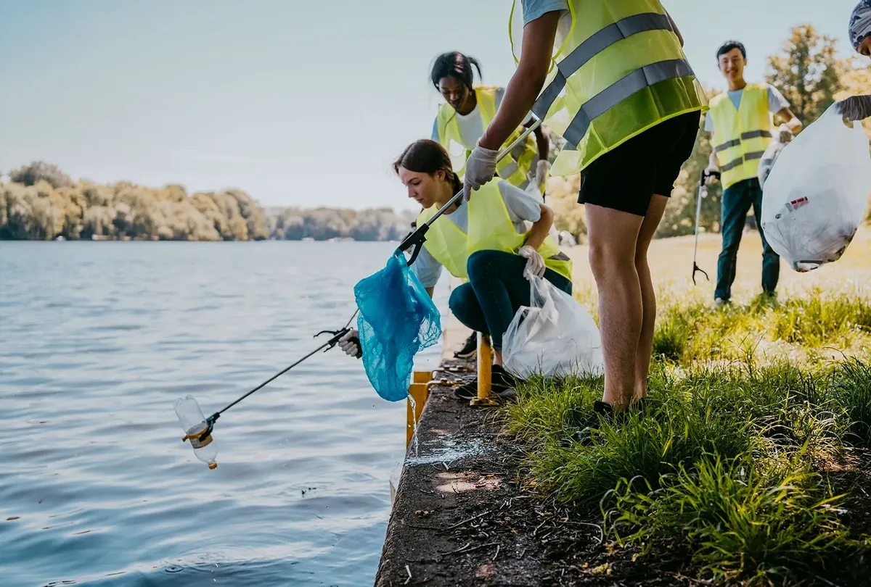
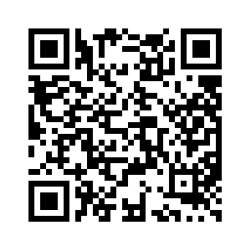
Community Service Event: Orlando Lakes Cleanup
Want to help clean up your community while earning community service hours? The organization Keep Orlando Beautiful is hiring volunteers to help clean up lakes in Orlando-and you have the opportunity to help them out on their mission.
Time: 1000 – 1200
Date: Saturday, September 16th
Where: Eagles Nest Park (5165 Metrowest Blvd)
If you wish to participate in this event, you must register as a volunteer with Orlando Cares. Scan the QR code to the right for more info on the event as well as a link to registration.
Please tell SMSgt Spencer if you are attending so we know how many people wish to attend.
If you have any questions, or need help with registration, contact C/ David Adepeju at 4806861837@students.ocps.net

Slide 6
Kitty Hawk Honor Society Meeting
Kitty Hawk meeting THIS WEEK 7 September 1430-1530 in room 950!
For any further details, please contact C/ 2nd Lt. Sara Mattox at (407) 242-3829 or 4804154679@students.ocps.net

Slide 7
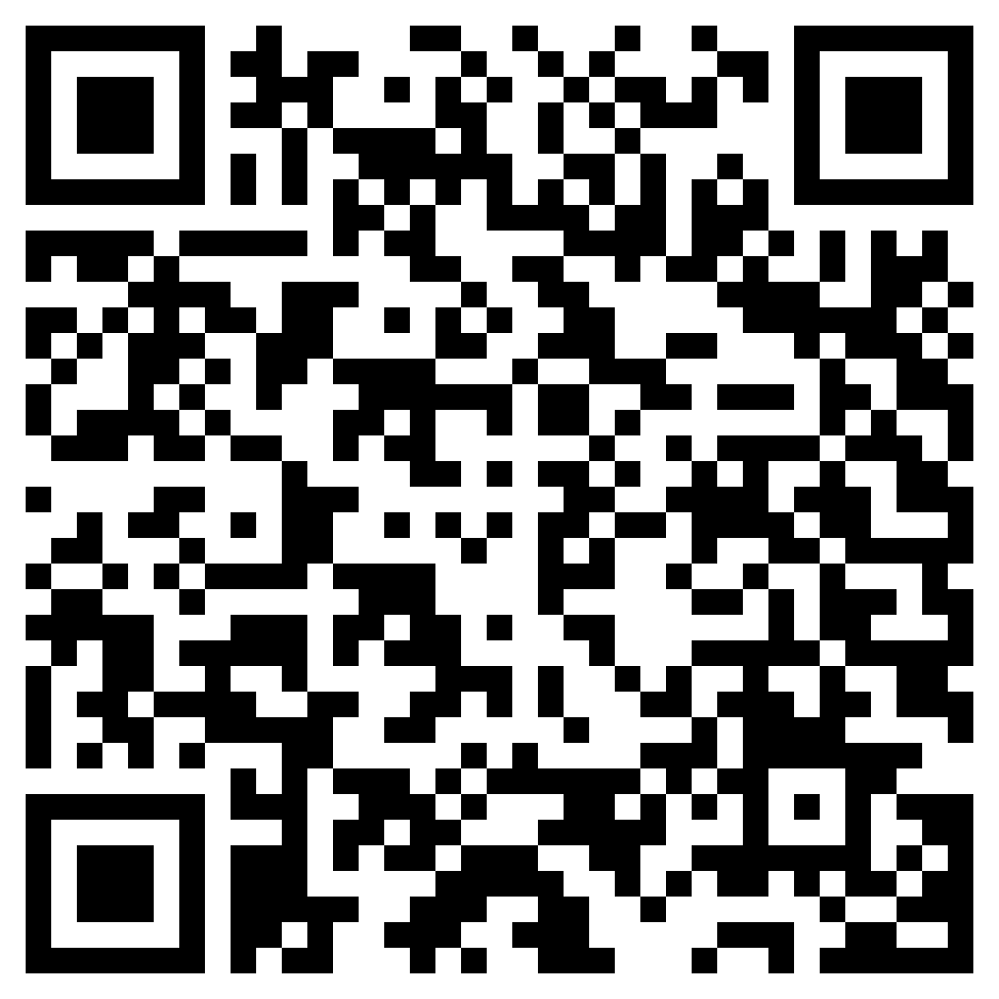
Join Recruiting!
If you are interested in helping our unit recruit new cadets, join the recruiting team.
If you would like to go out to schools and help boost our unit numbers and have the opportunity to earn the recruiting ribbon, scan the QR code provided.
Any questions, please contact C/ TSgt Princess Tolbert at 4804191858@students.ocps.net or (407) 259-717.

Slide 8
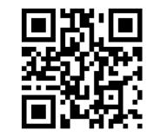
Logistics Appointment Schedule
New 2023-2024 Logistics appointment link
Logistics Appointment Form:
Monday: 1420-1500
Tuesday: 1420-1500
Thursday: 1420-1500
https://tinyurl.com/FL-802LSS
Questions, comments, concerns, contact C/SMSgt Anthony Torres at (775) 544-0842 or 4806810625@studnets.ocps.net

Slide 9
StellarXplorers
StellarXplorers is a competition based LDR (club) that focuses on real world aerospace problems. This LDR is a great opportunity for anyone wanting to work in the STEM field, lessons and tutoring will be held for anyone willing to participate but is not currently proficient in these topics. If you are interested in more information or would like to participate in StellarXplorers please join Remind: @23-24STLX
Questions, comments, concerns, contact C/SMSgt Anthony Torres at (775) 544-0842 or 4806810625@studnets.ocps.net

Slide 10
Military Knowledge
What do the colors on the flag mean?
Red – Valor, Blue – Justice, White – Purity

Slide 11
Summary
Upcoming Events
TBD
Notes
Logistics Appointment Schedule
Recruiting
Honor Guard

Slide 12
Briefing Slides
If you have a slide for the briefing, contact C/ Cruz-Garcia at 4804173126@students.ocps.net
If you want something in the briefing, you must contact C/Cruz-Garcia by Monday 1700 for the Tuesday brief and Wednesday 1700 for the Thursday brief

