Slide 1
West Orange FL-802
Semi-Weekly Brief
C/ Staff Sergeant Eliud Cruz-Garcia
31 October 2023
Lead,
Serve,
Dream
Unit Motto:

Slide 2
AFJROTC Mission
Develop citizens of character dedicated to serving their nation and community
Mission:
Goals:
Instill Values Of Citizenship,
Service To The United States,
Personal Responsibility/Sense Of Accomplishment

Slide 3
Chain of Command
Commander in Chief:
Sec Def:
Sec AF:
CSAF (Acting):
AETC CC:
AU CC:
Holm Center CC:
Director, AFJROTC:
SASI:
Group CC:
Deputy Group CC:
President Joseph R. Biden Jr.
Honorable Lloyd Austin
Honorable Frank Kendall
Gen David Allvin
Lt. Gen Brian S. Robinson
Lt. Gen Andrea D. Tullos
Brig Gen Houston R. Cantwell
Col Johnny R. McGonigal
Lt. Colonel Micheal Carrizales
C/ Major Aidan Bernhard
C/ 1st Lieutenant Antonio Torre

Slide 4
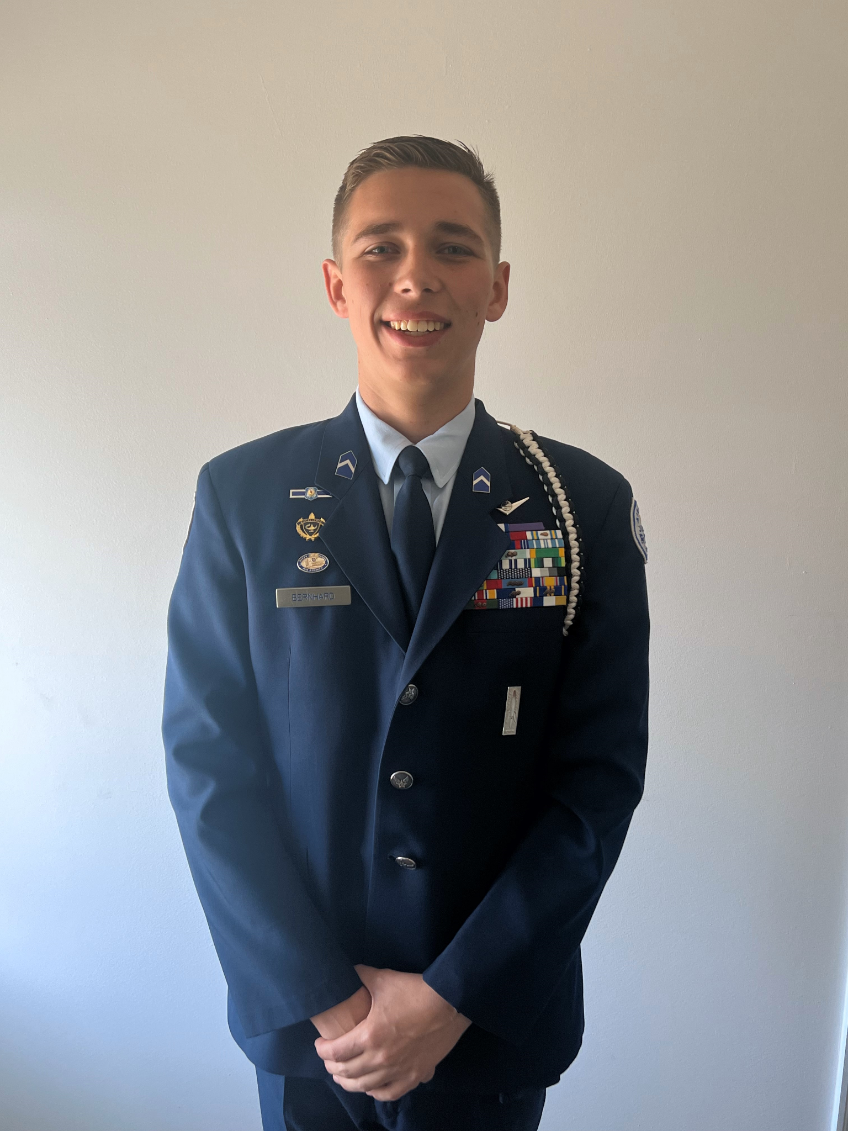
Group Commander
If you are interested in applying for the Group Commander position please email SMSgt Spencer at shonda.spencer@ocps.net to inform her. She will send you the information you need.

Slide 5
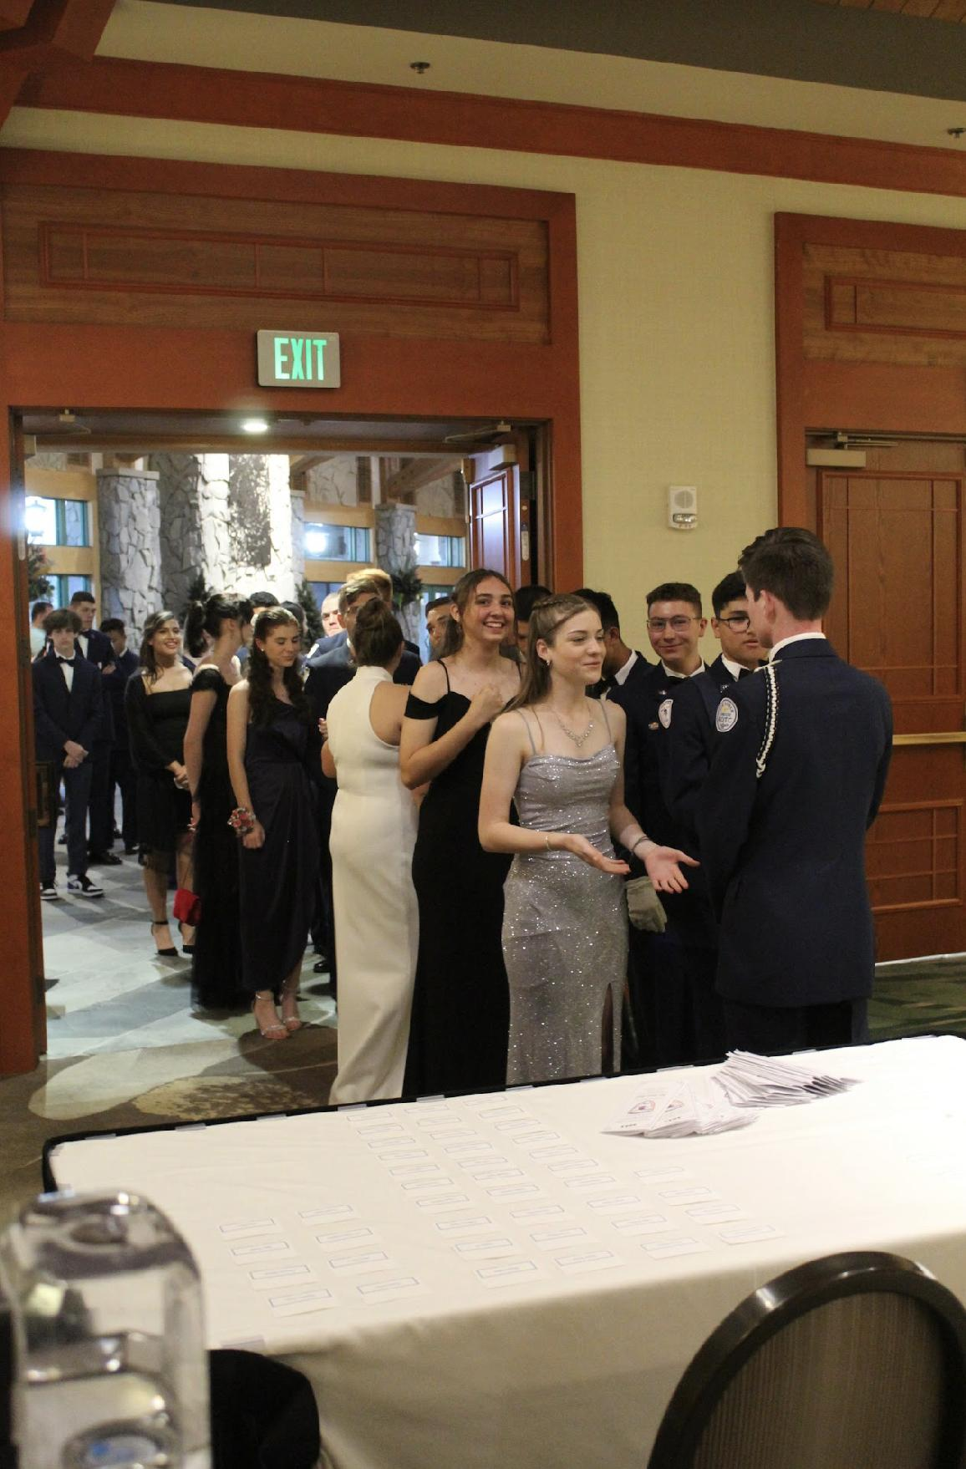
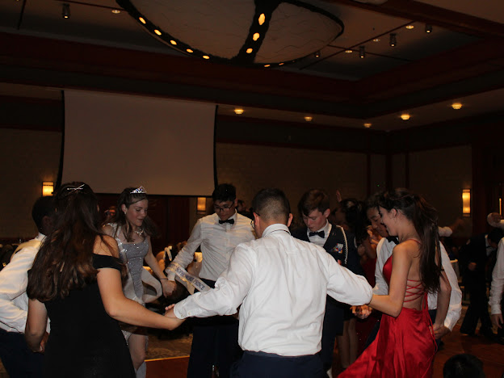
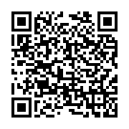
FL-802 Air Force Ball
Air Force Ball is our unit’s very own dance! It is a fun filled night with ceremonies, food, and lots of dancing! This years AFB is 10 February 2024 at Rosen Plaza from 1830 to 2230!
https://www.schoolpay.com/pay/for/Air-Force-Ball-Tickets-2324/SbGcCl
Ticket prices are as follows:
Cadets: $45
Guests: $50

Slide 6
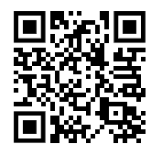
Theme Voting for AFB
Kitty Hawk Honor Society is giving the unit a chance to vote on their favorite theme for AFB this year! Please scan the QR code or copy the link to vote. Voting ends on 1 November and the winning theme will be announced 2 November!
https://tinyurl.com/AFBThemeVoting
If you have any questions or concerns, please contact C/ 2nd Lt Sara Mattox @ 4072423829 or at 4804154679@students.ocps.net

Slide 7
Logistics
If you have any items in Logistics please come pick them up by Friday. Logistics was closed on October 30th. There will be no more logistics appointments until after inspection.
If there is any questions please contact C/ Vanessa Maloney at 4804210309@students.ocps.net or 321-318-2929

Slide 8
KHHS Meeting
KHHS meeting this week 2 November 1700-1800 on Microsoft Teams!
Questions, comments, or concerns? Please contact C/ 2nd Lt. Sara Mattox at 407-242-3829 or 4804154679@students.ocps.net

Slide 9
Attention Inspection Marching Team!!!
Practice Monday, Tuesday, Wednesday, and Thursday
After school for 1 hour
Wear your PT Uniform
Meet in Colonel’s room (950)
Contact Agrafena Ritz at (386) 344-9452 or 1816002482@students.ocps.net if you can make it!

Slide 10
Athletic Clearance
These Cadets below are missing the Athletic Clearance:
Aguilar - Bravo Mezime - Delta Saint Franc-Golf
Bermudez - Alpha Osoria - Charlie
Ceballos - Charlie Palacios - Foxtrot
Damuth - Alpha Parboo - Alpha
DeSilva - Charlie Rosario - Delta
Doyle - Alpha Vazquez- Charlie
James- Golf Almodovar-Charlie
Madera - Bravo Saint Franc-Alpha
https://athleticclearance.fhsaahome.org/

Slide 11
Cadet Forms
The following cadets are missing their CONSENT FORM:
Rodriguez, Analis
Saint Franc, Rose
Torres, Anthony
Abrache, Hannah
Abrache, Simon
Aguilar, Andres
Barber, Chloe
Damuth, Dalton
Doyle, Ryan
Go, Connor
Nicholas, Alejandro
Osoria, Massyel
If you fill one out, please hand it to SENIOR OR COLONEL!!

Slide 12
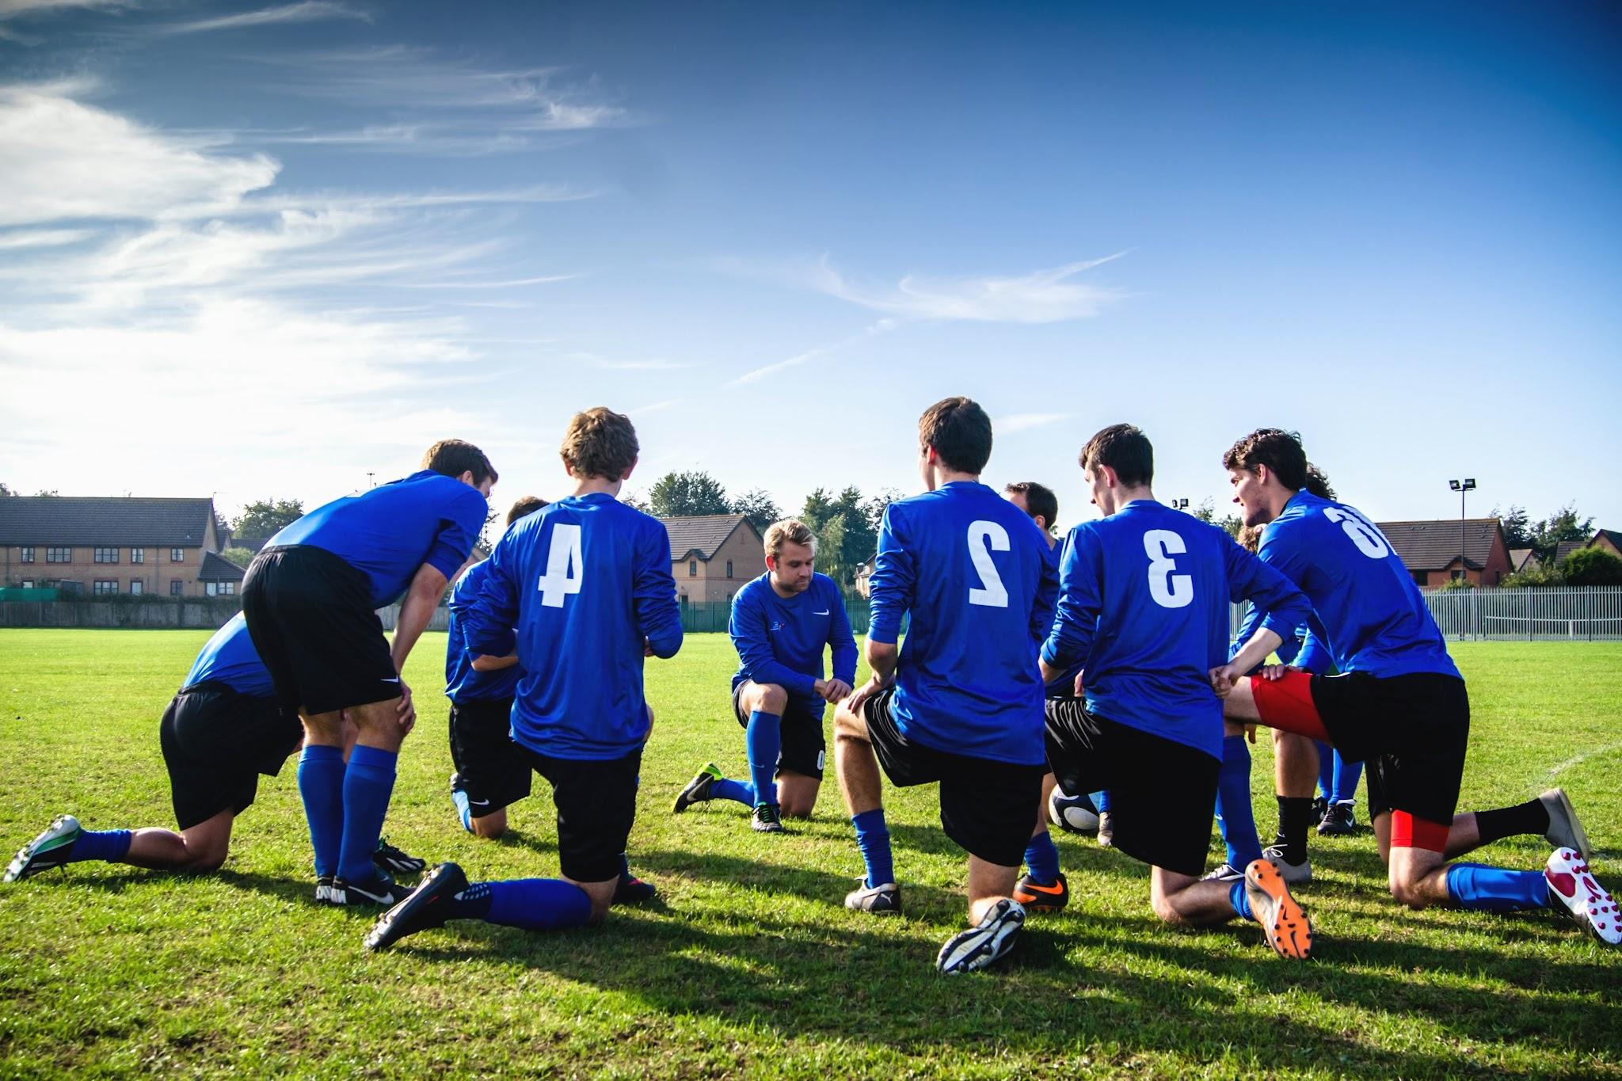
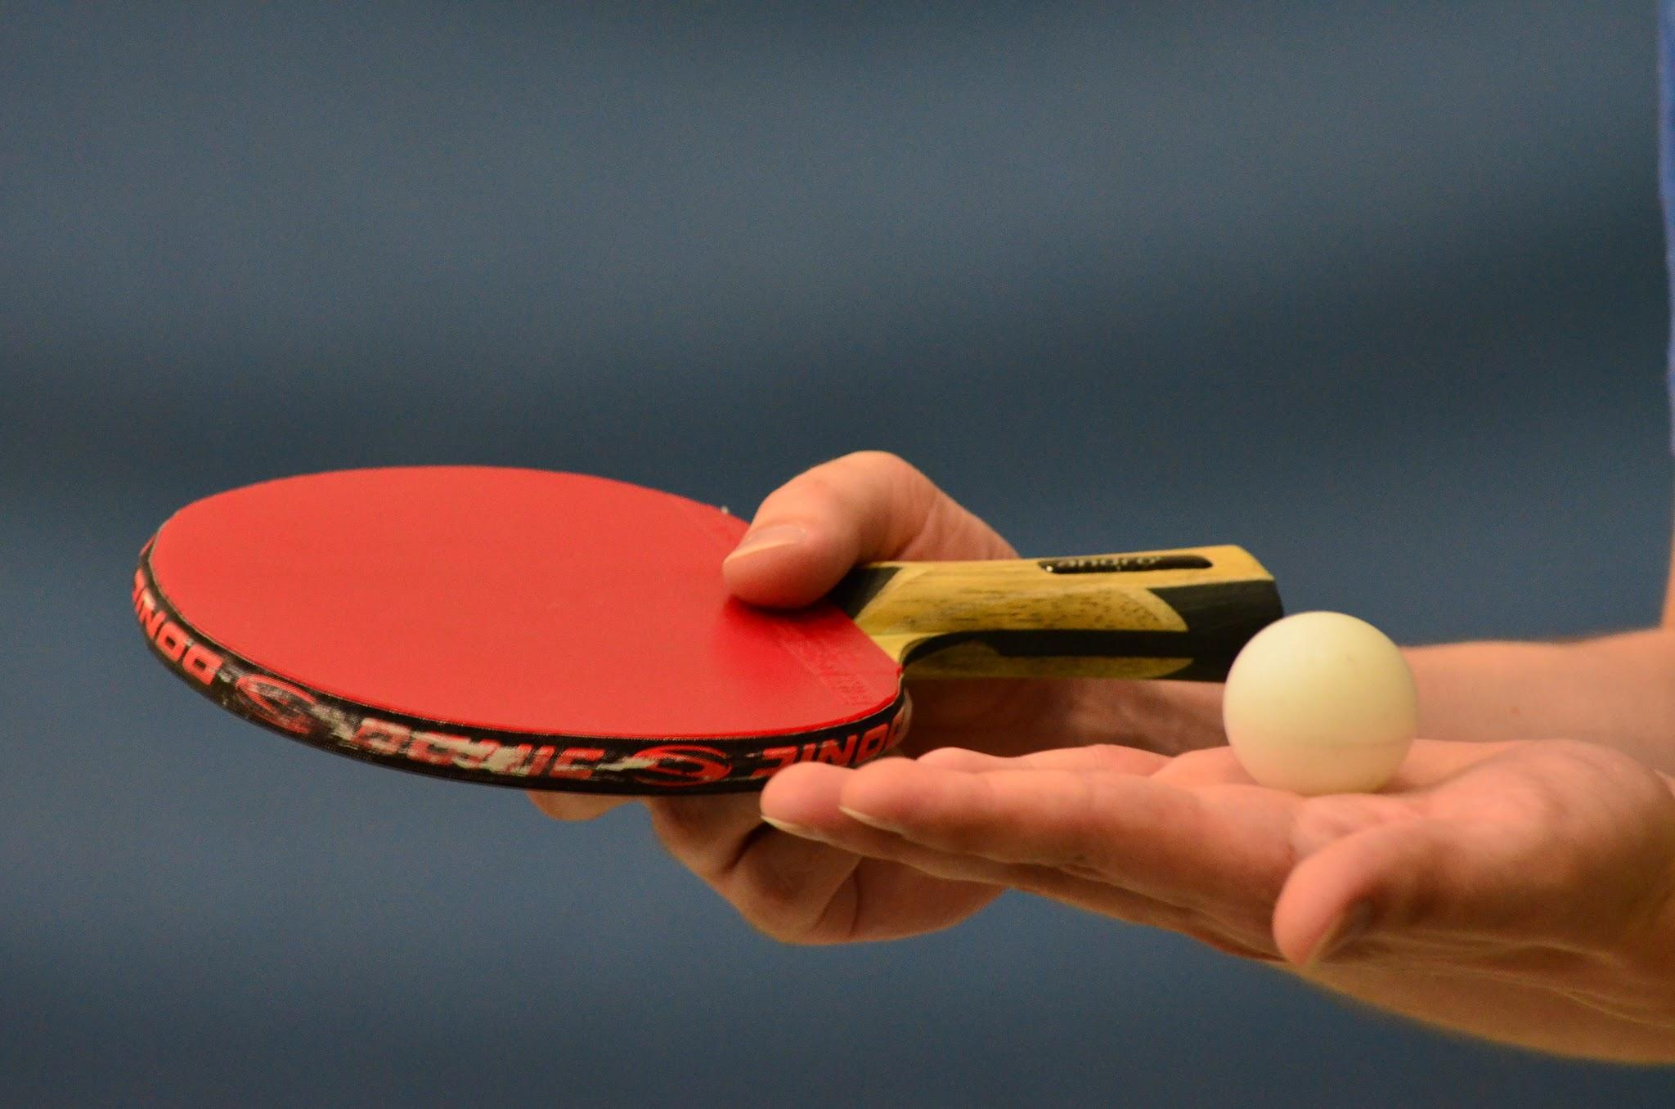
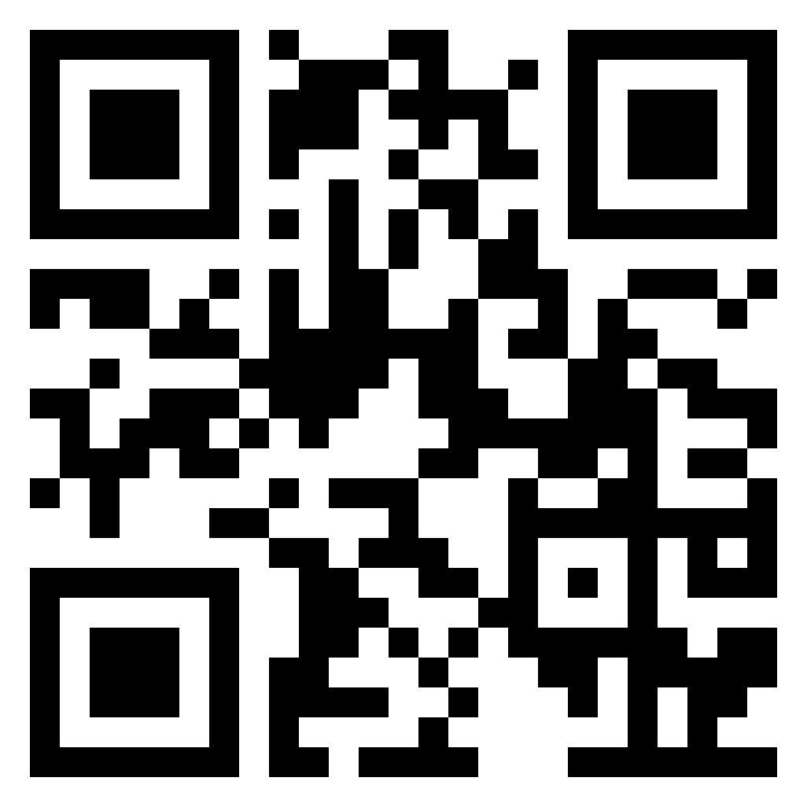
School Involvement
We recognize many of you are involved in other school activities. As we prepare for inspection, as well as set up for future collaboration, we would love to hear which activities you are involved in!
Please let us know with this form: https://tinyurl.com/FL-802SchoolActivityPoll

Slide 13
Military Knowledge
What is Florida’s capital?
Tallahassee

Slide 14
Summary
Upcoming Events
KHHS Meeting (11/2)
Football Parking (11/3)
Notes
Inspection Marching Team
Athletic Clearances
Consent Forms
Air Force Ball
Theme Voting For AFB
Logistics
Group Commander Interest

Slide 15
Briefing Slides
If you have a slide for the briefing, contact C/ Cruz-Garcia at 4804173126@students.ocps.net
If you want something in the briefing, you must contact C/ Cruz-Garcia by Monday 1700 for the Tuesday brief and Wednesday 1700 for the Thursday brief

