Slide 1
West Orange FL-802
Semi-Weekly Brief
C/ Staff Sergeant Eliud Cruz-Garcia
31 August 2023
Lead,
Serve,
Dream
Unit Motto:

Slide 2
AFJROTC Mission
Develop citizens of character dedicated to serving their nation and community
Mission:
Goals:
Instill Values Of Citizenship,
Service To The United States,
Personal Responsibility/Sense Of Accomplishment

Slide 3
Chain of Command
Commander in Chief:
Sec Def:
Sec AF:
CSAF:
AETC CC:
AU CC:
Holm Center CC:
Director, AFJROTC:
SASI:
Group CC:
Deputy Group CC:
President Joseph R. Biden Jr.
Honorable Lloyd Austin
Honorable Frank Kendall
Gen Charles Q. Brown Jr.
Lt. Gen Brian S. Robinson
Lt. Gen Andrea D. Tullos
Brig Gen Houston R. Cantwell
Col Johnny R. McGonigal
Lt. Colonel Michael Carrizales
C/ Major Aidan Bernhard
C/ 1st Lieutenant Antonio Torre

Slide 4
Orange Rope
Flight Commanders, please remember to award Orange Rope to the upperclassman and first-year with the highest average uniform wear over the last two weeks on Wednesday. First-years with no combo 1 are not eligible.
Take pictures and send to C/Lopez at (321)440-7611

Slide 5
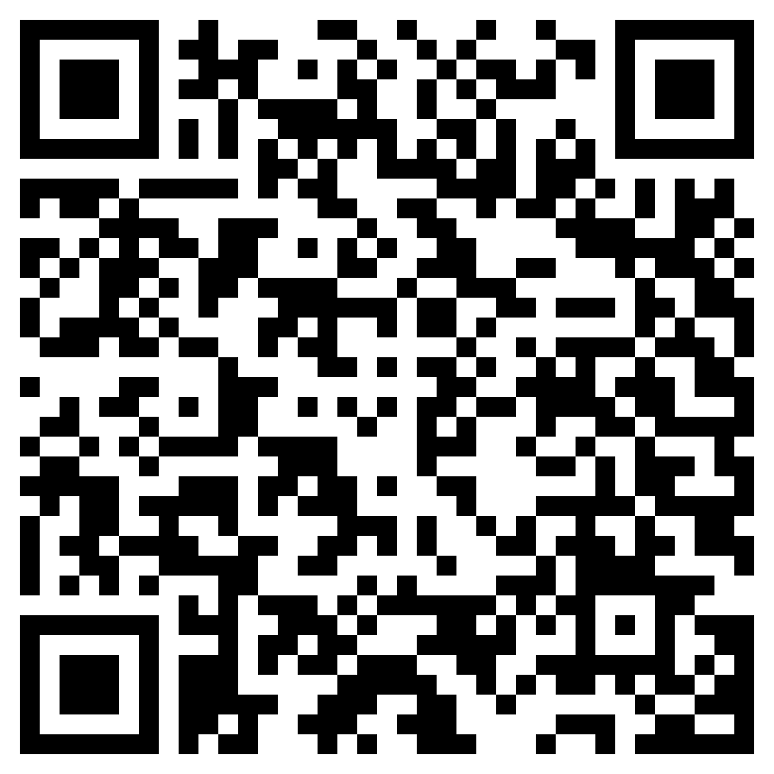
Join Recruiting!
If you are interested in helping our unit recruit new cadets, join the recruiting team.
If you would like to go out to schools and help boost our unit numbers and have the opportunity to earn the recruiting ribbon, scan the QR code provided.
Any questions, please contact C/ TSgt Princess Tolbert at 4804191858@students.ocps.net or (407) 259-717.

Slide 6
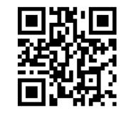
Logistics Appointment Schedule
New 2023-2024 Logistics appointment link
Logistics Appointment Form:
Monday: 1420-1500
Tuesday: 1420-1500
Thursday: 1420-1500
https://tinyurl.com/FL-802LSS
Questions, comments, concerns, contact C/SMSgt Anthony Torres at (775) 544-0842 or 4806810625@studnets.ocps.net

Slide 7
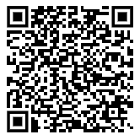
Join Honor Guard!!
Sharpen your marching and drill movements
Make friends in a team environment
Go to competitions
Earn awards
Honor Guard counts as a varsity sport!
Honor Guard conditioning starts 28 August through 1 September after school.
NOTE: You need an athletic clearance to participate!
If you have any questions, please contact C/ CMSgt Ritz at 386-344-9452.

Slide 8
StellarXplorers
StellarXplorers is a competition based LDR (club) that focuses on real world aerospace problems. This LDR is a great opportunity for anyone wanting to work in the STEM field, lessons and tutoring will be held for anyone willing to participate but is not currently proficient in these topics. If you are interested in more information or would like to participate in StellarXplorers please join Remind: @23-24STLX
Questions, comments, concerns, contact C/SMSgt Anthony Torres at (775) 544-0842 or 4806810625@studnets.ocps.net

Slide 9
Chief’s Quote of the Week
"The pessimist complains about the wind. The optimist expects it to change. The leader adjusts the sails."
– John C. Maxwell

Slide 10
Military Knowledge
Who was the first Secretary of the Air Force?
Honorable Stuart Symington

Slide 11
Summary
Upcoming Events
Notes
Logistics Appointment Schedule
Recruiting
Honor Guard

Slide 12
Briefing Slides
If you have a slide for the briefing, contact C/ Cruz-Garcia at 4804173126@students.ocps.net
If you want something in the briefing, you must contact C/Cruz-Garcia by Monday 1700 for the Tuesday brief and Wednesday 1700 for the Thursday brief

