Slide 1
West Orange FL-802
Semi-Weekly Brief
C/ Staff Sergeant Eliud Cruz-Garcia
28 September 2023
Lead,
Serve,
Dream
Unit Motto:

Slide 2
AFJROTC Mission
Develop citizens of character dedicated to serving their nation and community
Mission:
Goals:
Instill Values Of Citizenship,
Service To The United States,
Personal Responsibility/Sense Of Accomplishment

Slide 3
Chain of Command
Commander in Chief:
Sec Def:
Sec AF:
CSAF:
AETC CC:
AU CC:
Holm Center CC:
Director, AFJROTC:
SASI:
Group CC:
Deputy Group CC:
President Joseph R. Biden Jr.
Honorable Lloyd Austin
Honorable Frank Kendall
Gen Charles Q. Brown Jr.
Lt. Gen Brian S. Robinson
Lt. Gen Andrea D. Tullos
Brig Gen Houston R. Cantwell
Col Johnny R. McGonigal
Lt. Colonel Micheal Carrizales
C/ Major Aidan Bernhard
C/ 1st Lieutenant Antonio Torre

Slide 4
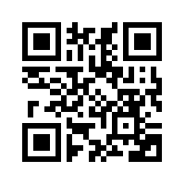
JLAB Interest Form
Junior Leadership & Academic bowl is like Jeopardy but with teams! Earn 2 ribbons!
Example Question: A government that is limited in practice by a written or unwritten constitution which they must obey is known as a(n) ____________.
JLAB MEETING TODAY AFTER SCHOOL!!! AT 14:30
Constitutional government
https://tinyurl.com/JLABFL802
For any questions, comments or concerns contact C/Staff Sergeant Ian Kristona@4804098968@students.ocps.net

Slide 5
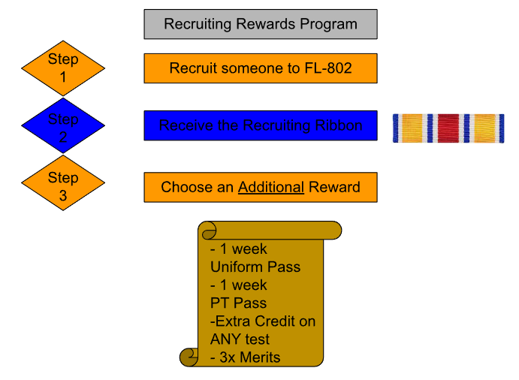
Recruiting
Possible Reasons:
No 1st yr uniforms
LDRs (Drill/Raiders)
Scholarships
Air Force Ball
Community Service hrs
Unit Picnic
Field Day
Sports Days

Slide 6
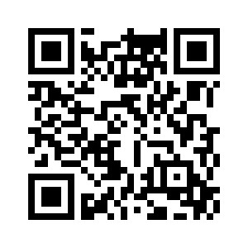
Homecoming court
Vote for your homecoming court here:
https://forms.gle/BWMZsp1HRVtjXuzv8

Slide 7
Chief’s Quote of the Week
"You gain strength, courage and confidence by every experience in which you really stop to look fear in the face. You must do the thing you think you cannot do."
– Eleanor Roosevelt

Slide 8
Military Knowledge
When is Memorial Day?
Last Monday in May

Slide 9
Homecoming court
Vote for your homecoming court here:
https://forms.gle/BWMZsp1HRVtjXuzv8

Slide 10
Summary
Upcoming Events
JLAB Interest Meeting (9/28)
Notes
Recruiting

Slide 11
Briefing Slides
If you have a slide for the briefing, contact C/ Cruz-Garcia at 4804173126@students.ocps.net
If you want something in the briefing, you must contact C/ Cruz-Garcia by Monday 1700 for the Tuesday brief and Wednesday 1700 for the Thursday brief

