Slide 1
West Orange FL-802
Semi-Weekly Brief
C/ Staff Sergeant Eliud Cruz-Garcia
26 September 2023
Lead,
Serve,
Dream
Unit Motto:

Slide 2
AFJROTC Mission
Develop citizens of character dedicated to serving their nation and community
Mission:
Goals:
Instill Values Of Citizenship,
Service To The United States,
Personal Responsibility/Sense Of Accomplishment

Slide 3
Chain of Command
Commander in Chief:
Sec Def:
Sec AF:
CSAF:
AETC CC:
AU CC:
Holm Center CC:
Director, AFJROTC:
SASI:
Group CC:
Deputy Group CC:
President Joseph R. Biden Jr.
Honorable Lloyd Austin
Honorable Frank Kendall
Gen Charles Q. Brown Jr.
Lt. Gen Brian S. Robinson
Lt. Gen Andrea D. Tullos
Brig Gen Houston R. Cantwell
Col Johnny R. McGonigal
Lt. Colonel Micheal Carrizales
C/ Major Aidan Bernhard
C/ 1st Lieutenant Antonio Torre

Slide 4
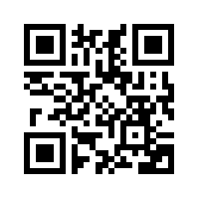
JLAB Interest Form
Junior Leadership & Academic bowl is like Jeopardy but with teams! Earn 2 ribbons!
Example Question: During this Union General’s “march to the sea” he captured Savannah Georgia and caused over $100 Million in damage by famously burning the countryside. Name this Union General loathed by the Confederacy.
JLAB MEETING TODAY AFTER SCHOOL!!! AT 14:30
General Sherman (William Tecumseh)
https://tinyurl.com/JLABFL802
For any questions, comments or concerns contact C/Staff Sergeant Ian Kristona@4804098968@students.ocps.net

Slide 5
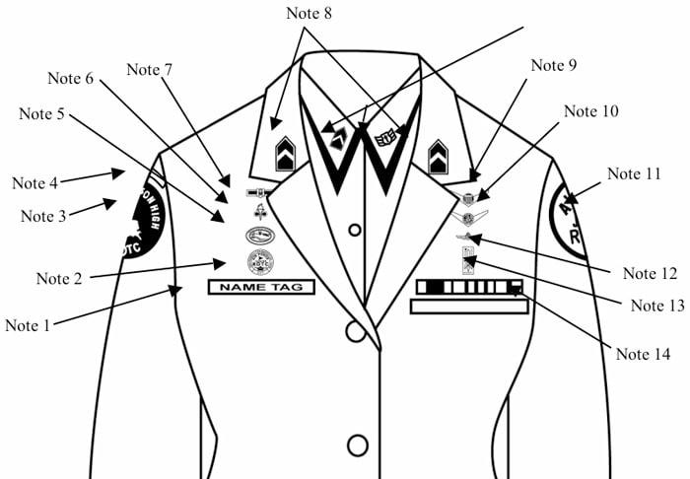
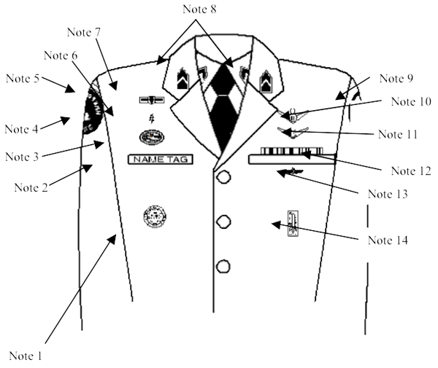
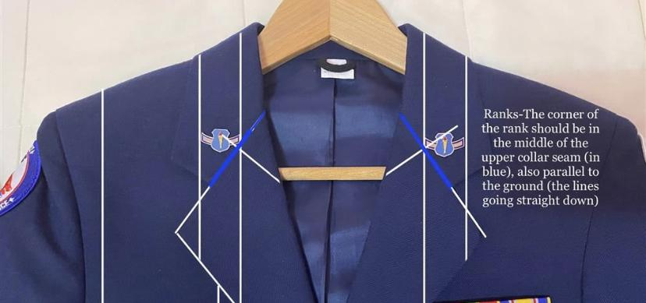
Weekly Uniform Reminder
Grade insignia (officer or enlisted) worn on both lapels. Place insignia halfway up the seam, resting on but not over it. Bottom of insignia is horizontal with the ground.

Slide 6
Military Knowledge
What is Florida’s state bird?
The Mockingbird

Slide 7
Summary
Upcoming Events
TBD
Notes
JLAB
Weekly Uniform Reminder

Slide 8
Briefing Slides
If you have a slide for the briefing, contact C/ Cruz-Garcia at 4804173126@students.ocps.net
If you want something in the briefing, you must contact C/ Cruz-Garcia by Monday 1700 for the Tuesday brief and Wednesday 1700 for the Thursday brief

