Slide 1
West Orange FL-802
Semi-Weekly Brief
C/ Staff Sergeant Eliud Cruz-Garcia
26 October 2023
Lead,
Serve,
Dream
Unit Motto:

Slide 2
AFJROTC Mission
Develop citizens of character dedicated to serving their nation and community
Mission:
Goals:
Instill Values Of Citizenship,
Service To The United States,
Personal Responsibility/Sense Of Accomplishment

Slide 3
Chain of Command
Commander in Chief:
Sec Def:
Sec AF:
CSAF (Acting):
AETC CC:
AU CC:
Holm Center CC:
Director, AFJROTC:
SASI:
Group CC:
Deputy Group CC:
President Joseph R. Biden Jr.
Honorable Lloyd Austin
Honorable Frank Kendall
Gen David Allvin
Lt. Gen Brian S. Robinson
Lt. Gen Andrea D. Tullos
Brig Gen Houston R. Cantwell
Col Johnny R. McGonigal
Lt. Colonel Micheal Carrizales
C/ Major Aidan Bernhard
C/ 1st Lieutenant Antonio Torre

Slide 4
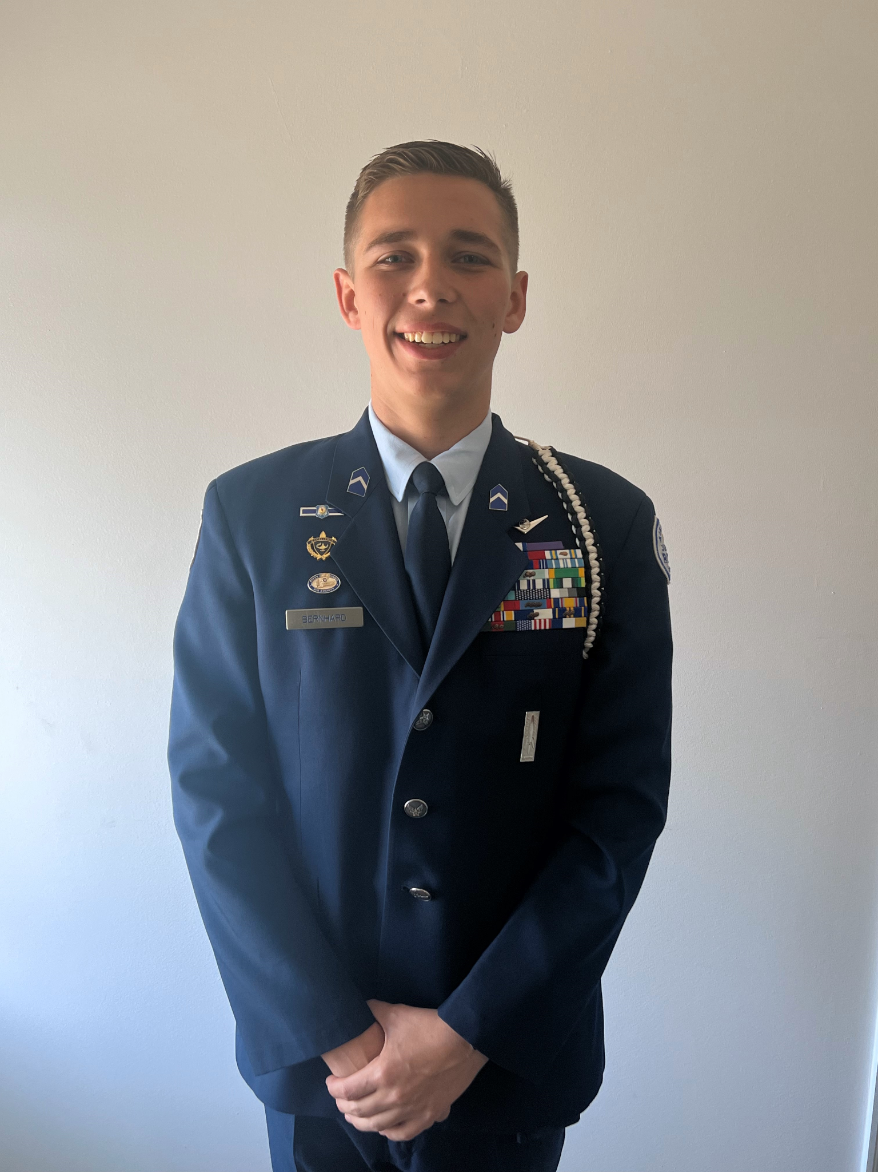
Group Commander
If you are interested in applying for the Group Commander position please email SMSgt Spencer at shonda.spencer@ocps.net to inform her. She will send you the information you need.

Slide 5
Report Cards
Report cards are OUT, and are required for your promotion as well as your eligibility for receiving different semester awards.
Please send a PDF file of your report card to shonda.spencer@ocps.net by Friday, 27 October so that your GPA may be calculated.
If you have any questions, please contact Cadet Aidan Bernhard at 4804148902@students.ocps.net (for business purposes only).

Slide 6
FL-802 Unit Picnic!!
The unit picnic is the first time during the school year the whole unit is invited out to meet one another and boost morale! Food, fun, and friends is what this event is all about!
Parents and family are more than welcome to come and hang out for the duration of the picnic. (more information on the next slide.)
Date: 28 October
Time: 1100-1400
Location: Veterans Memorial Park (420 S Park Ave, Winter Garden, FL)

Slide 7
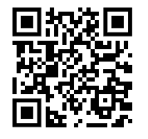
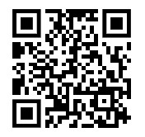
FL-802 Unit Picnic!!
If you are interested in going please fill out the google form below as well as fill out the perfect potluck link!
https://tinyurl.com/802UnitPicnicInterest
https://tinyurl.com/PerfectPotluck802
If you have any questions or concerns, please contact C/ 2nd Lt Sara Mattox @ 4072423829

Slide 8
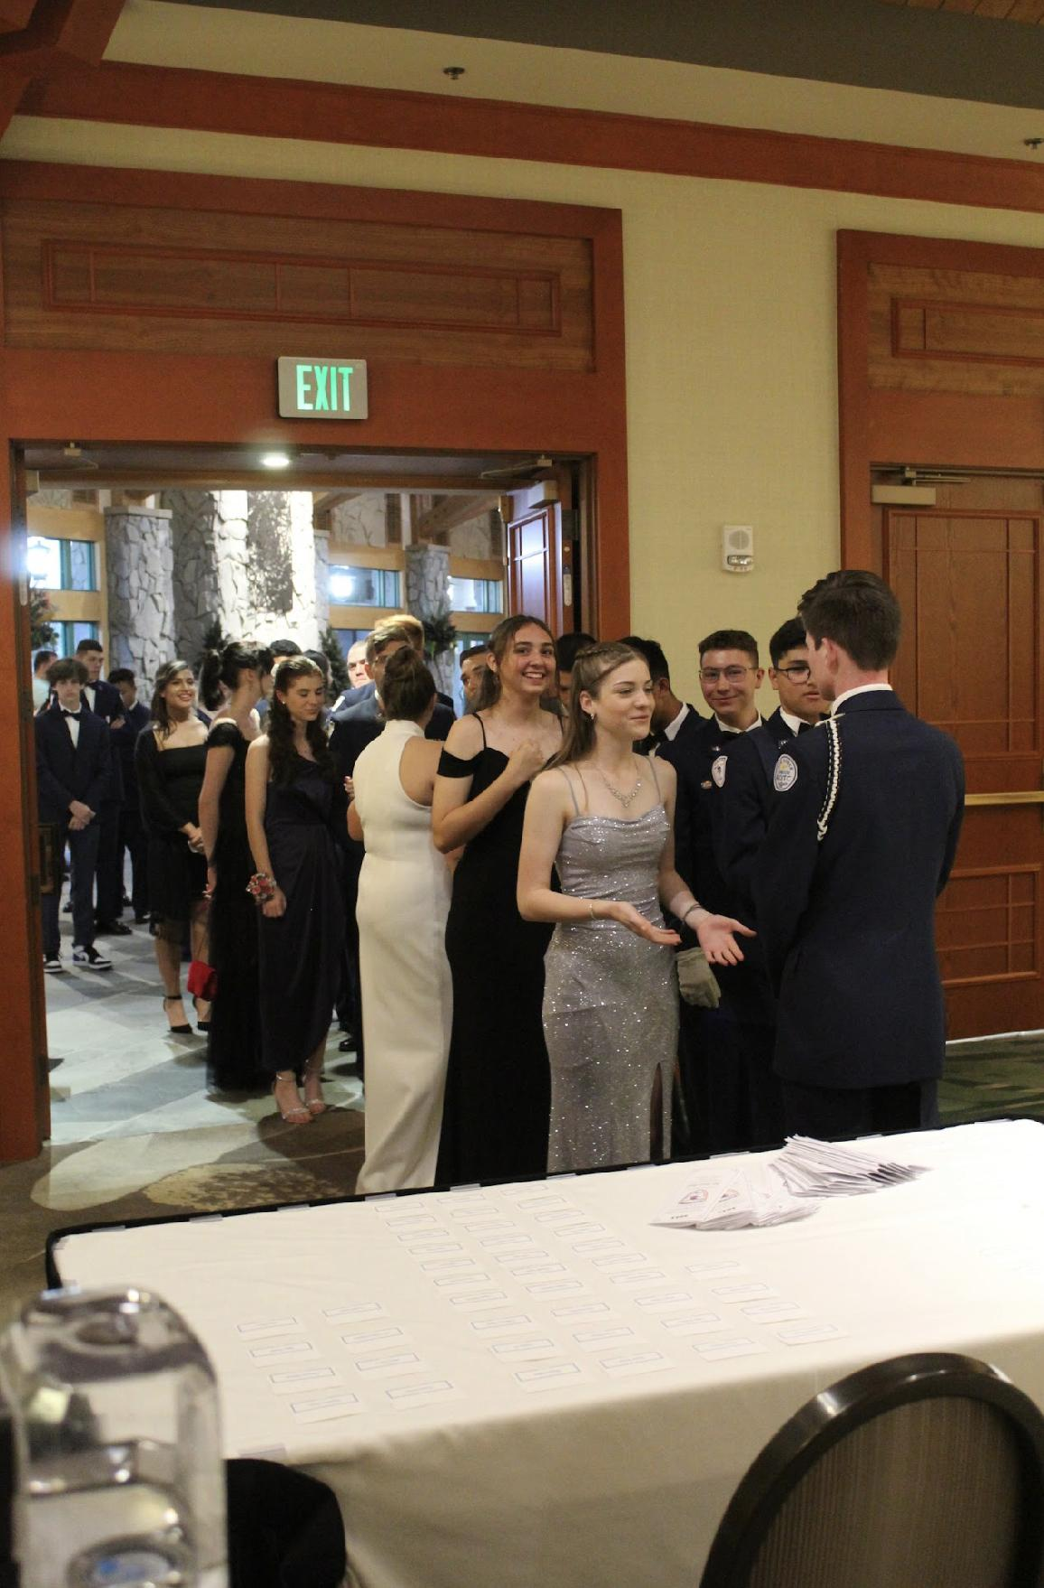
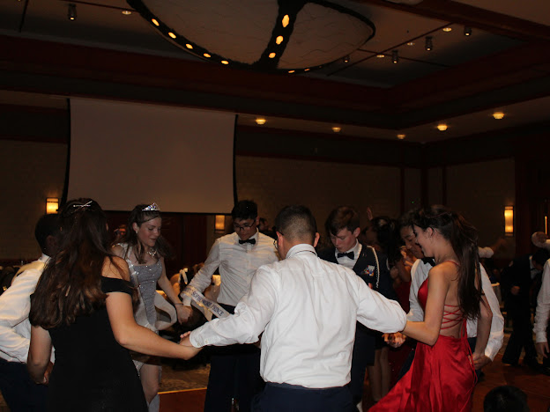
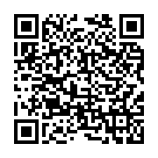
FL-802 Air Force Ball
Air Force Ball is our unit’s very own dance! It is a fun filled night with ceremonies, food, and lots of dancing! This years AFB is 10 February 2024 at Rosen Plaza from 1830 to 2230!
https://www.schoolpay.com/pay/for/Air-Force-Ball-Tickets-2324/SbGcCl
Ticket prices are as follows:
Cadets: $45
Guests: $50

Slide 9
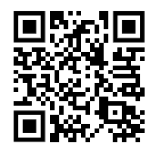
Theme Voting for AFB
Kitty Hawk Honor Society is giving the unit a chance to vote on their favorite theme for AFB this year! Please scan the QR code or copy the link to vote. Voting ends on 1 November and the winning theme will be announced 2 November!
https://tinyurl.com/AFBThemeVoting
If you have any questions or concerns, please contact C/ 2nd Lt Sara Mattox @ 4072423829 or at 4804154679@students.ocps.net

Slide 10
Attention Inspection Marching Team!!!
Practice Monday, Tuesday, Wednesday, and Thursday
After school for 1 hour
Wear your PT Uniform
Meet in Colonel’s room (950)
Contact Agrafena Ritz at (386) 344-9452 or 1816002482@students.ocps.net if you can make it!

Slide 11
Athletic Clearance
These Cadets below are missing the Athletic Clearance:
Aguilar - Bravo Mezime - Delta Saint Franc-Golf
Bermudez - Alpha Osoria - Charlie
Ceballos - Charlie Palacios - Foxtrot
Damuth - Alpha Parboo - Alpha
DeSilva - Charlie Rosario - Delta
Doyle - Alpha Vazquez- Charlie
James- Golf Almodovar-Charlie
Madera - Bravo Saint Franc-Alpha
https://athleticclearance.fhsaahome.org/

Slide 12
Cadet Forms
The following cadets are missing the forms listed:
Consent Form:
Abrache, Hannah
Abrache, Simon
Aguilar, Andres
Barber, Chloe
Cortes, Jenni
Damuth, Dalton
Doyle, Ryan
Go, Connor
Nicholas, Alejandro
Osoria, Massyel
Rodriguez, Analis
St. Franc, Rose
Torres, Anthony
Cadet Agreement:
Abney, Noah
Abrache, Hannah
Nicholas, Alejandro
Bruce, Wyatt
Butler, Josiah
Cortes, Jenni
Damuth, Dalton
Doyle, Ryan
Go, Connor
Hernandez, Angelina
Madera, Jalissa
Mezime, Taylor
Osoria, Massyel
Rodriguez, Thalia
Rosario, Carlos
St. Franc, Rose
Sherrow, Jeromy
Torres, Anthony

Slide 13
Chief’s Quote of the Week
“If people are doubting how far you can go, go so far that you can’t hear them anymore.”
– Michele Ruiz

Slide 14
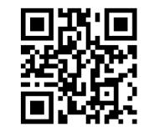
Logistics Closed
Questions, comments, concerns, contact C/SMSgt Anthony Torres at (775) 544-0842 or 4806810625@studnets.ocps.net
Logistics will be closed from 30 October - 14 November if you need anything make sure to get it BEFORE 30 October. https://tinyurl.com/FL-802LSS

Slide 15
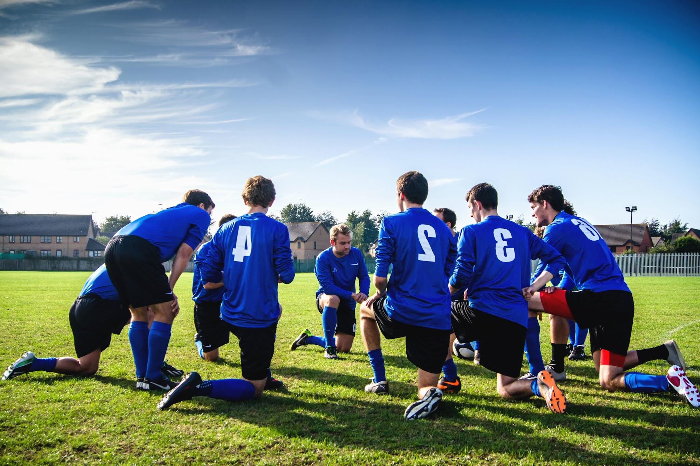
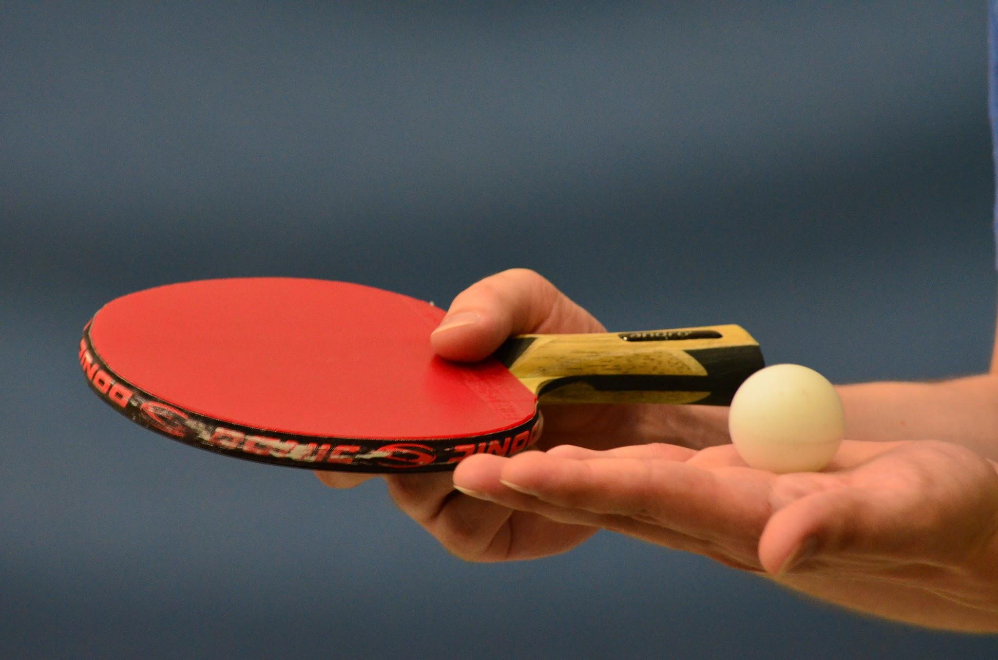
School Involvement
We recognize many of you are involved in other school activities. As we prepare for inspection, as well as set up for future collaboration, we would love to hear which activities you are involved in!
Please let us know with this form: https://tinyurl.com/FL-802SchoolActivityPoll

Slide 16
Military Knowledge
Who wrote the Constitution?
James Madison

Slide 17
Summary
Upcoming Events
Maxey Fall Festival (10/26)
Unit Picnic (10/28)
Notes
Inspection Marching Team
Athletic Clearances
Cadet Forms
Air Force Ball
Theme Voting For AFB
Logistics Update
Report Cards

Slide 18
Briefing Slides
If you have a slide for the briefing, contact C/ Cruz-Garcia at 4804173126@students.ocps.net
If you want something in the briefing, you must contact C/ Cruz-Garcia by Monday 1700 for the Tuesday brief and Wednesday 1700 for the Thursday brief

