Slide 1
West Orange FL-802
Semi-Weekly Brief
C/ Staff Sergeant Eliud Cruz-Garcia
22 August 2023
Lead,
Serve,
Dream
Unit Motto:

Slide 2
AFJROTC Mission
Develop citizens of character dedicated to serving their nation and community
Mission:
Goals:
Instill Values Of Citizenship,
Service To The United States,
Personal Responsibility/Sense Of Accomplishment

Slide 3
Chain of Command
Commander in Chief:
Sec Def:
Sec AF:
CSAF:
AETC CC:
AU CC:
Holm Center CC:
Director, AFJROTC:
SASI:
Group CC:
Deputy Group CC:
President Joseph R. Biden Jr.
Honorable Lloyd Austin
Honorable Frank Kendall
Gen Charles Q. Brown Jr.
Lt Gen Brian S. Robinson
Lt Gen Andrea D. Tullos
Brig Gen Houston R. Cantwell
Col Johnny R. McGonigal
Lt. Colonel Michael Carrizales
C/ Major Aidan Bernhard
C/ 1st Lieutenant Antonio Torre

Slide 4
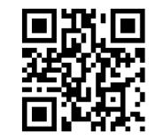
Logistics Appointment Schedule
New 2023-2024 Logistics appointment link
Logistics Appointment Form:
Monday: 1420-1500
Tuesday: 1420-1500
Thursday: 1420-1500
https://tinyurl.com/FL-802LSS
Questions, comments, concerns, contact C/SMSgt Anthony Torres at (775) 544-0842 or 4806810625@studnets.ocps.net

Slide 5
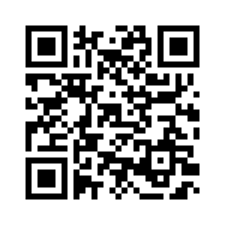
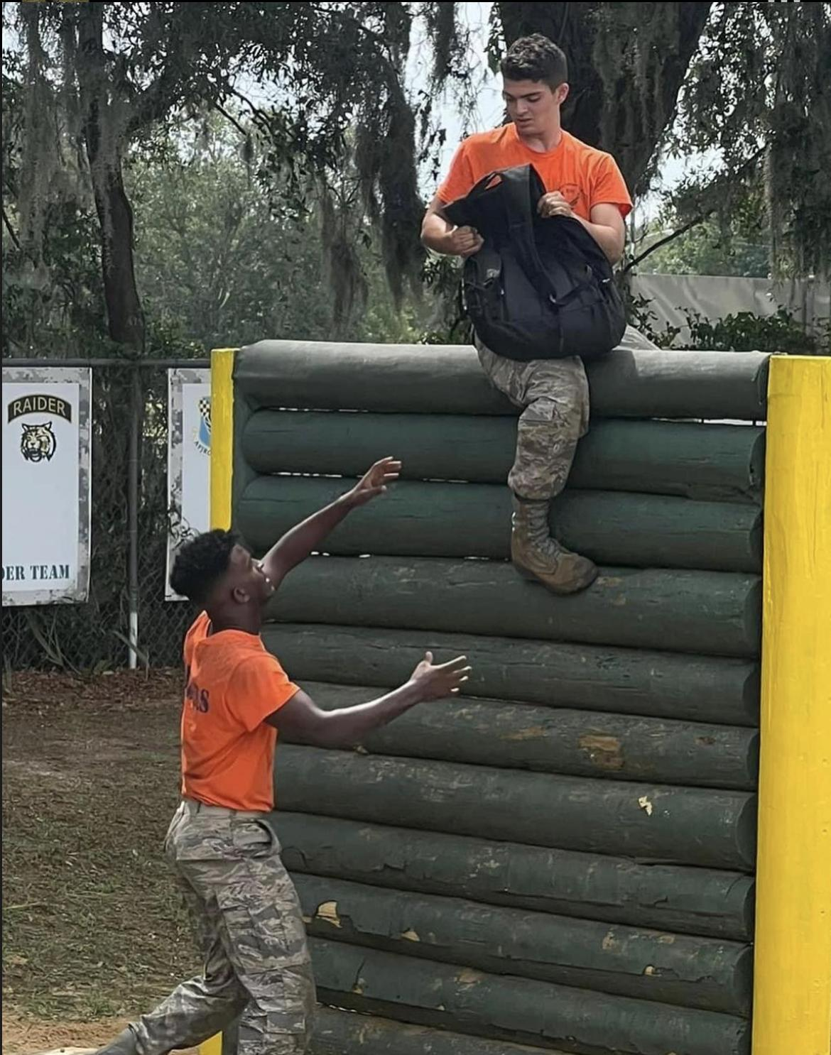
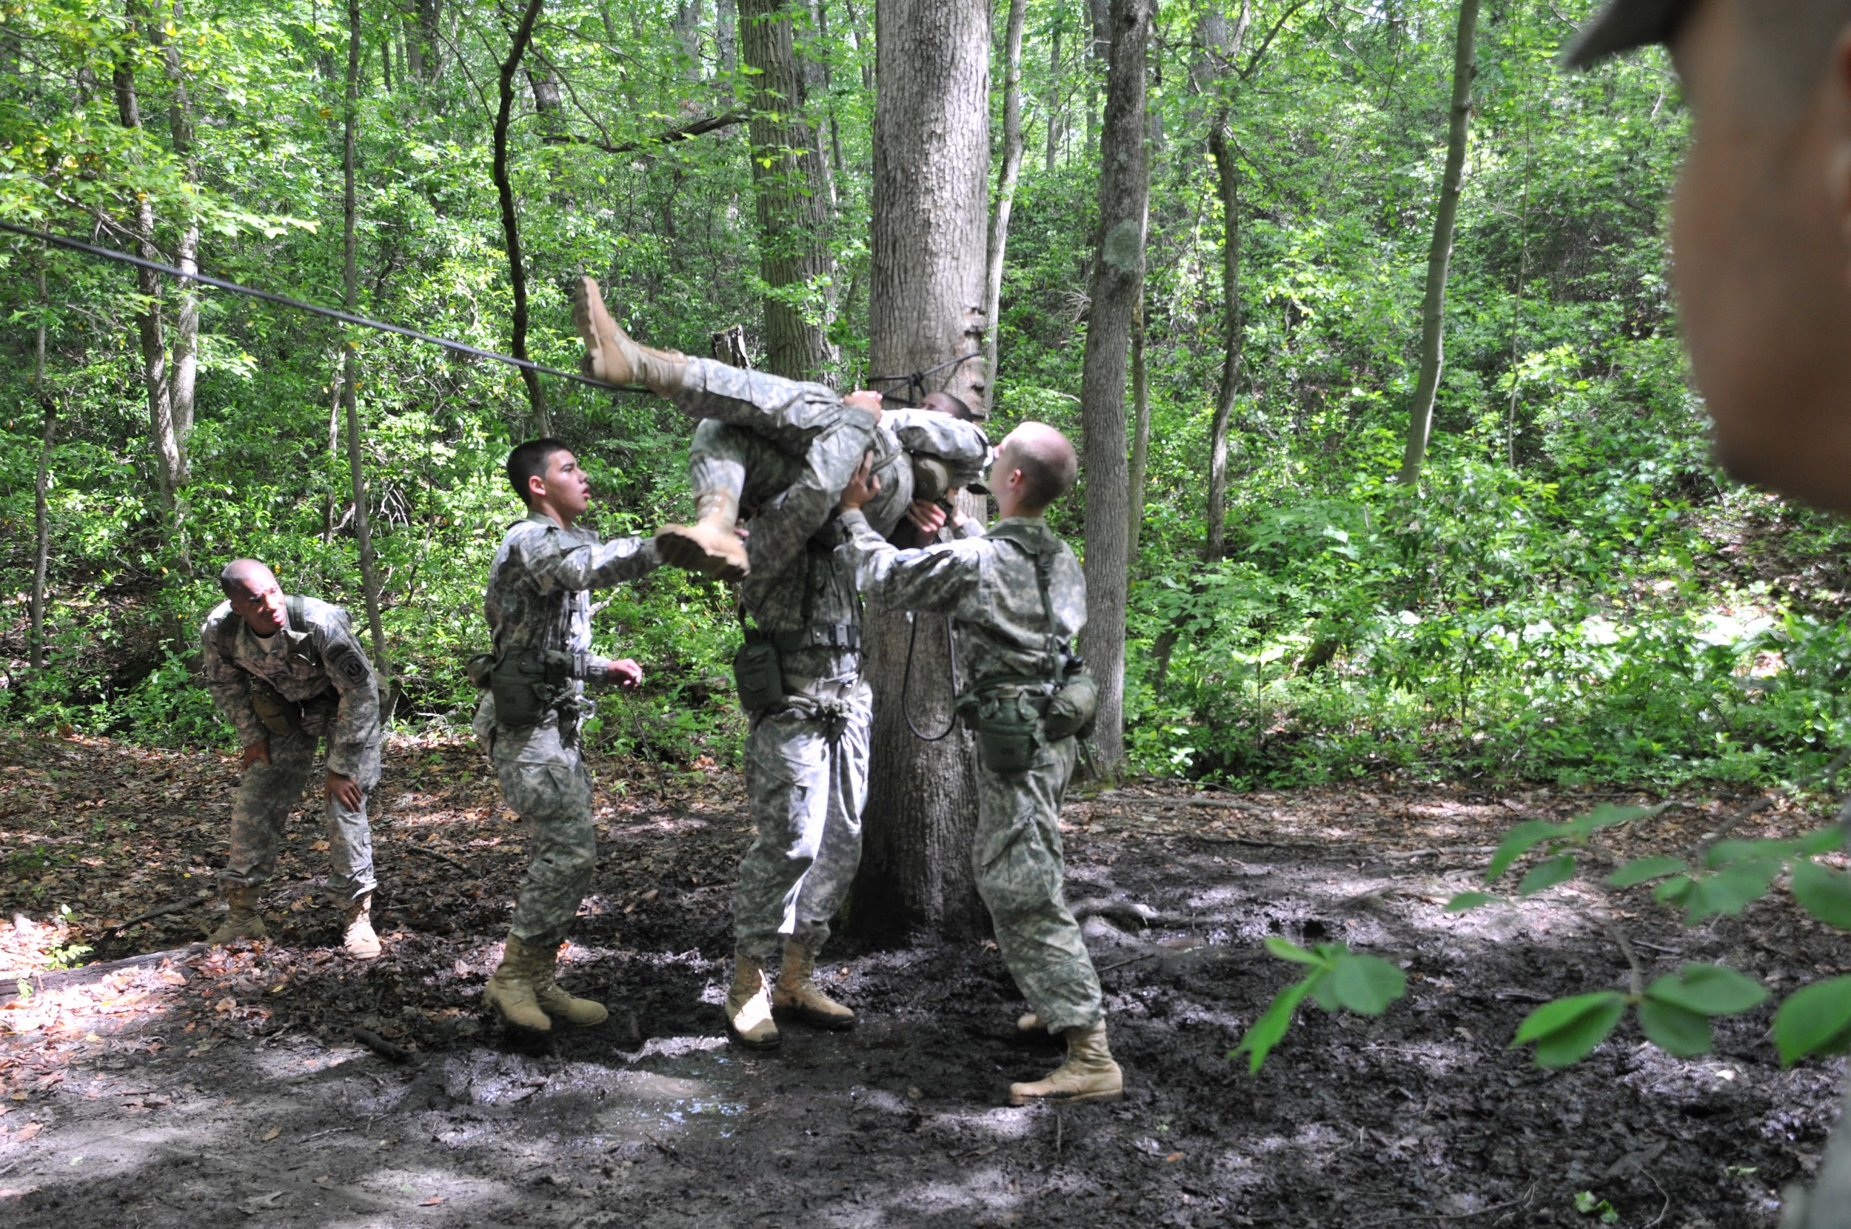
Raiders Interest Form and Interest Meeting
Raiders is a competitive athletic LDR. If you are interested in learning more about it or joining, the meeting is today, 22 August, @ room 950 from 1430 to 1500. All are welcome.
https://tinyurl.com/joinraiders
For more details, please contact C/1st Lt. Antonio Torre at 4804182497@students.ocps.net or (407) 773-0450 for any questions about Raiders.
Take a Picture & Sign up!!

Slide 6
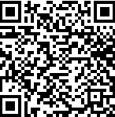
KHHS Interest Meeting
Kitty Hawk is an honors society within AFJROTC and is one of our many LDRs. If you have any interest in joining there will be a meeting 24 August from 1430 to 1515.
For any further details, please contact C/ 2nd Lt. Sara Mattox at (407) 242-3829 or 4804154679@students.ocps.net
https://tinyurl.com/KHHSInterestMeeting

Slide 7
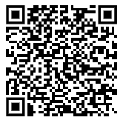
Join Honor Guard!!
Sharpen your marching and drill movements
Make friends in a team environment
Go to competitions
Earn awards
Honor Guard counts as a varsity sport!
Honor Guard conditioning starts August 28th through September 1st after school
NOTE: You need an athletic clearance to participate!
If you have any questions, please contact C/ CMSgt Ritz at 386-344-9452.

Slide 8
Football Parking
TAKE A PICTURE!
Who: Our Cadet Corps
What: Direct people and their vehicles
When: 1700, 25 August
Where: Room 950(Colonel’s Room)
Why:To help out our school
Sign up:On the paper!
If you have any questions,please contact C/ SrAmn Gabriel Motta at 407-202-9362 or 4804175879@students.ocps.net

Slide 9
Military Knowledge
What are the six military branches?
Air Force, Army, Coast Guard, Marine Corps, Navy, and Space Force

Slide 10
Summary
Upcoming Events
Raiders Interest Meeting (8/22)
Kitty Hawk Interest Meeting (8/24)
Football Parking (8/25)
Notes
Logistics Appointment Schedule
Honor Guard

Slide 11
Briefing Slides
If you have a slide for the briefing, contact C/ Cruz-Garcia at 4804173126@students.ocps.net
If you want something in the briefing, you must contact C/Cruz-Garcia by Monday 1700 for the Tuesday brief and Wednesday 1700 for the Thursday brief

