Slide 1
West Orange FL-802
Semi-Weekly Brief
C/ Technical Sergeant Daphne Bray
20 February 2024
Lead,
Serve,
Dream
Unit Motto:

Slide 2
AFJROTC Mission
Develop citizens of character dedicated to serving their nation and community
Mission:
Goals:
Instill Values Of Citizenship,
Service To The United States,
Personal Responsibility/Sense Of Accomplishment

Slide 3
Chain of Command
Commander in Chief:
Sec Def:
Sec AF:
CSAF:
AETC CC:
AU CC:
Holm Center CC:
Director, AFJROTC:
SASI:
Group CC:
Deputy Group CC:
President Joseph R. Biden Jr.
Honorable Lloyd Austin
Honorable Frank Kendall
Gen David Allvin
Lt. Gen Brian S. Robinson
Lt. Gen Andrea D. Tullos
Brig Gen Houston R. Cantwell
Col Johnny R. McGonigal
Lt. Colonel Micheal Carrizales
C/ Captain Agrafena Ritz
C/ Major Elias Lopez

Slide 4
Athletic Clearance
https://athleticclearance.fhsaahome.org/
Alpha | Bravo | Charlie | Delta | Foxtrot | Golf
Bermudez | Madera | Benzakour | Busteros | Palacios | Funk
Damuth |  | DelSilva | Goldstein
Doyle |  | Vasquez | Mezime
Saint-Franc |  |  | Rosario

Slide 5
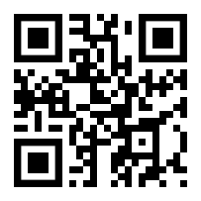
PT Makeups
Sign up here for the PT makeups or on Canvas
https://tinyurl.com/PT2324
For any questions,please contact C/A1C Ayana Putigna @4804185464@students.ocps.net
Meet at the 900 building in PT gear by 1430. Thursdays only.

Slide 6
Recruiting
Upcoming Events:
Hamlin Middle School visit (2/27/24)
To join recruiting Remind: Text @fl802re to 81010
Contact C/Amn David Peebles at 4804407123@students.ocps.net

Slide 7
Foxtrot Flight Merit Celebration
Foxtrot Flight,
Congratulations again on receiving the most merits for last semester! The day of your celebration will be Thursday, 29 February during class! If you would like to have cake and celebrate with your flight, make sure you’re there that day! It is also on the unit calendar if you forget the date. Keep up the good work!

Slide 8
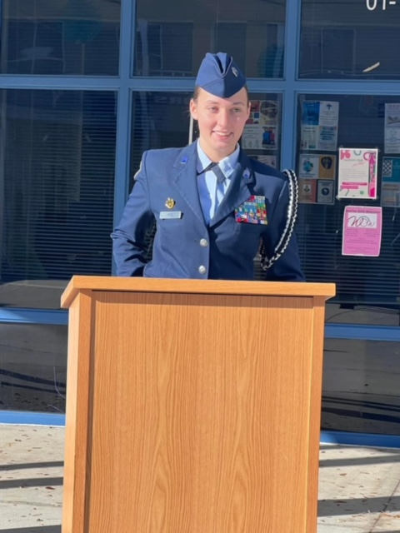
Group Commander
If you are interested in applying for the group commander position please email SMSgt Spencer NLT 28 Feb 2024
You must be:
sophomore or junior
at least 2.5 gpa
no disciplinary issues
no missing uniform grades

Slide 9
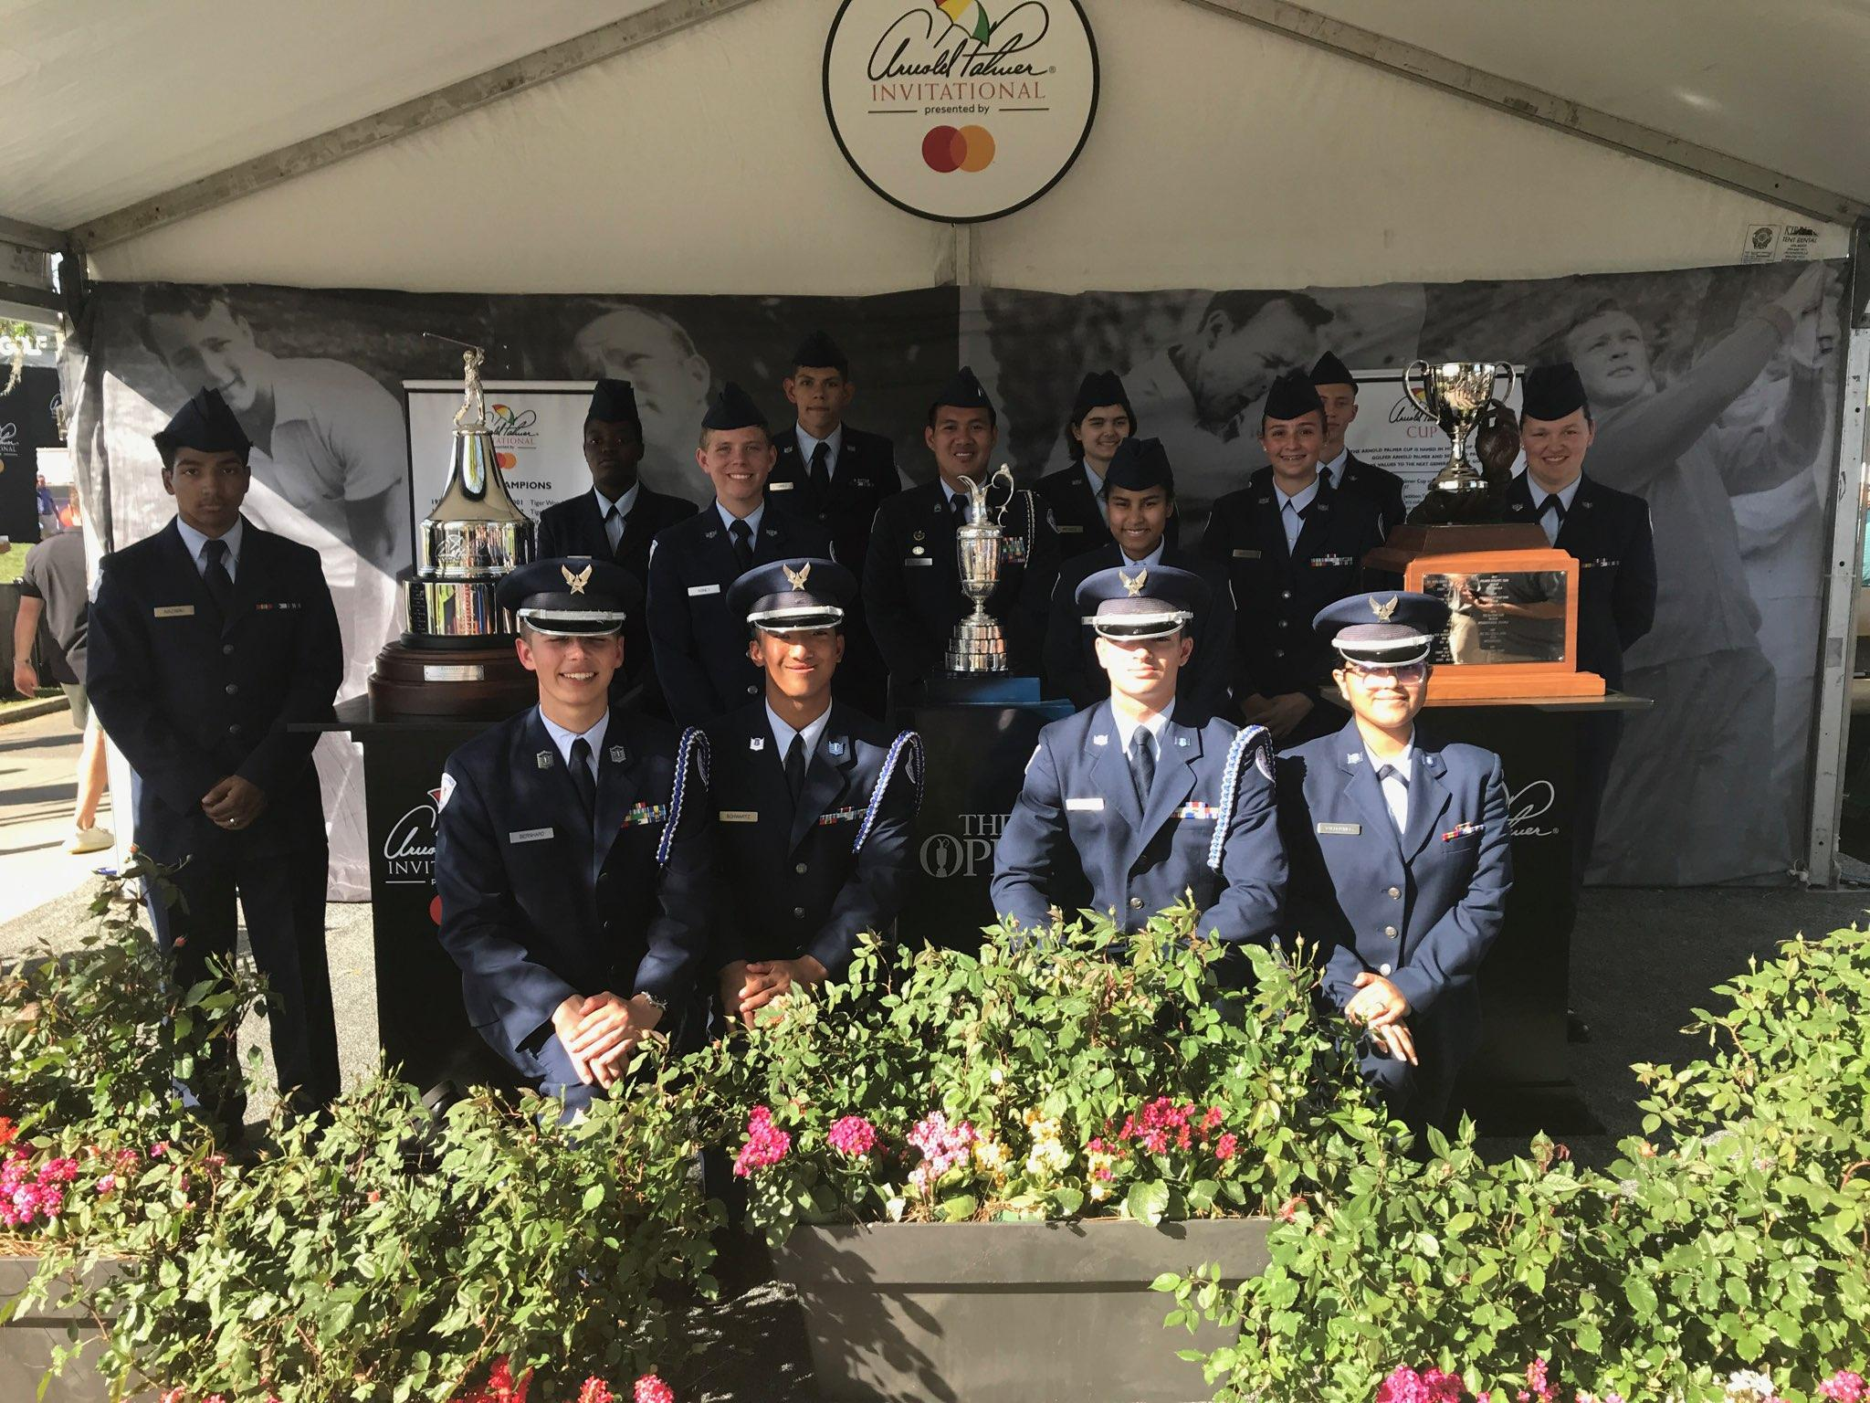
Arnold Palmer Invitational
Guard trophies for the Arnold Palmer Invitational golf tournament
Friday 3/8 and/or Sunday 3/10
Meet at Hyatt Grand Cypress 1 Grand Cypress Blvd, Orlando, FL 32836
Wear your Combo 2
Sign up sheet is on the board
If you’re interested in being Deputy CIC contact Cadet Mattox or Cadet Torre
Questions? Contact Sara Mattox at 407-242-3829/4804154679@students.ocps.net for March 8th or Antonio Torre at 407-773-0450/4804182497@students.ocps.net for March 10th

Slide 10
Model Rocketry
Interested in building model rockets? This is for you!
Model Rocketry is a STEM-based LDR in which you build launchable rockets. You will earn the Model Rocketry badge if you successfully launch 3 rockets.
Please contact C/ TSgt Princess Tolbert at 407-259-7171 or 4804191858@students.ocps.net if you are interested or have any questions.

Slide 11
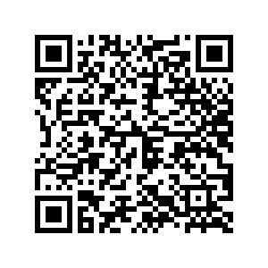
Air Force Ball 2024 Pictures
Here is the link for the pictures from the Air Force Ball this past Saturday, taken by Kristin Stewart. Feel free to download them and post them on your Instagram! Please make sure to tag @wohs_fl802!

Slide 12
Logistics
If you borrowed a bowtie from logistics for the Air Force Ball please return and sign it back in as soon as possible.
If there is any questions or concerns please contact C/TSgt Vanessa Maloney at 4804210309@students.ocps.net or 321-318-2929

Slide 13
Orange Rope/PT Rope
Flight Commanders,
Please remember to award Orange Rope and PT Rope every other Wednesday. Look at the unit calendar on the website to keep track of when they should be awarded.
Do not forget to send me your flight’s pictures! If you do not send them, there will be consequences. And remember: one first year, one upperclassmen for orange rope, and one PT rope per flight.
The next time you will award orange/PT rope is tomorrow!
Contact C/2nd Lt. Karynn Stewart at 4804169963@students.ocps.net or 407-797-7223 if you have any questions (business purposes only).

Slide 14
Air Commando Association Award
This award is presented annually to one cadet who most closely exemplifies the 13 critical attributes of success for Air Commandos. An essay submission is required if you’re interested in receiving the award. Please see the announcement on Canvas for more details.
*email your essay to micheal.carrizales@ocps.net

Slide 15
Military Knowledge
Where did the Air Force originate from?
U.S. Army Air Corps

Slide 16
Summary
Upcoming Events
Arnold Palmer (3/8-3/10)
Notes
Athletic Clearances
PT Makeups
Air Commando Association Award
Group Commander
Air Force Ball photos
Model Rocketry
Logistics
Orange/PT ropes

Slide 17
Briefing Slides
If you have a slide for the briefing, contact C/ Bray at 4804208068@students.ocps.net or (689)-229-0443
If you want something in the briefing, you must contact C/ Bray by Monday 1700 for the Tuesday brief and Wednesday 1700 for the Thursday brief

