Slide 1
West Orange FL-802
Semi-Weekly Brief
C/ Staff Sergeant Eliud Cruz-Garcia
19 October 2023
Lead,
Serve,
Dream
Unit Motto:

Slide 2
AFJROTC Mission
Develop citizens of character dedicated to serving their nation and community
Mission:
Goals:
Instill Values Of Citizenship,
Service To The United States,
Personal Responsibility/Sense Of Accomplishment

Slide 3
Chain of Command
Commander in Chief:
Sec Def:
Sec AF:
CSAF (Acting):
AETC CC:
AU CC:
Holm Center CC:
Director, AFJROTC:
SASI:
Group CC:
Deputy Group CC:
President Joseph R. Biden Jr.
Honorable Lloyd Austin
Honorable Frank Kendall
Gen David Allvin
Lt. Gen Brian S. Robinson
Lt. Gen Andrea D. Tullos
Brig Gen Houston R. Cantwell
Col Johnny R. McGonigal
Lt. Colonel Micheal Carrizales
C/ Major Aidan Bernhard
C/ 1st Lieutenant Antonio Torre

Slide 4
Athletic Clearance
These Cadets below are missing the Athletic Clearance:
Aguilar - Bravo Mezime - Delta Almodovar-Charlie
Bermudez - Alpha Osoria - Charlie
Ceballos - Charlie Palacios - Foxtrot
Damuth - Alpha Parboo - Alpha
DeSilva - Charlie Rosario - Delta
Doyle - Alpha Vazquez- Charlie
James- Golf Weidner - Alpha
Madera - Bravo
https://athleticclearance.fhsaahome.org/

Slide 5
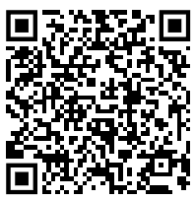
Special Olympics
Central Region Golf Competition
Time: 0700 to 1330
Date: Sunday, October 22, 2023
Where: Wedgefield Golf Club, 20550 Maxim Pkwy, Orlando, FL 32833
If you wish to participate in this event please sign up by October 12th so we can have the final headcount by October 13th. Lunch will be provided by the special olympics team. It is recommended that you bring a hat, bug spray, water bottle, and sunscreen. Please wear combo 4 (PT gear) and closed toed shoes
Please sign up here as well as the paper sign up sheet in
class. https://forms.gle/aiuoVF5ij9rz4EsG7
CIC needed for event
If you have any questions please contact C/ Vanessa Maloney @321-318-2929

Slide 6
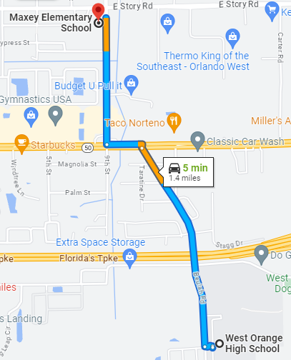
Maxey Elementary Fall Festival
October 26th, 4pm – 8pm
You will be assigned to work on concessions, parking, games, or teacher assistance
If there is enough signups, it can be divided into two shifts.
One shift = 10 – 15 volunteers (4 hours)
OR
Two shifts = 20 – 30 volunteers (2 hours)
602 E Story Rd, Winter Garden, FL 34787
For any questions, comments, or concerns, please contact
C/SrAmn Kei Seddon @ 321-888-1698

Slide 7
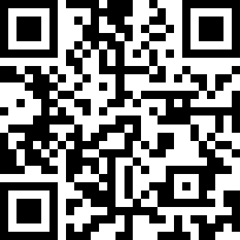
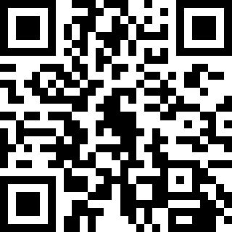
Maxey Elementary Fall Festival
Those who are volunteering need to sign up as an ADDition. Please do this as soon as possible.
https://tinyurl.com/fallfessignup
Also, please select which shift you would like to work on this google form. Not selecting one means you will be randomly assigned one.
https://tinyurl.com/fallfesshifts
For any questions, comments, or concerns, please contact
C/SrAmn Kei Seddon @ 321-888-1698

Slide 8
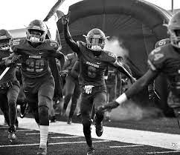
Football Parking
Time: 1630 to 1930
When: 20th, October
Where: Room 950(Colonel’s Room)
Uniform: COMBO 5
(you can only go if you have combo 5)
WEST ORANGE VS DR PHILLIPS!
If you would like to be CIC, please contact C/Bernhard @ (407) 408-6158

Slide 9
FL-802 Unit Picnic!!
The unit picnic is the first time during the school year the whole unit is invited out to meet one another and boost morale! Food, fun, and friends is what this event is all about!
Parents and family are more than welcome to come and hang out for the duration of the picnic. (more information on the next slide.)
Date: 28 October
Time: 1100-1400
Location: Veterans Memorial Park (420 S Park Ave, Winter Garden, FL)

Slide 10
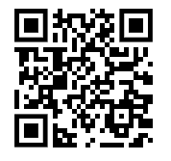
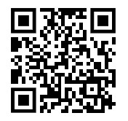
FL-802 Unit Picnic!!
If you are interested in going please fill out the google form below as well as fill out the perfect potluck link!
https://tinyurl.com/802UnitPicnicInterest
https://tinyurl.com/PerfectPotluck802
If you have any questions or concerns, please contact C/ 2nd Lt Sara Mattox @ 4072423829

Slide 11
Inspection Marching Team
We need 2nd years and some exceptional 1st years to march the 30 count for inspection. If you’re on this list, you’ve stood out in your drill skills and we want to help you get better to do good in marching for inspection;
Motta, G., Sanchez, Borgeson, Dalton, Walker, Vargas, Tolbert, Chuidian, Le, H., Johnson, Nguyen, Tawil, Bouknight and Wisdom.
If you can stay after school to practice the 30 count you will earn the achievement ribbon!
For any questions or concerns contact Cadet Agrafena Ritz at (386) 344-9452

Slide 12
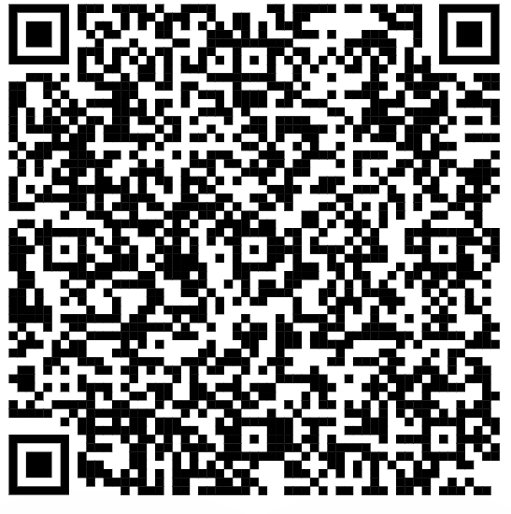
Inspection Marching Team (contd.)
Fill out this form for when you can practice after school (even if it’s never):
If you’re a 2nd or 1st year cadet and you weren’t on the last slide but you feel your drill skills are up to par for inspection-feel free to also fill out the form to be considered for the 30 Count Inspection Team!
For any questions or concerns contact Cadet Agrafena Ritz at (386) 344-9452

Slide 13
Cadet Forms
The following cadets are missing the forms listed:
Consent Form:
Abrache, Hannah
Aguilar, Andres
Barber, Chloe
Cortes, Jenni
Coutray, Angelina
Damuth, Dalton
Doyle, Ryan
Go, Connor
Nicholas, Alejandro
Osoria, Massyel
Rodriguez, Analis
Torres, Anthony
Cadet Agreement:
Abney, Noah
Abrache, Hannah
Adepeju, David
Aguilar, Andres
Nicholas, Alejandro
Bruce, Wyatt
Butler, Josiah
Cortes, Jenni
Coutray, Angelina
Damuth, Dalton
Doyle, Ryan
Go, Connor
Hernandez, Angelina
Hibbert, Damian
Madera, Jalissa
Mezime, Taylor
Osoria, Massyel
Rosario, Carlos
Shaw, Brooke
Sherrow, Jeromy
Torres, Anthony
Wright, Jayden
Cadet Data Form:
Madera, Jalissa
Cortes, Jenni

Slide 14
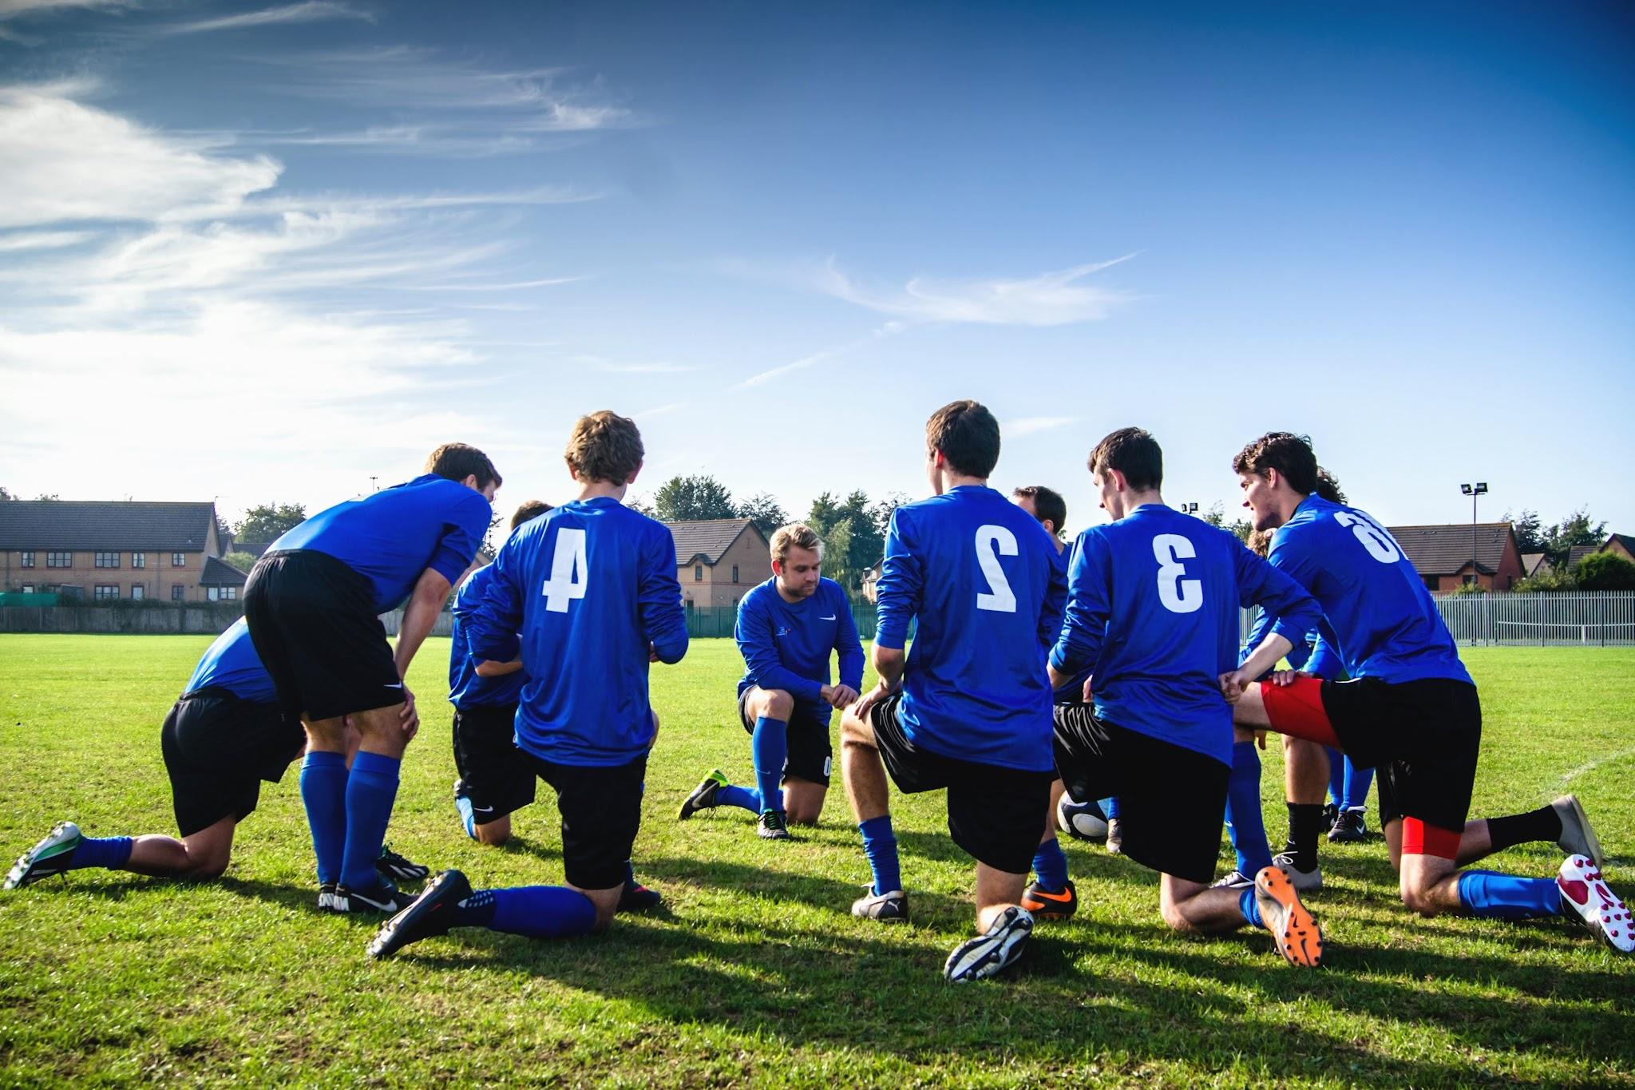
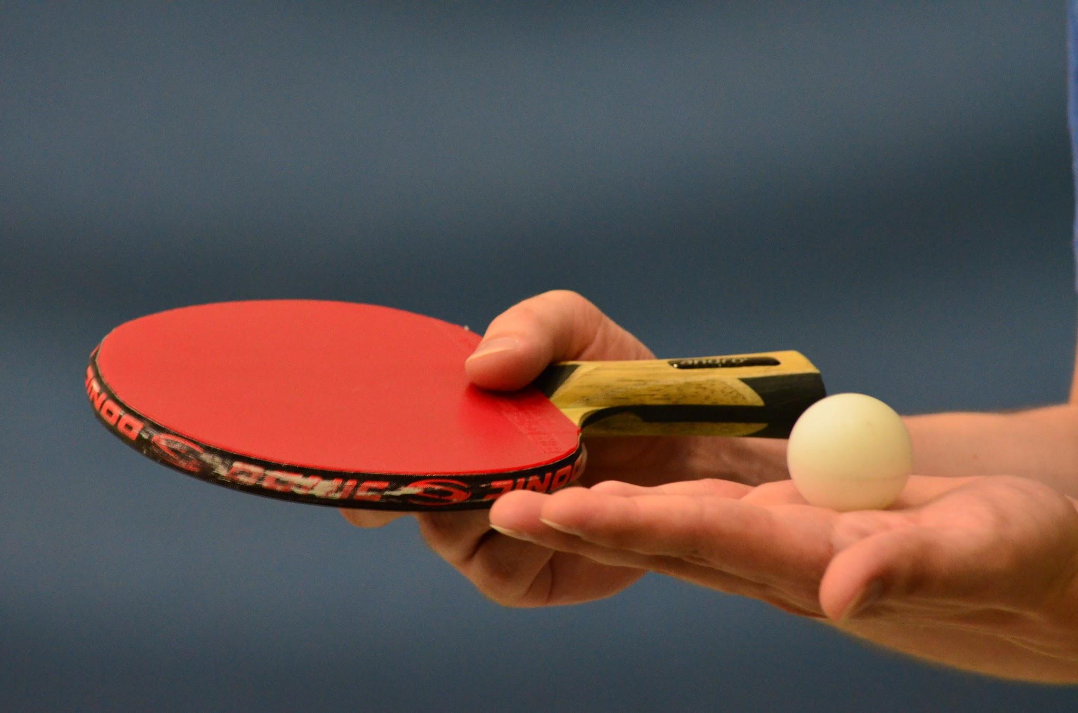
School Involvement
We recognize many of you are involved in other school activities. As we prepare for inspection, as well as set up for future collaboration, we would love to hear which activities you are involved in!
Please let us know with this form: https://tinyurl.com/FL-802SchoolActivityPoll

Slide 15
KHHS Meeting
KHHS meeting this week 19 October 1430-1530 in room 950!
Questions, comments, or concerns? Please contact C/ 2nd Lt. Sara Mattox at 407-242-3829 or 4804154679@students.ocps.net

Slide 16
Chief’s Quote of the Week
“Perfection is not attainable, but if we chase perfection we can catch excellence.”
– Vince Lombardi

Slide 17
Military Knowledge
What color represents honor?
Gold

Slide 18
Summary
Upcoming Events
KHHS Meeting (10/19)
Football Parking (10/20)
SOCRGC (10/22)
Maxey Fall Festival (10/26)
Unit Picnic (10/28)
Notes
Athletic Clearances
Inspection Marching Team
Cadet Forms (Due 10/20)
Chief’s Quote

Slide 19
Briefing Slides
If you have a slide for the briefing, contact C/ Cruz-Garcia at 4804173126@students.ocps.net
If you want something in the briefing, you must contact C/ Cruz-Garcia by Monday 1700 for the Tuesday brief and Wednesday 1700 for the Thursday brief

