Slide 1
West Orange FL-802
Semi-Weekly Brief
C/ Staff Sergeant Daphne Bray
18 January 2024
Lead,
Serve,
Dream
Unit Motto:

Slide 2
AFJROTC Mission
Develop citizens of character dedicated to serving their nation and community
Mission:
Goals:
Instill Values Of Citizenship,
Service To The United States,
Personal Responsibility/Sense Of Accomplishment

Slide 3
Chain of Command
Commander in Chief:
Sec Def:
Sec AF:
CSAF:
AETC CC:
AU CC:
Holm Center CC:
Director, AFJROTC:
SASI:
Group CC:
Deputy Group CC:
President Joseph R. Biden Jr.
Honorable Lloyd Austin
Honorable Frank Kendall
Gen David Allvin
Lt. Gen Brian S. Robinson
Lt. Gen Andrea D. Tullos
Brig Gen Houston R. Cantwell
Col Johnny R. McGonigal
Lt. Colonel Micheal Carrizales
C/ Captain Agrafena Ritz
C/ Captain Elias Lopez

Slide 4
Athletic Clearance
These Cadets below are missing the Athletic Clearance:
Mezime - Delta
Bermudez - Alpha Osoria - Charlie
Ceballos - Charlie Palacios - Foxtrot
Damuth - Alpha Parboo - Alpha
DeSilva - Charlie Rosario - Delta
Doyle - Alpha Vazquez- Charlie
Funk - Golf Saint Franc - Alpha
Madera - Bravo
https://athleticclearance.fhsaahome.org/

Slide 5
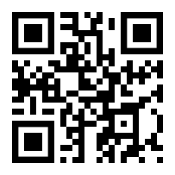
PT Makeups
Sign up here for the PT makeups or on Canvas
https://tinyurl.com/PT2324
For any questions,please contact C/A1C Ayana Putigna @4804185464@students.ocps.net
Meet at the 900 building in PT gear by 1430. Thursdays only.

Slide 6
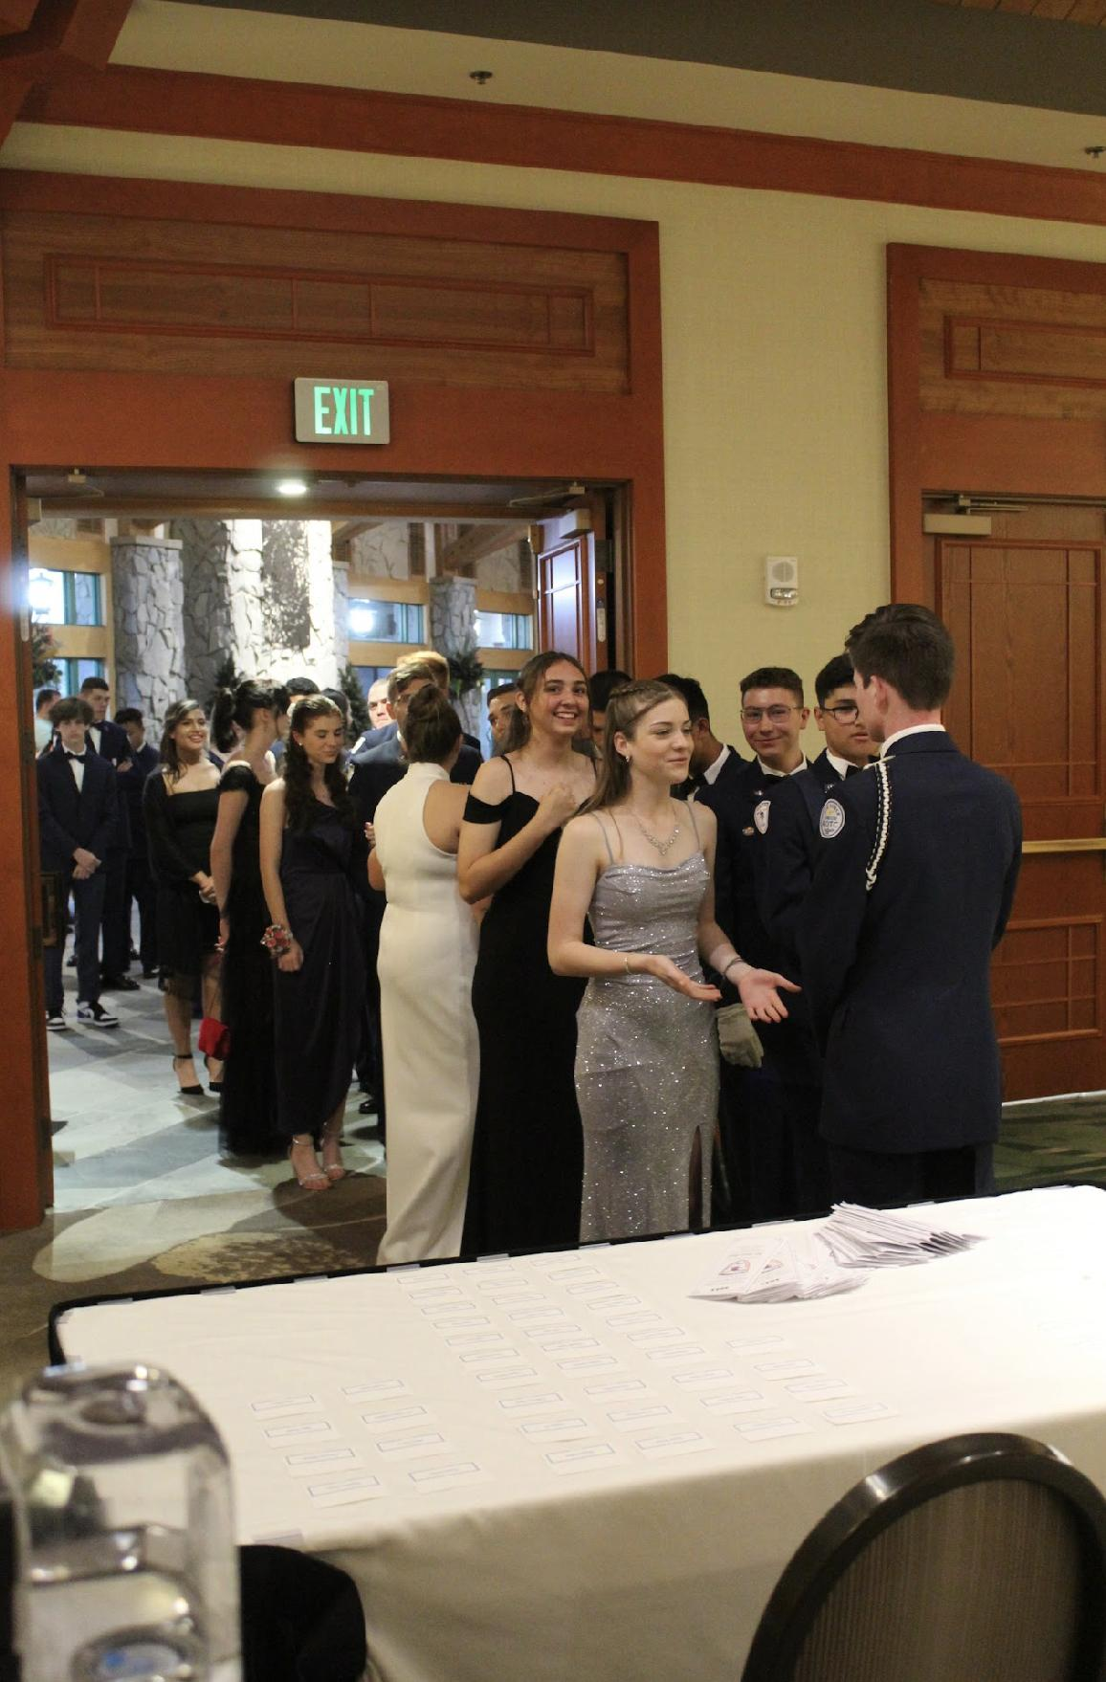
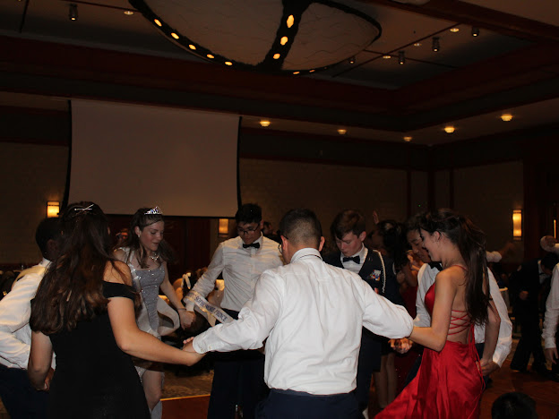
FL-802 Air Force Ball
Air Force Ball is our unit’s very own dance! It is a fun filled night with ceremonies, food, and lots of dancing! This years AFB is 10 February 2024 at Rosen Plaza from 1800 to 2200!
https://www.schoolpay.com/pay/for/Air-Force-Ball-Tickets-2324/SbGcCl
Ticket prices are as follows:
Cadets: $45
Guests: $50
If you have any questions or concerns, please contact C/ 1st Lt Sara Mattox @ 4072423829 or at 4804154679@students.ocps.net

Slide 7
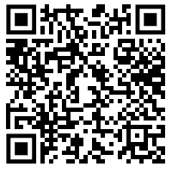
Air Force Ball RSVP
Here is a link to fill out an RSVP for the Air Force Ball on February 10th.
If you have any questions or concerns please contact C/SSgt Vanessa Maloney at 321-318-2929 or 4804210309@students.ocps.net

Slide 8
Recruiting
Upcoming Events:
Rising Sophomore meeting (1/19/24)
Parent Night (1/30/24)
Sunridge Middle School visit (2/19/24)
Lakeview Middle School visit (2/19/24)
Hamlin Middle School visit (2/27/24)
To join recruiting Remind: Text @fl802re to 81010
Contact C/Amn David Peebles at 4804407123@students.ocps.net

Slide 9
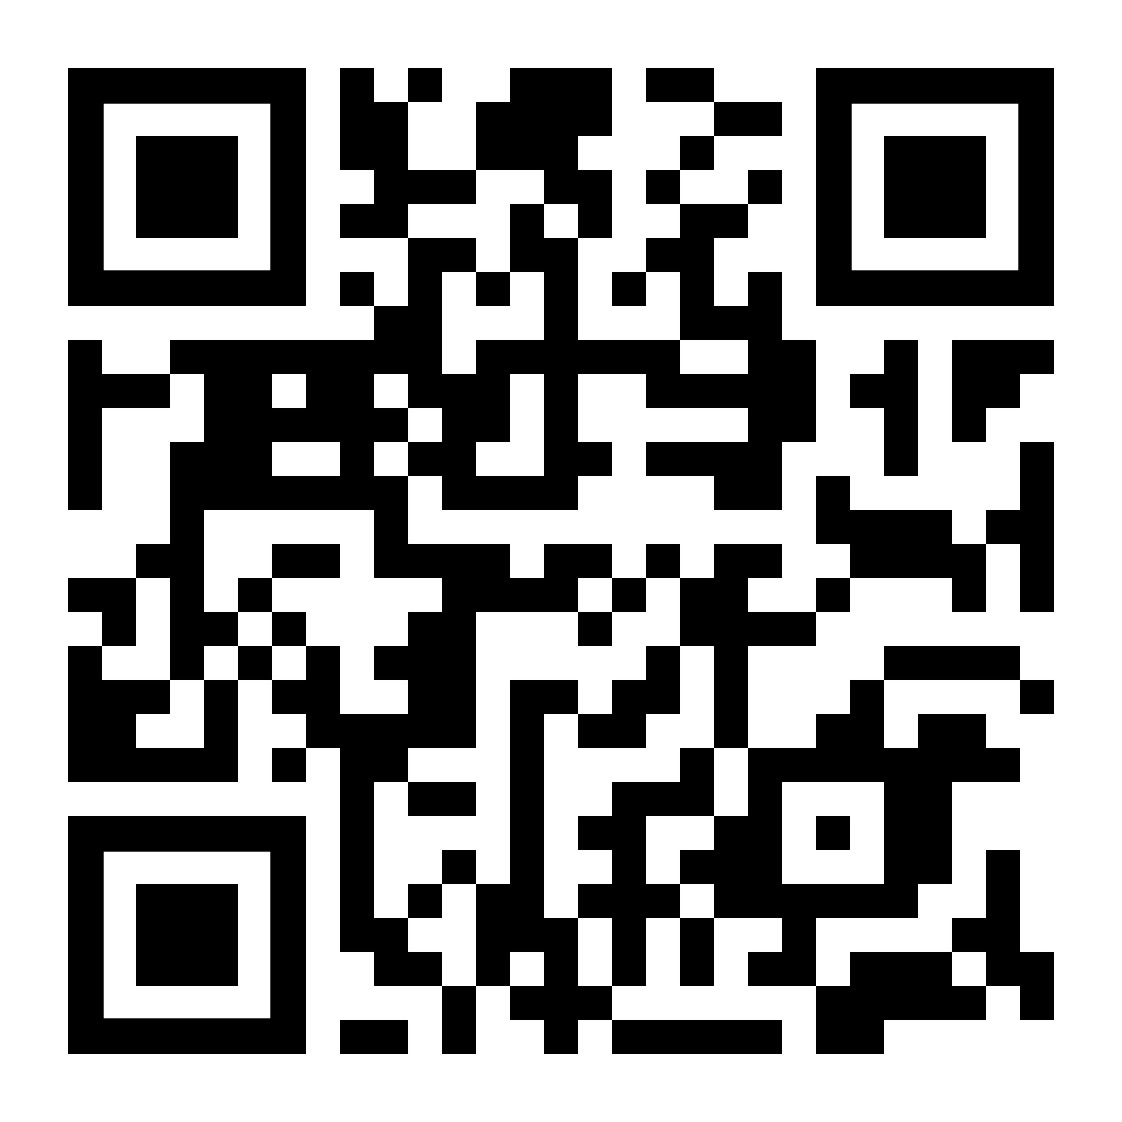
CICs/ DCICs
If you have been a CIC or DCIC, please fill out the google form by scanning the QR code or going to the link below.
http://tinyurl.com/f8bdhnv5
If you have any questions, please contact C/ SSgt Gabriel Motta at 4804175879@students.ocps.net

Slide 10
Dillard Street Dragon Festival
Dillard Street Elementary is hosting their annual Dragon Festival on 19 January and requests that we assist. It includes:
Set up begins at 4 PM; the actual festival is from 5-7PM; cleanup is until 8 PM.
Cadets will be assisting with stations/ activities such as bounce houses and carnival games.
Wear Combo 5!
If you have questions of concerns contact
C/ Agrafena Ritz at 1816002482@students.ocps.net.

Slide 11
Bataan Death March
TAKE A PICTURE!
Who: Our Cadet Corps, Dr. Phillips and Ocoee Cadet Corps
What: 14.4 Mile March on the West Orange Trail
When: 20 January, from 0730-1330
Where: Killarney Station to Chapin Station (Round Trip)
Why: To Honor Prisoners of War
Uniform: Combo 4 (PT Clothes and Orange Shirt)
Sign Up: Sheet on the Board
If you have any questions, please contact C/ MSgt Noah Abney @ 407-961-2474 or 4804172400@students.ocps.net.

Slide 12
Chief’s Quote of the Week
"You make a choice: continue living your life feeling muddled in this abyss of self-misunderstanding, or you find your identity independent of it."
– Duchess Meghan

Slide 13
Military Knowledge
When is Memorial Day
The last Monday in May

Slide 14
Summary
Upcoming Events
Dillard Street Dragon Festival (1/19)
Bataan Death March (1/20)
Notes
Athletic Clearances
AFB
PT Makeups
CIC/DCIC form

Slide 15
Briefing Slides
If you have a slide for the briefing, contact C/ Bray at 4804208068@students.ocps.net or (689)-229-0443
If you want something in the briefing, you must contact C/ Bray by Monday 1700 for the Tuesday brief and Wednesday 1700 for the Thursday brief

