Slide 1
West Orange FL-802
Semi-Weekly Brief
C/ Staff Sergeant Eliud Cruz-Garcia
16 May 2023
Lead,
Serve,
Dream
Unit Motto:

Slide 2
AFJROTC Mission
Develop citizens of character dedicated to serving their nation and community
Mission:
Goals:
Instill Values Of Citizenship,
Service To The United States,
Personal Responsibility/Sense Of Accomplishment

Slide 3
Chain of Command
Commander in Chief:
Sec Def:
Sec AF:
CSAF:
AETC CC:
AU CC:
Holm Center CC:
Director, AFJROTC:
SASI:
Group CC:
Deputy Group CC:
President Joseph R. Biden Jr.
Honorable Lloyd Austin
Honorable Frank Kendall
Gen Charles Q. Brown Jr.
Lt Gen Brian S. Robinson
Lt Gen Andrea D. Tullos
Brig Gen Houston R. Cantwell
Col Johnny R. McGonigal
Colonel Stuart Rhoades
C/ Captain Aidan Bernhard
C/ 2nd Lieutenant Antonio Torre

Slide 4
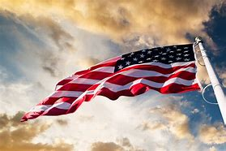
Flag Detail
Want to help start and end the military day? Join Flag Detail every morning at 0655 and after school to learn how to set up and take down our nations flag!
Earn 5 points and you can receive the respected Patriotic Flag ribbon, as well as community service hours!
0.25 points per reveille/retreat.
0.25 hours of community service per reveille/retreat.
If you have any questions, or concerns please contact C/TSgt Lorenzo Motta @4075678283 BUSINESS PURPOSES ONLY

Slide 5
Community Service
Task: Cadets will be set up in groups of 5, where they will be given a list of various classrooms where they are to move notated items from one room to another.
For any questions, comments or concerns contact C/TSgt
Noah Abney @4804172400@students.ocps.net and 407-961-2474
Time: 9 am - Noon
Date: TBD
Uniform: PT Gear
Where: West Orange High School

Slide 6
BCT Cadre
If you have signed up to be a BCT Cadre, you will be notified of your status and position at 1700 hrs Tonight.
For any questions, comments or concerns contact
C/Torre @ (407)-773-0450

Slide 7
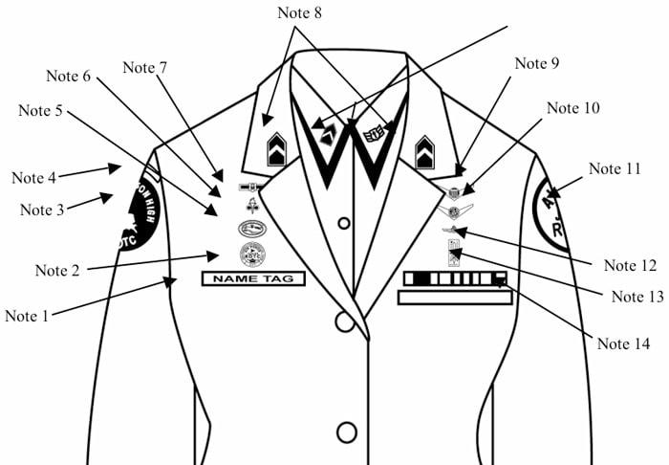
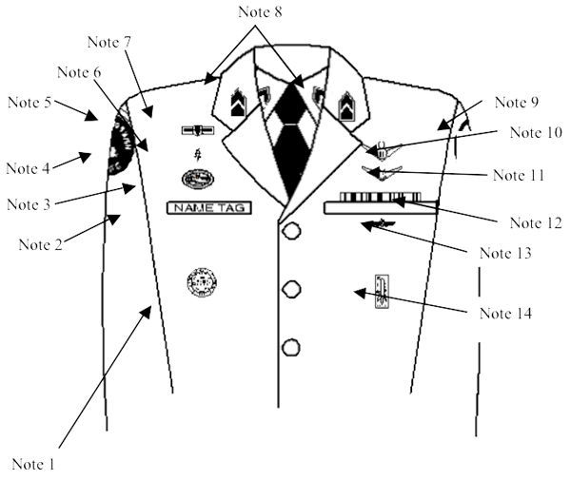
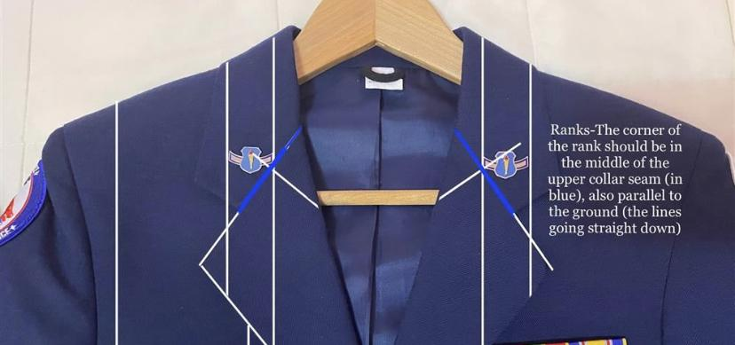
Weekly Uniform Reminder
Grade insignia (officer or enlisted) worn on both lapels. Place insignia halfway up the seam, resting on but not over it. Bottom of insignia is horizontal with the ground.

Slide 8
Speaking of uniforms…
The following cadets need to turn in uniforms ASAP
Baruch, Natalie | Howe, Jonah
Beacham, Matthew | Lopez, Carlos
Bermudez, Jasmin | Nazario, Victor
Burgess, Nehemaih | Ndungu, LIndsey
Chavez, Jorge | Ovalles, Layla
Goldstein, Noah

Slide 9
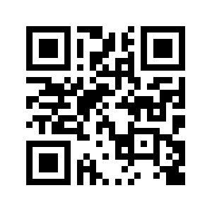
Uniform Return Information
All cadets who are NOT returning to AFJROTC next year must return all uniform items. Anyone who does not return uniform items CAN NOT graduate. If you have not already returned your uniform please do so IMMEDIATELY!
https://tinyurl.com/FL-802LGS
Items to be returned: Shirt, Pants, Belt, Flight Cap,
Service Coat, and Lightweight Jacket
All items must be dry cleaned PRIOR to return.
Questions, comments, concerns, contact C/SMSgt Anthony Torres at (775) 544-0842 or 4806810625@studnets.ocps.net

Slide 10
Military Knowledge
Who killed the leader of ISIS?
U.S. Delta Force soldiers

Slide 11
Summary
Upcoming Events
CLC
BCT
Community Service Opportunity
Notes
Flag Detail
Weekly Uniform Reminder
Uniform Return Information

Slide 12
Briefing Slides
If you have a slide for the briefing, contact C/ Cruz-Garcia at 4804173126@students.ocps.net
If you want something in the briefing, you must contact C/Cruz-Garcia by Monday 1700 for the Tuesday brief and Wednesday 1700 for the Thursday brief

