Slide 1
West Orange FL-802
Semi-Weekly Brief
C/ Staff Sergeant Eliud Cruz-Garcia
14 September 2023
Lead,
Serve,
Dream
Unit Motto:

Slide 2
AFJROTC Mission
Develop citizens of character dedicated to serving their nation and community
Mission:
Goals:
Instill Values Of Citizenship,
Service To The United States,
Personal Responsibility/Sense Of Accomplishment

Slide 3
Chain of Command
Commander in Chief:
Sec Def:
Sec AF:
CSAF:
AETC CC:
AU CC:
Holm Center CC:
Director, AFJROTC:
SASI:
Group CC:
Deputy Group CC:
President Joseph R. Biden Jr.
Honorable Lloyd Austin
Honorable Frank Kendall
Gen Charles Q. Brown Jr.
Lt. Gen Brian S. Robinson
Lt. Gen Andrea D. Tullos
Brig Gen Houston R. Cantwell
Col Johnny R. McGonigal
Lt. Colonel Michael Carrizales
C/ Major Aidan Bernhard
C/ 1st Lieutenant Antonio Torre

Slide 4
Flight Commander Meeting
Attention Flight Commanders! There is a mandatory meeting this Friday from 1430-1530 in room 950.
Any Questions? Contact C/Lopez at (321)440-7611 - TEXT ONLY Please

Slide 5
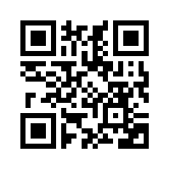
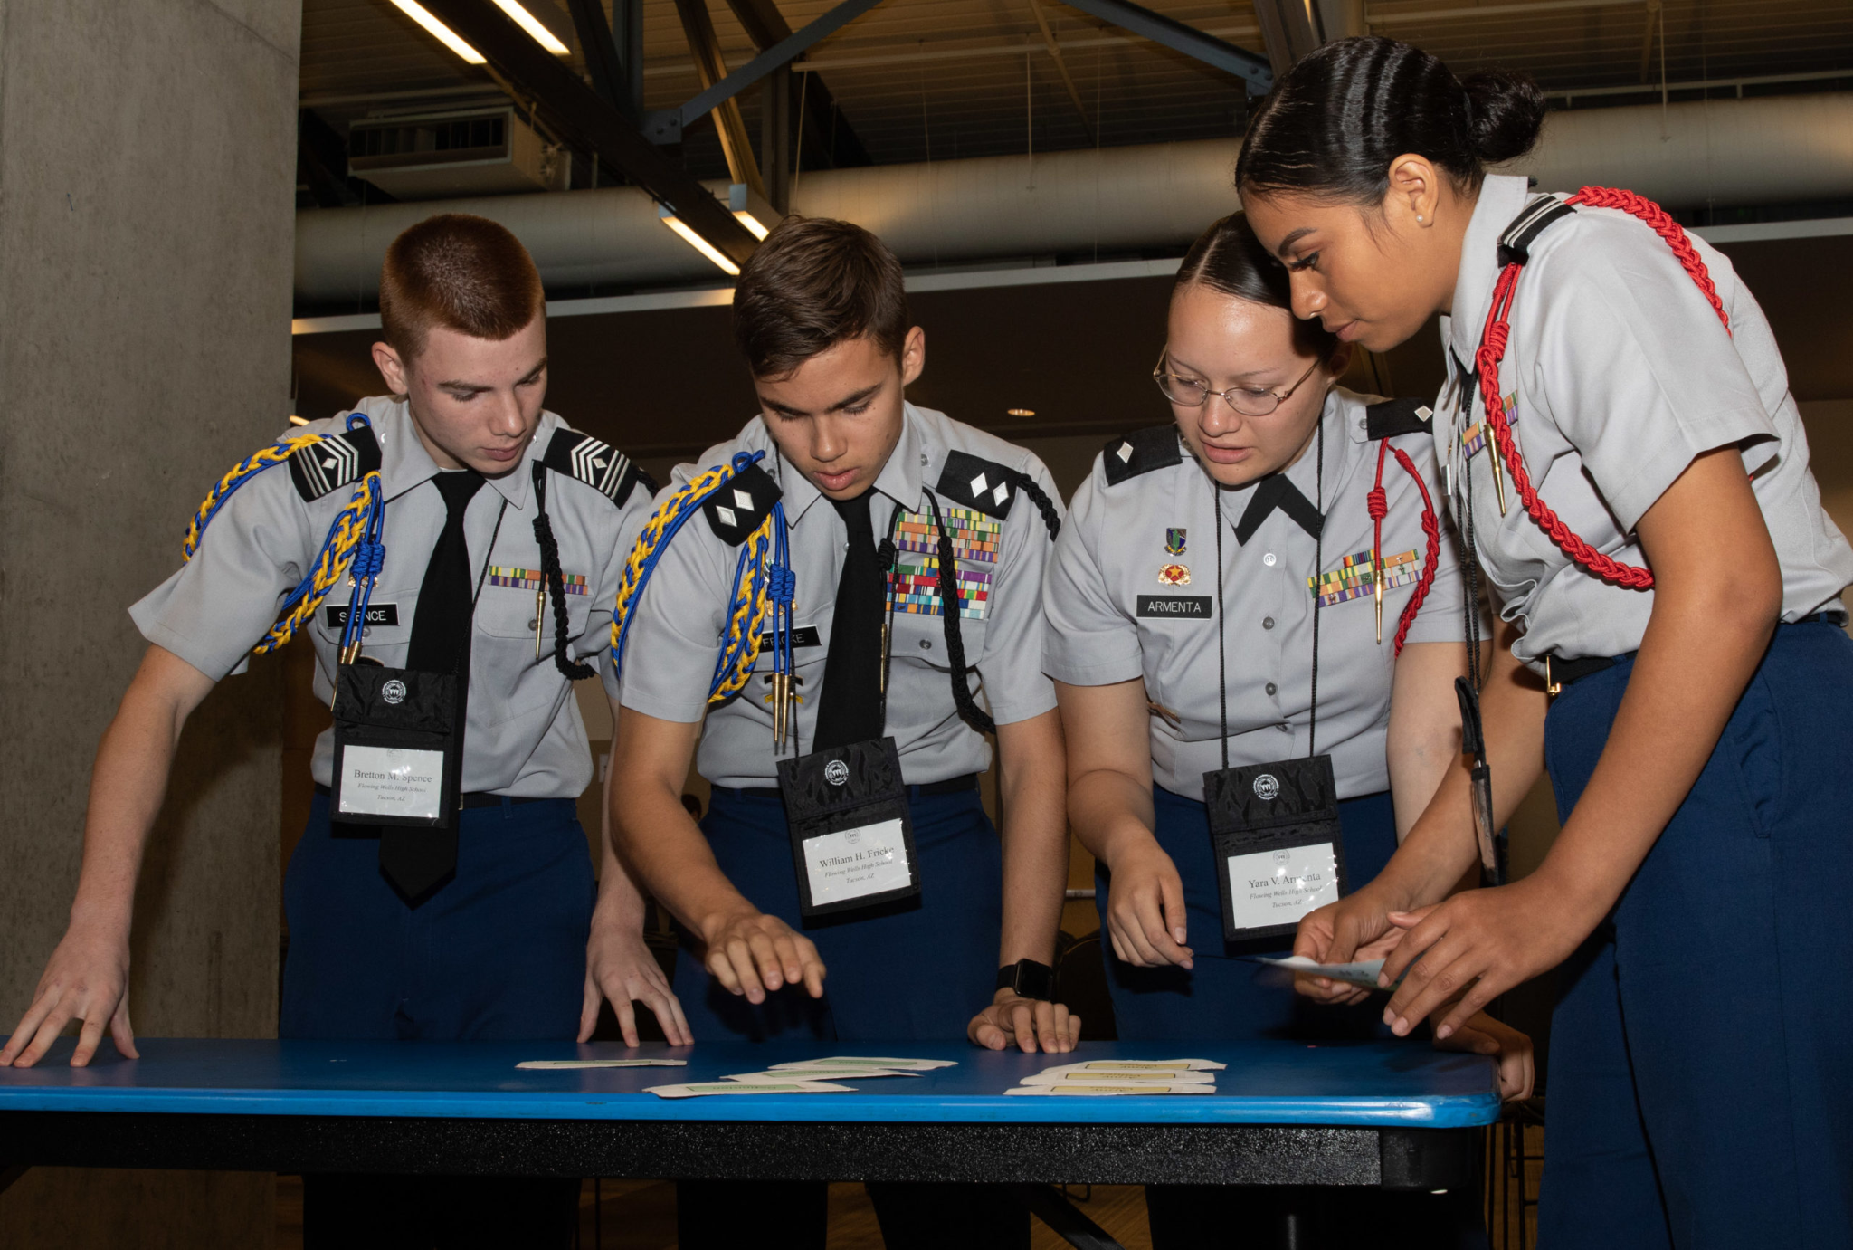
JLAB Interest Form
Junior Leadership & Academic bowl is a national competition that is comprised academic questions that very from SAT based questions to current events.
Example Question: The function g(x) is defined by g(x) = x²+ 9 For which value of x is g(x) = 25 ? “
If you are interested in JLAB for the next school year please fill out the interest form.
https://tinyurl.com/JLABFL802
For any questions, comments or concerns contact C/Staff Sergeant Ian Kristona@4804098968@students.ocps.net

Slide 6
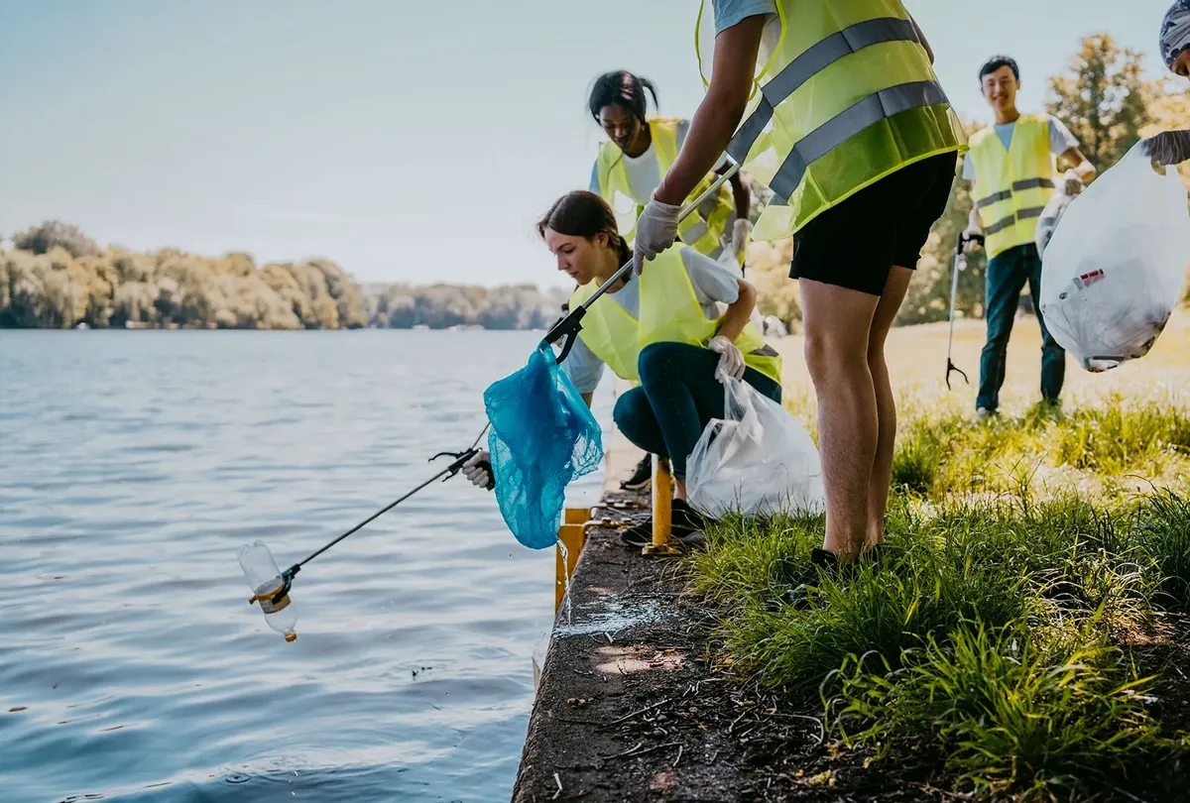
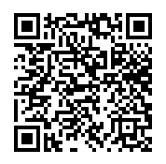
Community Service Event: Orlando Lakes Cleanup
Time: 1000 – 1200
Date: Saturday, September 16th
Where: Eagles Nest Park (5165 Metrowest Blvd)
If you wish to participate in this event, you must register as a volunteer with Orlando Cares. Scan the QR code or copy the link to get to the sign up information (you must do this.)
Water will be provided, however a refillable water bottle is highly recommended. Sun screen, bug spray, and hats are not required but recommended. Closed-toed shoes and combo 4 (PT clothes) are REQUIRED!
Any questions, comments, or concerns please contact C/ Sara Mattox @ 407-242-3829.
https://tinyurl.com/LakeCleanupSU

Slide 7
Football Parking
TAKE A PICTURE!
Who: Our Cadet Corps
What: Direct people and their vehicles
When: 22 September
Where: Room 950(Colonel’s Room)
Why:To help out our school
Sign up:On the paper!
If you have any questions, contact C/Bernhard at +1(407) 408-6158.

Slide 8
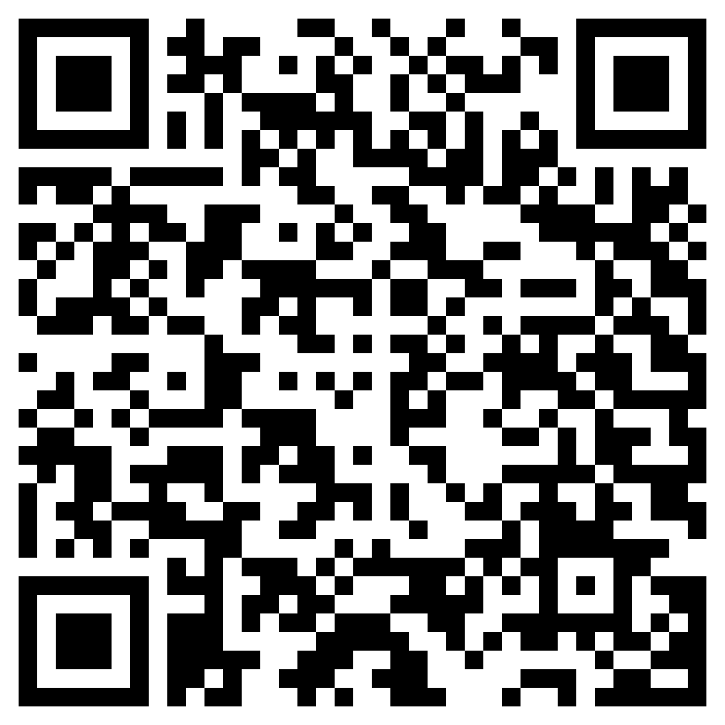
Join Recruiting!
If you are interested in helping our unit recruit new cadets, join the recruiting team.
If you would like to go out to schools and help boost our unit numbers and have the opportunity to earn the recruiting ribbon, scan the QR code provided.
Any questions, please contact C/ TSgt Princess Tolbert at 4804191858@students.ocps.net or (407) 259-7171.

Slide 9
StellarXplorers
StellarXplorers is having a practice this Thursday 14 September in room 950. Everyone is welcome to attend.
Questions, comments, concerns, contact C/SMSgt Anthony Torres at (775) 544-0842 or 4806810625@studnets.ocps.net

Slide 10
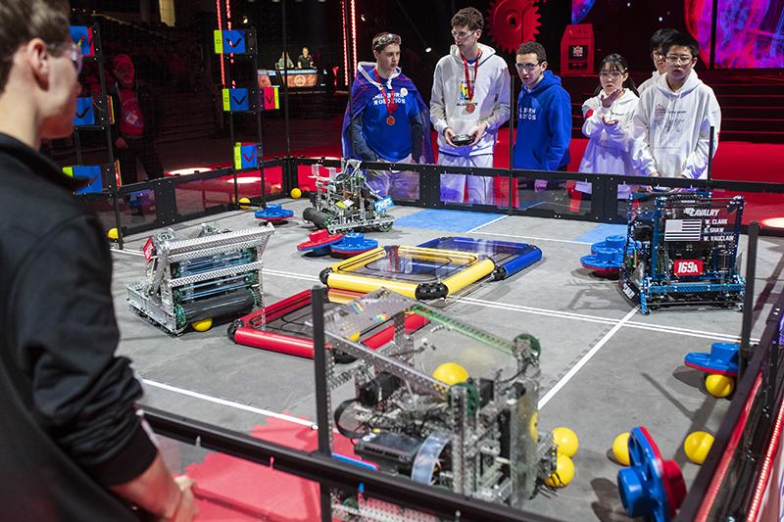
Robotics
Are you interested in engineering, robotics, or programming? Join the robotics LDR. For more information join Remind @fl802rec
Questions, comments, concerns, contact C/SMSgt Anthony Torres at (775) 544-0842 or 4806810625@studnets.ocps.net

Slide 11
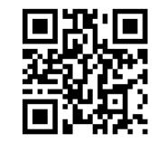
Logistics Appointment Schedule
New 2023-2024 Logistics appointment link
Logistics Appointment Form:
Monday: 1420-1500
Tuesday: 1420-1500
Thursday: 1420-1500
https://tinyurl.com/FL-802LSS
Questions, comments, concerns, contact C/SMSgt Anthony Torres at (775) 544-0842 or 4806810625@studnets.ocps.net

Slide 12
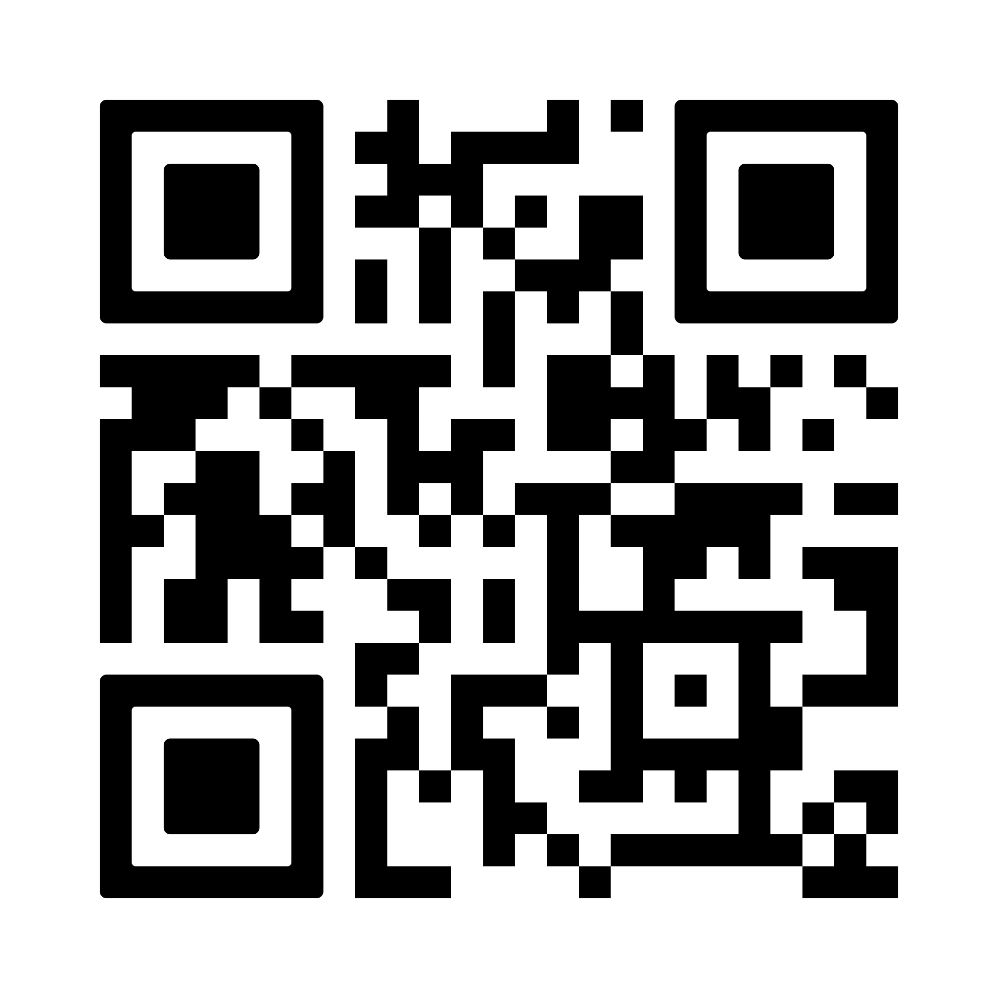
PT Makeups
Sign up here for the PT makeups or on Canvas
https://tinyurl.com/PT2324
For any questions, comments or concerns contact C/SSgt Michael Romeu @4804278080@students.ocps.net and/ or 407-790-9996
Meet at the 900 building in PT gear by 1430. I won't wait for you, Be on time
Message me if you can’t make it.

Slide 13
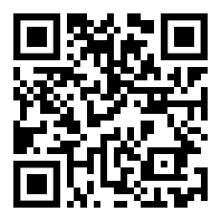
PT Rope
FLIGHT COMMANDERS!
Open the link below to fill out the form to recognize a cadet in your flight for the outstanding qualities shown for September’s PT! The winner will receive the illustrious PT rope and a merit.
https://tinyurl.com/ptcadetofthemonth
If you have any questions, or concerns please contact C/SSgt Michael Romeu @4077909996 or 4804278080@students.ocps.net
SEND PICTURES TO C/LOPEZ (321)-440-7611

Slide 14
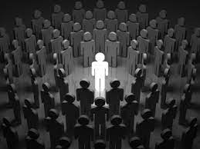
Chief’s Quote of the Week
"Don't follow the crowd. Let the crowd follow you."
– Margaret Thatcher

Slide 15
August Gold Rope
Congratulations to the recipients of the gold rope for the month of August!
1st Year:
C/Adepeju
Upperclassman:
C/Tolbert

Slide 16
Military Knowledge
When was Pearl Harbor attacked?
7 December 1941

Slide 17
Summary
Upcoming Events
Orlando Lakes Cleanup (9/16)
Football Parking (9/22)
Notes
Logistics Appointment Schedule
Recruiting
StellarXplorers
Robotics
PT Makeups
PT Rope
Gold Rope

Slide 18
Briefing Slides
If you have a slide for the briefing, contact C/ Cruz-Garcia at 4804173126@students.ocps.net
If you want something in the briefing, you must contact C/Cruz-Garcia by Monday 1700 for the Tuesday brief and Wednesday 1700 for the Thursday brief

