Slide 1
West Orange FL-802
Semi-Weekly Brief
C/ Technical Sergeant Daphne Bray
13 February 2024
Lead,
Serve,
Dream
Unit Motto:

Slide 2
AFJROTC Mission
Develop citizens of character dedicated to serving their nation and community
Mission:
Goals:
Instill Values Of Citizenship,
Service To The United States,
Personal Responsibility/Sense Of Accomplishment

Slide 3
Chain of Command
Commander in Chief:
Sec Def:
Sec AF:
CSAF:
AETC CC:
AU CC:
Holm Center CC:
Director, AFJROTC:
SASI:
Group CC:
Deputy Group CC:
President Joseph R. Biden Jr.
Honorable Lloyd Austin
Honorable Frank Kendall
Gen David Allvin
Lt. Gen Brian S. Robinson
Lt. Gen Andrea D. Tullos
Brig Gen Houston R. Cantwell
Col Johnny R. McGonigal
Lt. Colonel Micheal Carrizales
C/ Captain Agrafena Ritz
C/ Major Elias Lopez

Slide 4
Athletic Clearance
https://athleticclearance.fhsaahome.org/
Alpha | Bravo | Charlie | Delta | Foxtrot | Golf
Bermudez | Madera | Benzakour | Busteros | Palacios | Funk
Damuth |  | DelSilva | Goldstein
Doyle |  | Vasquez | Mezime
Saint-Franc |  |  | Rosario

Slide 5
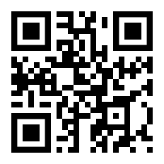
PT Makeups
Sign up here for the PT makeups or on Canvas
https://tinyurl.com/PT2324
For any questions,please contact C/A1C Ayana Putigna @4804185464@students.ocps.net
Meet at the 900 building in PT gear by 1430. Thursdays only.

Slide 6
Recruiting
Upcoming Events:
Sunridge Middle School visit (2/16/24)
Lakeview Middle School visit (2/15/24)
Hamlin Middle School visit (2/27/24)
To join recruiting Remind: Text @fl802re to 81010
Contact C/Amn David Peebles at 4804407123@students.ocps.net

Slide 7
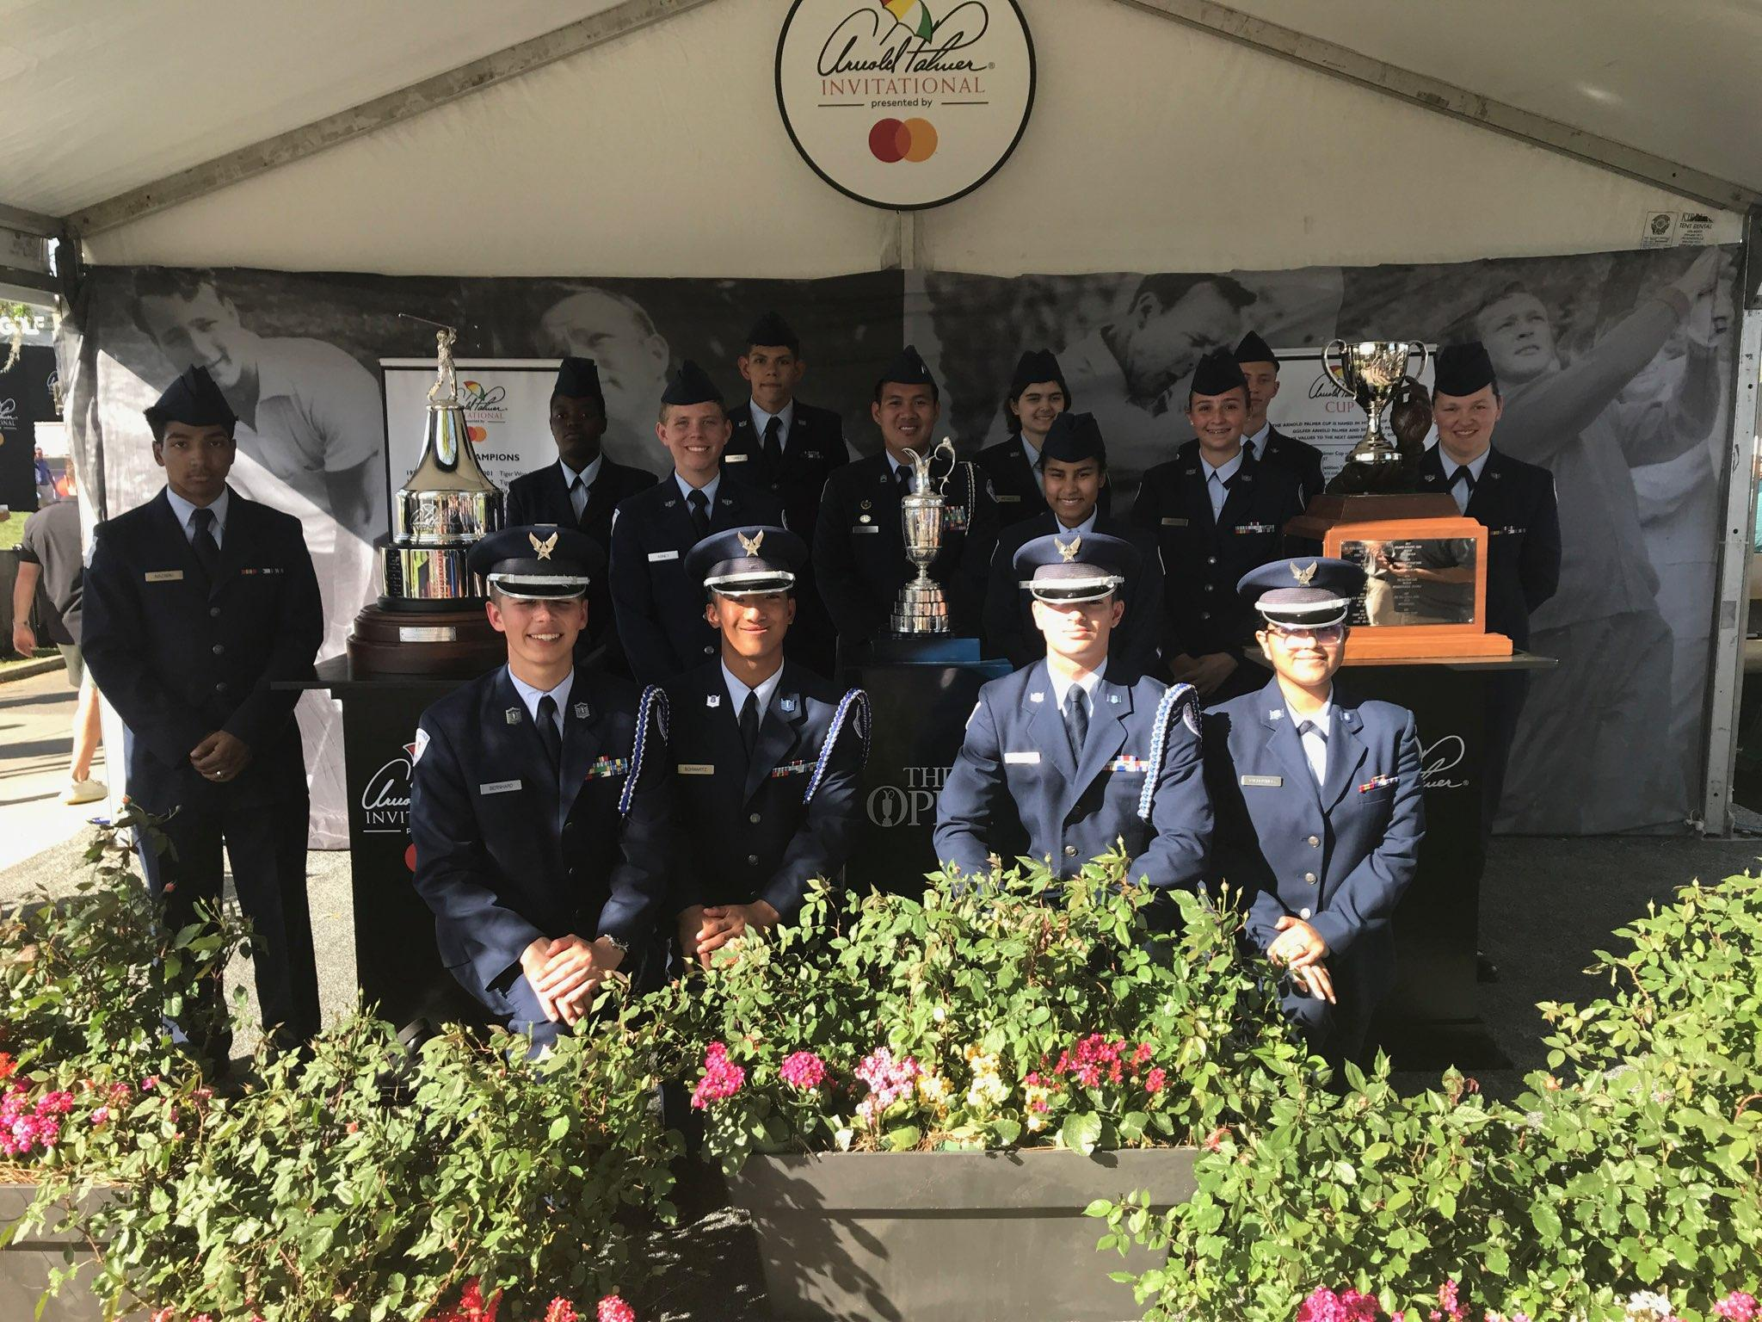
Arnold Palmer Invitational
Guard trophies for the Arnold Palmer Invitational golf tournament
Friday 3/8 and/or Sunday 3/10
Meet at Hyatt Grand Cypress 1 Grand Cypress Blvd, Orlando, FL 32836
Wear your Combo 2
Sign up sheet is on the board
If you’re interested in being Deputy CIC contact Cadet Mattox or Cadet Torre
Questions? Contact Sara Mattox at 407-242-3829/4804154679@students.ocps.net for March 8th or Antonio Torre at 407-773-0450/4804182497@students.ocps.net for March 10th

Slide 8
Blaze Spirit Night
We are having a spirit night at Blaze Pizza! If you attend, you will receive one merit!
When: 16 February, 6PM-9PM
Where: Blaze Pizza on West Colonial Drive (13599 W Colonial Dr).
Why: To raise money for our unit! :)
If you have any questions, comments, or concerns, please contact C/ CMSgt Diego Cuevas at 407-575-3811.

Slide 9
Model Rocketry
Interested in building model rockets? This is for you!
Model Rocketry is a STEM-based LDR in which you build launchable rockets. You will earn the Model Rocketry badge if you successfully launch 3 rockets.
Please contact C/ TSgt Princess Tolbert at 407-259-7171 or 4804191858@students.ocps.net if you are interested or have any questions.

Slide 10
SNCO/Officer Meeting
There will be a Senior NCO and Officer meeting this Friday, 16 Feb, after school. It should not take more than 30-45 minutes. Please let me know if you cannot attend at one of the contacts below.
Contact C/ 2nd Lt. Karynn Stewart at 407-797-7223 or 4804169963@students.ocps.net for any questions (business purposes only)

Slide 11
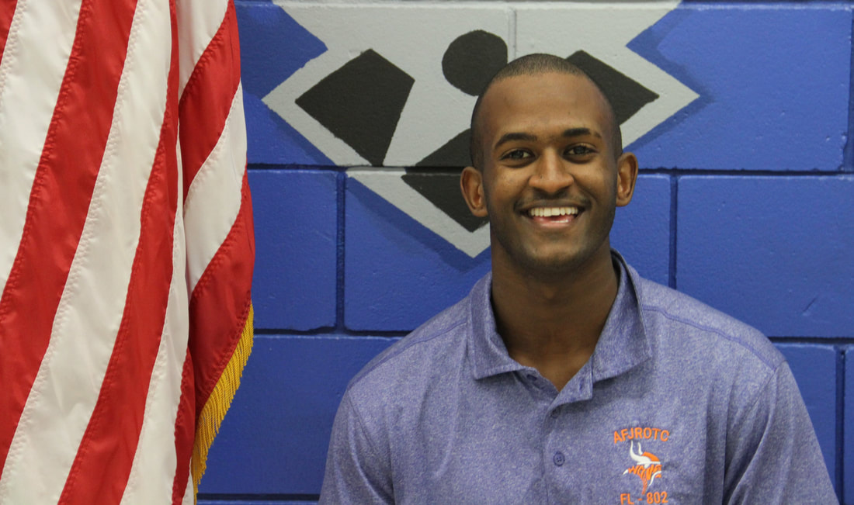
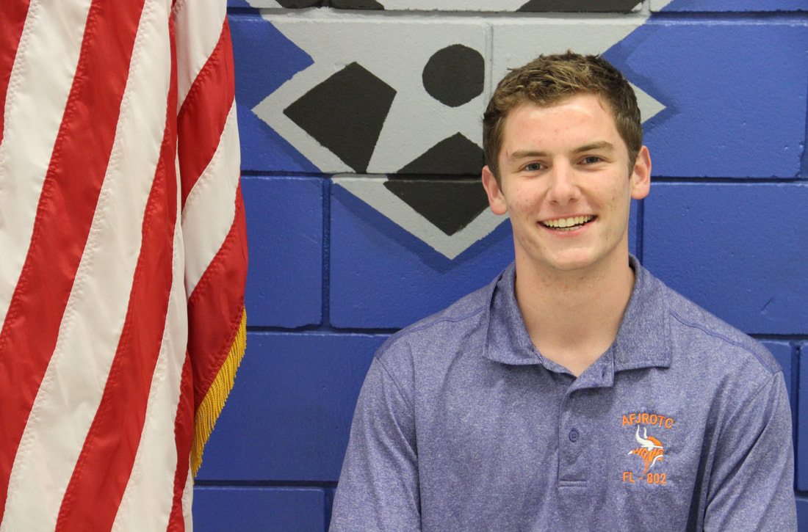
January Gold Rope Winners!
The winners for January’s Gold Rope are…
C/ Ayana Putigna
C/ David Peebles
Congratulations! Thank you for exemplifying our core values. You will receive your gold rope to wear for the month tomorrow!

Slide 12
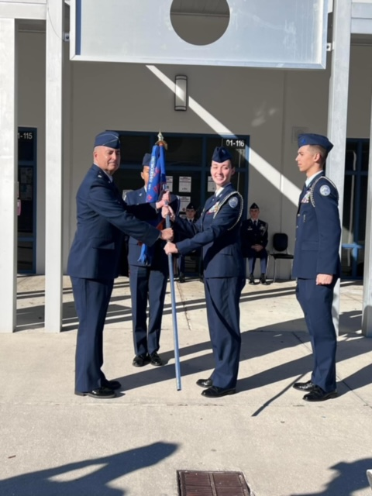
Group Commander
IF you are interested in applying for the group commander position please email SMSgt Spencer NLT 28 Feb 2024
You must be:
sophomore or junior
at least 2.5 gpa
no disciplinary issues
no missing uniform grades

Slide 13
Middle School Visits
The following cadets have been selected to go to the middle schools for recruiting efforts
Lakeview Middle School 2/15/2024
Abney, Maloney, Dalton, Molnar
Sunridge Middle School 2/16/2024
Stewart, Tolbert, Sanchez, Go
*please get a permission form from Lt. Colonel Carrizales

Slide 14
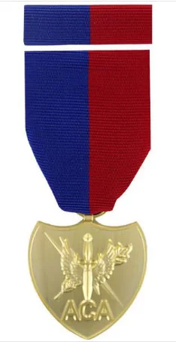
Air Commando Association Award
This award is presented annually to one cadet who most closely exemplifies the 13 critical attributes of success for Air Commandos. An essay submission is required if you’re interested in receiving the award. Please see the announcement on Canvas for more details.

Slide 15
Senior Video

Slide 16
Unit Video

Slide 17
Military Knowledge
How many stripes are there on the U.S. Flag and what do they mean?
13, 6 white and 7 red; they represent the original 13 colonies

Slide 18
Summary
Upcoming Events
Middle School Visits (2/15-2/16)
SNCO/Officer meeting (2/16)
Blaze Spirit Night (2/16)
Arnold Palmer (3/8-3/10)
Notes
Athletic Clearances
PT Makeups
Air Commando Association Award
Group Commander
January Gold Rope Winners

Slide 19
Briefing Slides
If you have a slide for the briefing, contact C/ Bray at 4804208068@students.ocps.net or (689)-229-0443
If you want something in the briefing, you must contact C/ Bray by Monday 1700 for the Tuesday brief and Wednesday 1700 for the Thursday brief

