Slide 1
West Orange FL-802
Semi-Weekly Brief
C/ Staff Sergeant Eliud Cruz-Garcia
12 September 2023
Lead,
Serve,
Dream
Unit Motto:

Slide 2
AFJROTC Mission
Develop citizens of character dedicated to serving their nation and community
Mission:
Goals:
Instill Values Of Citizenship,
Service To The United States,
Personal Responsibility/Sense Of Accomplishment

Slide 3
Chain of Command
Commander in Chief:
Sec Def:
Sec AF:
CSAF:
AETC CC:
AU CC:
Holm Center CC:
Director, AFJROTC:
SASI:
Group CC:
Deputy Group CC:
President Joseph R. Biden Jr.
Honorable Lloyd Austin
Honorable Frank Kendall
Gen Charles Q. Brown Jr.
Lt. Gen Brian S. Robinson
Lt. Gen Andrea D. Tullos
Brig Gen Houston R. Cantwell
Col Johnny R. McGonigal
Lt. Colonel Michael Carrizales
C/ Major Aidan Bernhard
C/ 1st Lieutenant Antonio Torre

Slide 4
Flight Commander Meeting
Attention Flight Commanders! There is a mandatory meeting this Friday from 1430-1530 in room 950.
Any Questions? Contact C/Lopez at (321)440-7611 - TEXT ONLY Please

Slide 5
Volunteer Opportunity
Unified Cheers needs two or three volunteers to stand by the ticket booths at the home JV football games from 1845hrs-1945hrs
The volunteers would pass out flyers to every person that enters
Flyers will encourage fans to cheer along with the Unified Cheerleading team
.
There’s no CIC for this event yet. Please volunteer to be a CIC. The next game is tomorrow night.

Slide 6
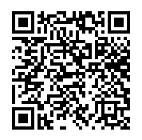
Community Service Event: Orlando Lakes Cleanup
Time: 1000 – 1200
Date: Saturday, September 16th
Where: Eagles Nest Park (5165 Metrowest Blvd)
If you wish to participate in this event, you must register as a volunteer with Orlando Cares. Scan the QR code or copy the link to get to the sign up information (you must do this.)
Water will be provided, however a refillable water bottle is highly recommended. Sun screen, bug spray, and hats are not required but recommended. Closed-toed shoes and combo 4 (PT clothes) are REQUIRED!
Any questions, comments, or concerns please contact C/ Sara Mattox @ 407-242-3829.
https://tinyurl.com/LakeCleanupSU

Slide 7
Football Parking
TAKE A PICTURE!
Who: Our Cadet Corps
What: Direct people and their vehicles
When: 22 September
Where: Room 950(Colonel’s Room)
Why:To help out our school
Sign up:On the paper!
If you have any questions, contact C/Bernhard at +1(407) 408-6158.

Slide 8
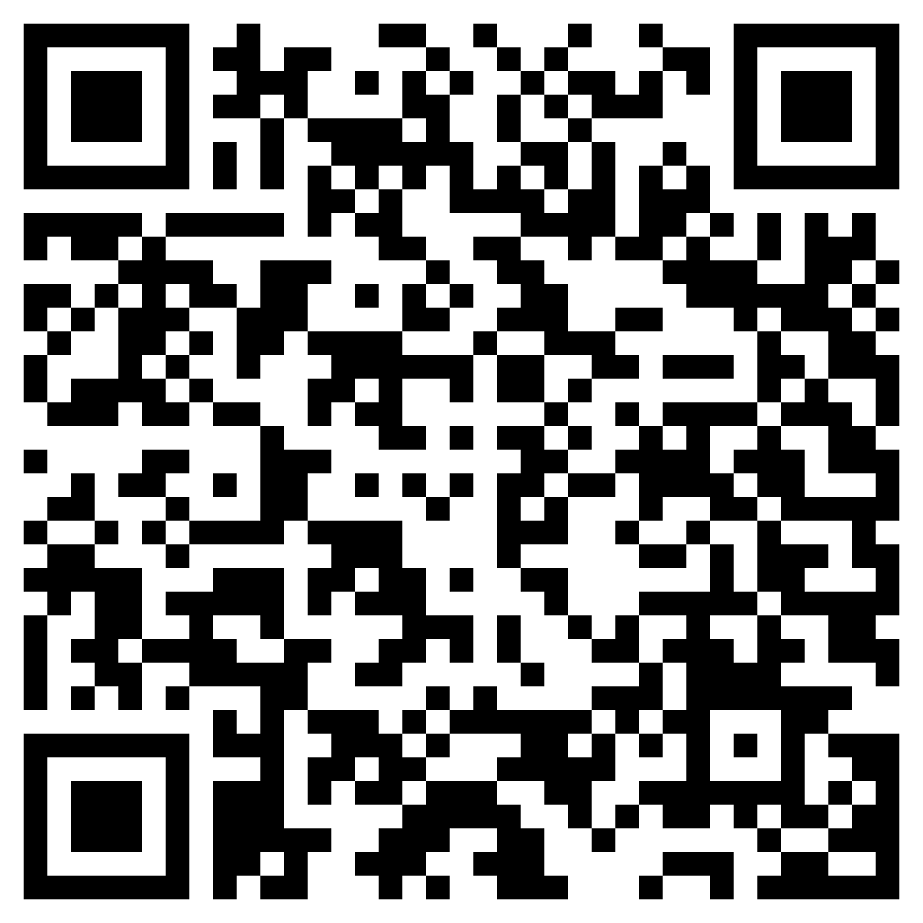
Join Recruiting!
If you are interested in helping our unit recruit new cadets, join the recruiting team.
If you would like to go out to schools and help boost our unit numbers and have the opportunity to earn the recruiting ribbon, scan the QR code provided.
Any questions, please contact C/ TSgt Princess Tolbert at 4804191858@students.ocps.net or (407) 259-7171.

Slide 9
StellarXplorers
StellarXplorers is having a practice this Thursday 14 September in room 950. Everyone is welcome to attend.
Questions, comments, concerns, contact C/SMSgt Anthony Torres at (775) 544-0842 or 4806810625@studnets.ocps.net

Slide 10
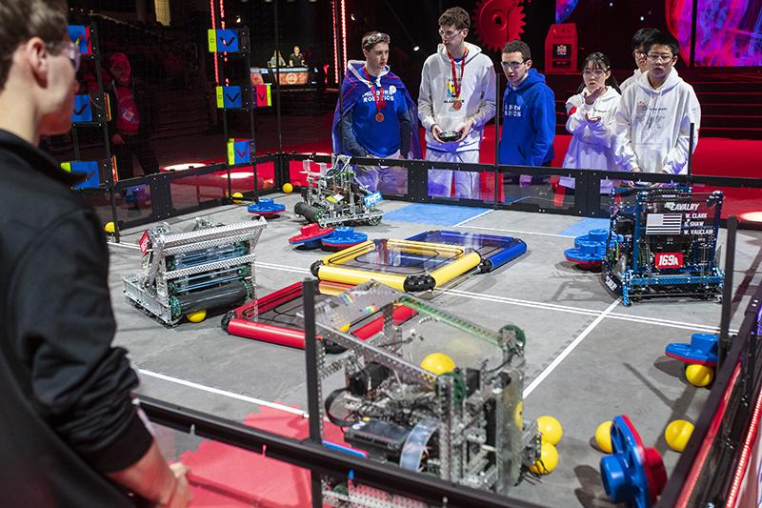
Robotics
Are you interested in engineering, robotics, or programming? Join the robotics LDR. For more information join Remind @fl802rec
Questions, comments, concerns, contact C/SMSgt Anthony Torres at (775) 544-0842 or 4806810625@studnets.ocps.net

Slide 11
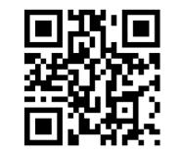
Logistics Appointment Schedule
New 2023-2024 Logistics appointment link
Logistics Appointment Form:
Monday: 1420-1500
Tuesday: 1420-1500
Thursday: 1420-1500
https://tinyurl.com/FL-802LSS
Questions, comments, concerns, contact C/SMSgt Anthony Torres at (775) 544-0842 or 4806810625@studnets.ocps.net

Slide 12
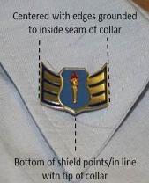
Weekly Uniform Reminder
Grade insignia are worn on both left and right collar, centered side to side and top to bottom. The bottom point of the torch should point to the tip of the collar.

Slide 13
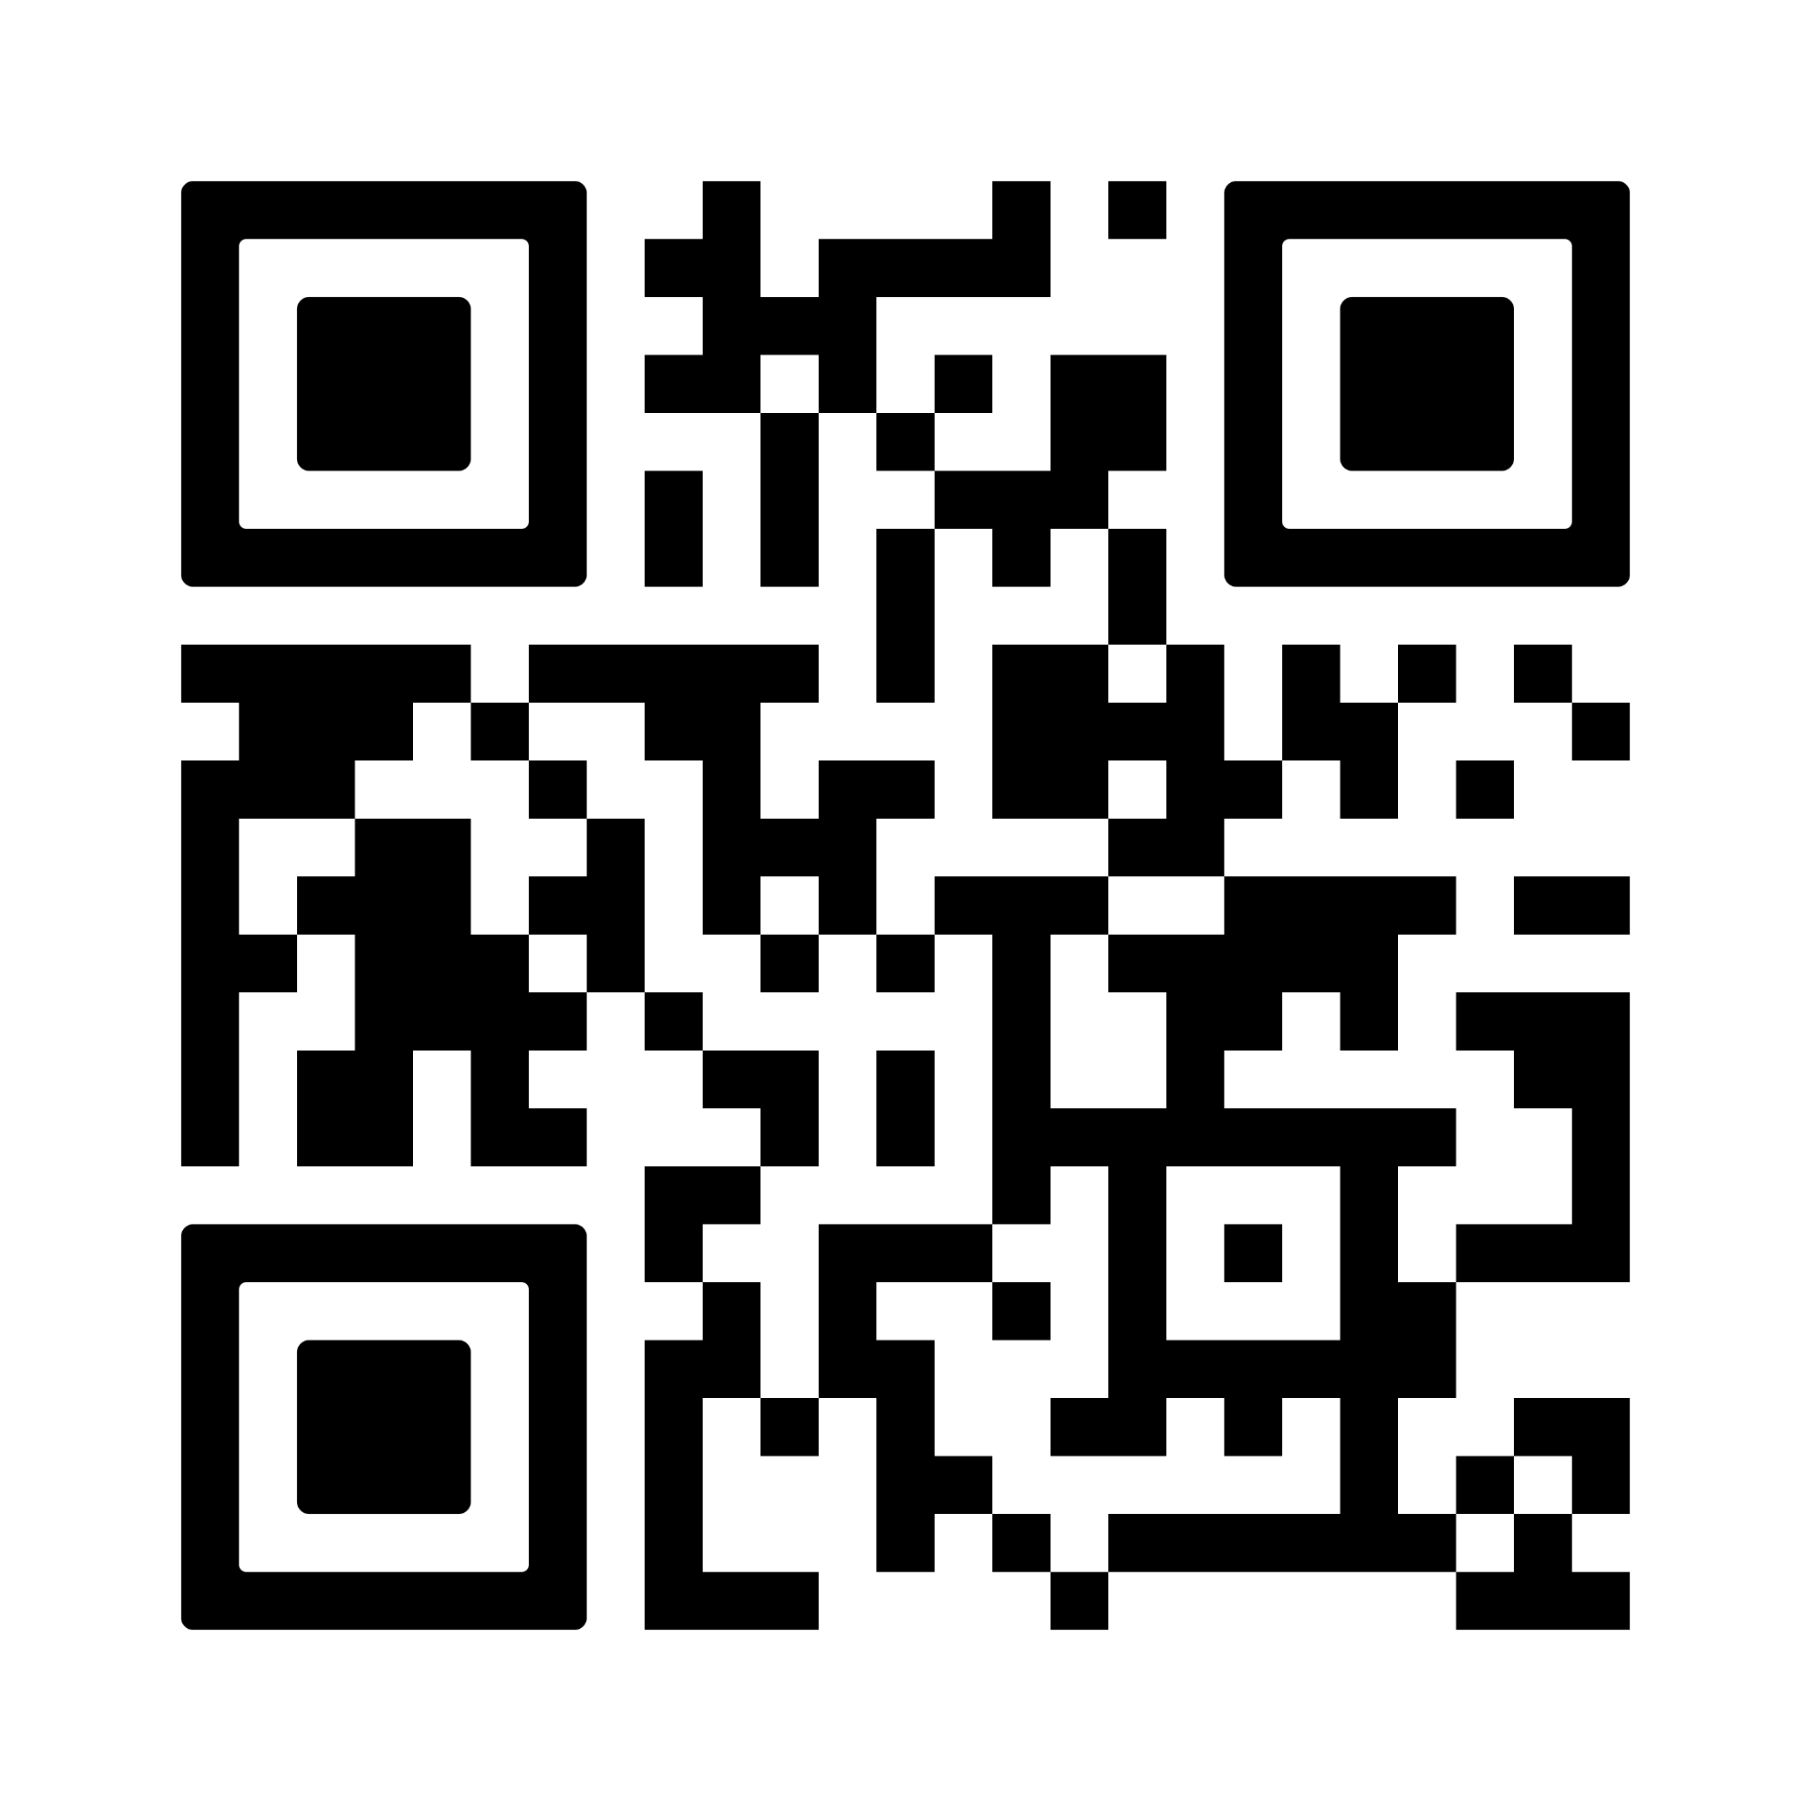
PT Makeups
Sign up here for the PT makeups or on Canvas
https://tinyurl.com/PT2324
For any questions, comments or concerns contact C/SSgt Michael Romeu @4804278080@students.ocps.net and/ or 407-790-9996
Meet at the 900 building in PT gear by 1430. I won't wait for you, Be on time
Message me if you can’t make it.

Slide 14
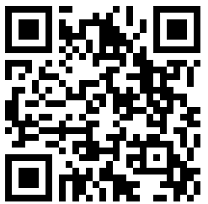
PT Rope
FLIGHT COMMANDERS!
Open the link below to fill out the form to recognize a cadet in your flight for the outstanding qualities shown for September’s PT! The winner will receive the illustrious PT rope and a merit.
https://tinyurl.com/ptcadetofthemonth
If you have any questions, or concerns please contact C/SSgt Michael Romeu @4077909996 or 4804278080@students.ocps.net
SEND PICTURES TO C/LOPEZ (321)-440-7611

Slide 15
August Gold Rope
Flight commanders! Fill out this form for the gold rope for the month of August. Nominate your best 1st year and upperclassman cadets!
Google Form: https://tinyurl.com/GoldRope
Any Questions? Contact C/Lopez at 4804132471@students.ocps.net or (321)440-7611
QR Code

Slide 16
Merit Incentives
When a cadet goes above and beyond in the proceedings of the unit, they are awarded with merits, which heavily weigh in to national award selection and group staff consideration. Those with the largest amount of merits will be rewarded.
Top 5 Cadets: Quarterly
Top Flight: Semesterly
Top Performer: Semesterly

Slide 17
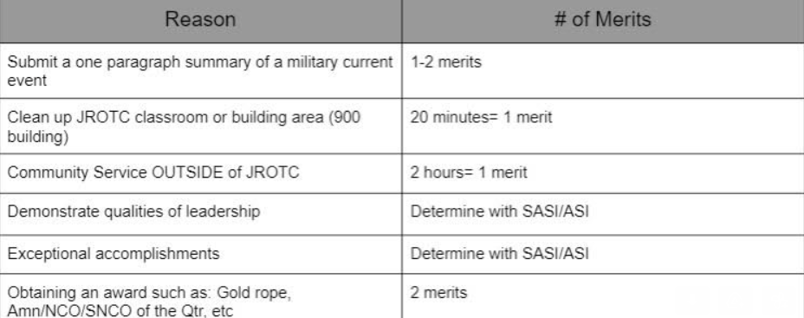
Merit Chart

Slide 18
Military Knowledge
What two groups create the Legislative Branch?
The Senate and the House of Representatives

Slide 19
Summary
Upcoming Events
Orlando Lakes Cleanup (9/16)
Football Parking (9/22)
Notes
Logistics Appointment Schedule
Recruiting
StellarXplorers
Robotics
PT Makeups
PT Rope
Gold Rope

Slide 20
Briefing Slides
If you have a slide for the briefing, contact C/ Cruz-Garcia at 4804173126@students.ocps.net
If you want something in the briefing, you must contact C/Cruz-Garcia by Monday 1700 for the Tuesday brief and Wednesday 1700 for the Thursday brief

