Slide 1
West Orange FL-802
Semi-Weekly Brief
C/ Staff Sergeant Eliud Cruz-Garcia
7 September 2023
Lead,
Serve,
Dream
Unit Motto:

Slide 2
AFJROTC Mission
Develop citizens of character dedicated to serving their nation and community
Mission:
Goals:
Instill Values Of Citizenship,
Service To The United States,
Personal Responsibility/Sense Of Accomplishment

Slide 3
Chain of Command
Commander in Chief:
Sec Def:
Sec AF:
CSAF:
AETC CC:
AU CC:
Holm Center CC:
Director, AFJROTC:
SASI:
Group CC:
Deputy Group CC:
President Joseph R. Biden Jr.
Honorable Lloyd Austin
Honorable Frank Kendall
Gen Charles Q. Brown Jr.
Lt. Gen Brian S. Robinson
Lt. Gen Andrea D. Tullos
Brig Gen Houston R. Cantwell
Col Johnny R. McGonigal
Lt. Colonel Michael Carrizales
C/ Major Aidan Bernhard
C/ 1st Lieutenant Antonio Torre

Slide 4
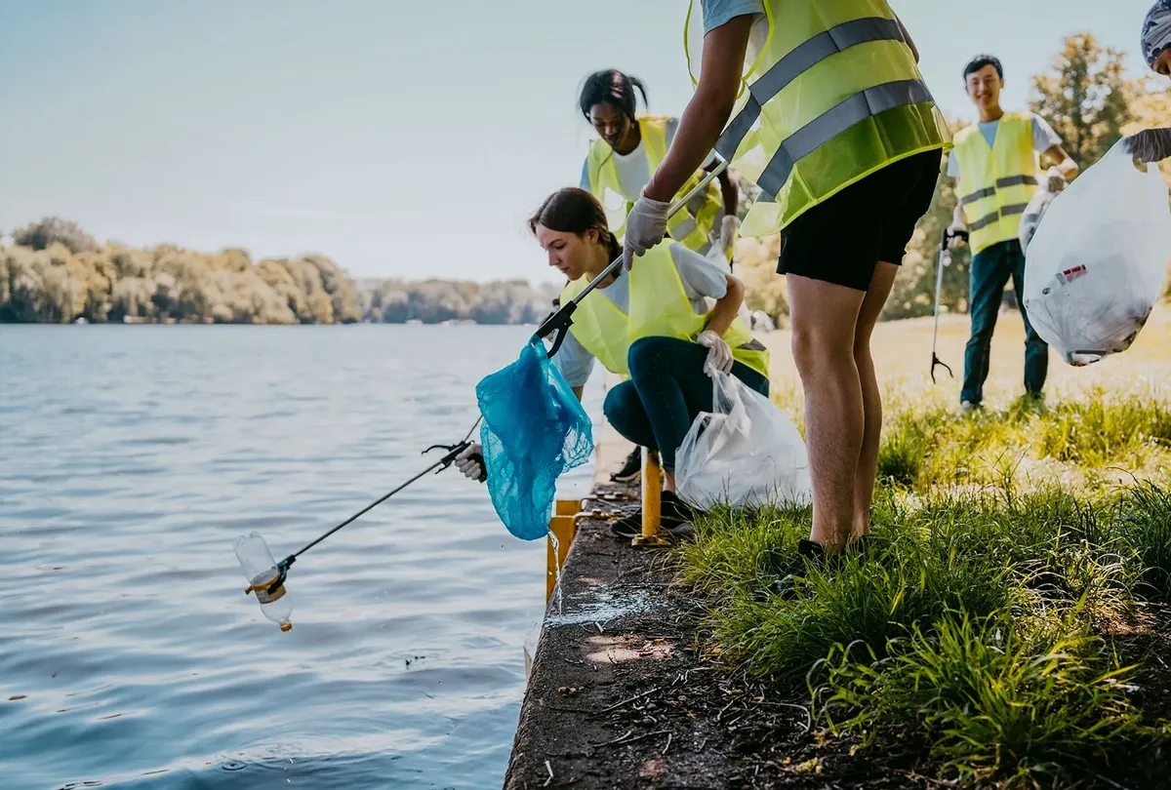
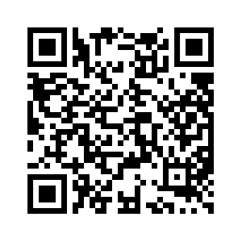
Community Service Event: Orlando Lakes Cleanup
Want to help clean up your community while earning community service hours? The organization Keep Orlando Beautiful is hiring volunteers to help clean up lakes in Orlando-and you have the opportunity to help them out on their mission.
Time: 1000 – 1200
Date: Saturday, September 16th
Where: Eagles Nest Park (5165 Metrowest Blvd)
If you wish to participate in this event, you must register as a volunteer with Orlando Cares. Scan the QR code to the right for more info on the event as well as a link to registration.
Please tell SMSgt Spencer if you are attending so we know how many people wish to attend.
If you have any questions, or need help with registration, contact C/ David Adepeju at 4806861837@students.ocps.net

Slide 5
Community Service Event: AG Cleanup
Who: Our Cadet Corps and FFA
What: Helping cleaning up the AG area
When: 10th Sept. 11-2 PM
Where: AG Building
Why:To help out our FFA move things and clean around.
Sign up:On the paper!
If you would like to be CIC, please contact C/Bernhard @ (407) 408-6158

Slide 6
Kitty Hawk Honor Society Meeting
Kitty Hawk meeting TODAY 7 September 1430-1530 in room 950!
For any further details, please contact C/ 2nd Lt. Sara Mattox at (407) 242-3829 or 4804154679@students.ocps.net

Slide 7
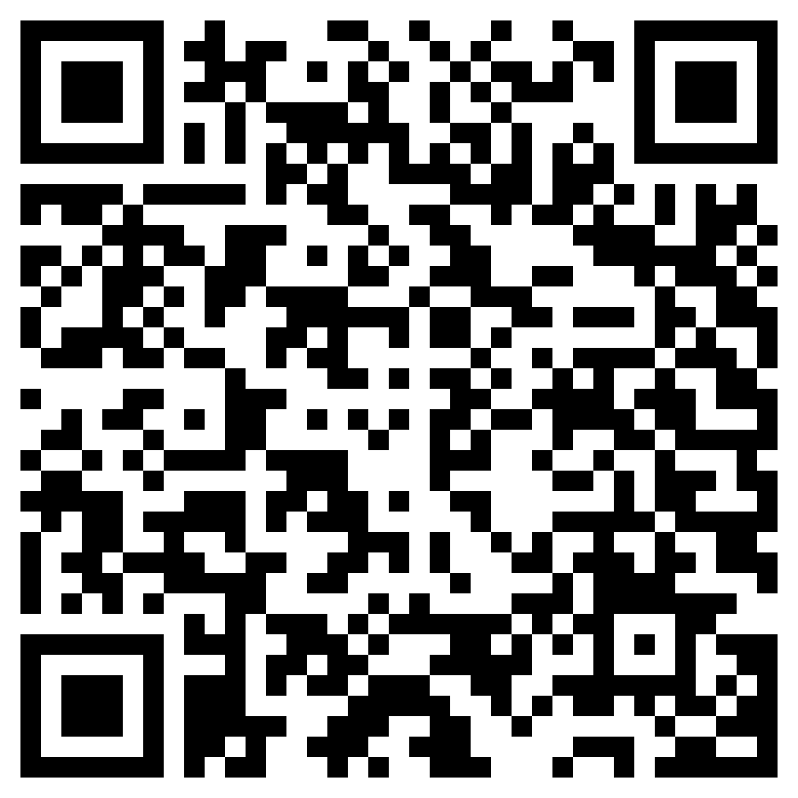
Join Recruiting!
If you are interested in helping our unit recruit new cadets, join the recruiting team.
If you would like to go out to schools and help boost our unit numbers and have the opportunity to earn the recruiting ribbon, scan the QR code provided.
Any questions, please contact C/ TSgt Princess Tolbert at 4804191858@students.ocps.net or (407) 259-7171.

Slide 8
StellarXplorers
StellarXplorers is a competition based LDR (club) that focuses on real world aerospace problems. This LDR is a great opportunity for anyone wanting to work in the STEM field, lessons and tutoring will be held for anyone willing to participate but is not currently proficient in these topics. If you are interested in more information or would like to participate in StellarXplorers please join Remind: @23-24STLX
Questions, comments, concerns, contact C/SMSgt Anthony Torres at (775) 544-0842 or 4806810625@studnets.ocps.net

Slide 9
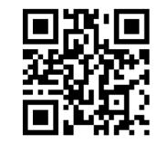
Logistics Appointment Schedule
New 2023-2024 Logistics appointment link
Logistics Appointment Form:
Monday: 1420-1500
Tuesday: 1420-1500
Thursday: 1420-1500
https://tinyurl.com/FL-802LSS
Questions, comments, concerns, contact C/SMSgt Anthony Torres at (775) 544-0842 or 4806810625@studnets.ocps.net

Slide 10
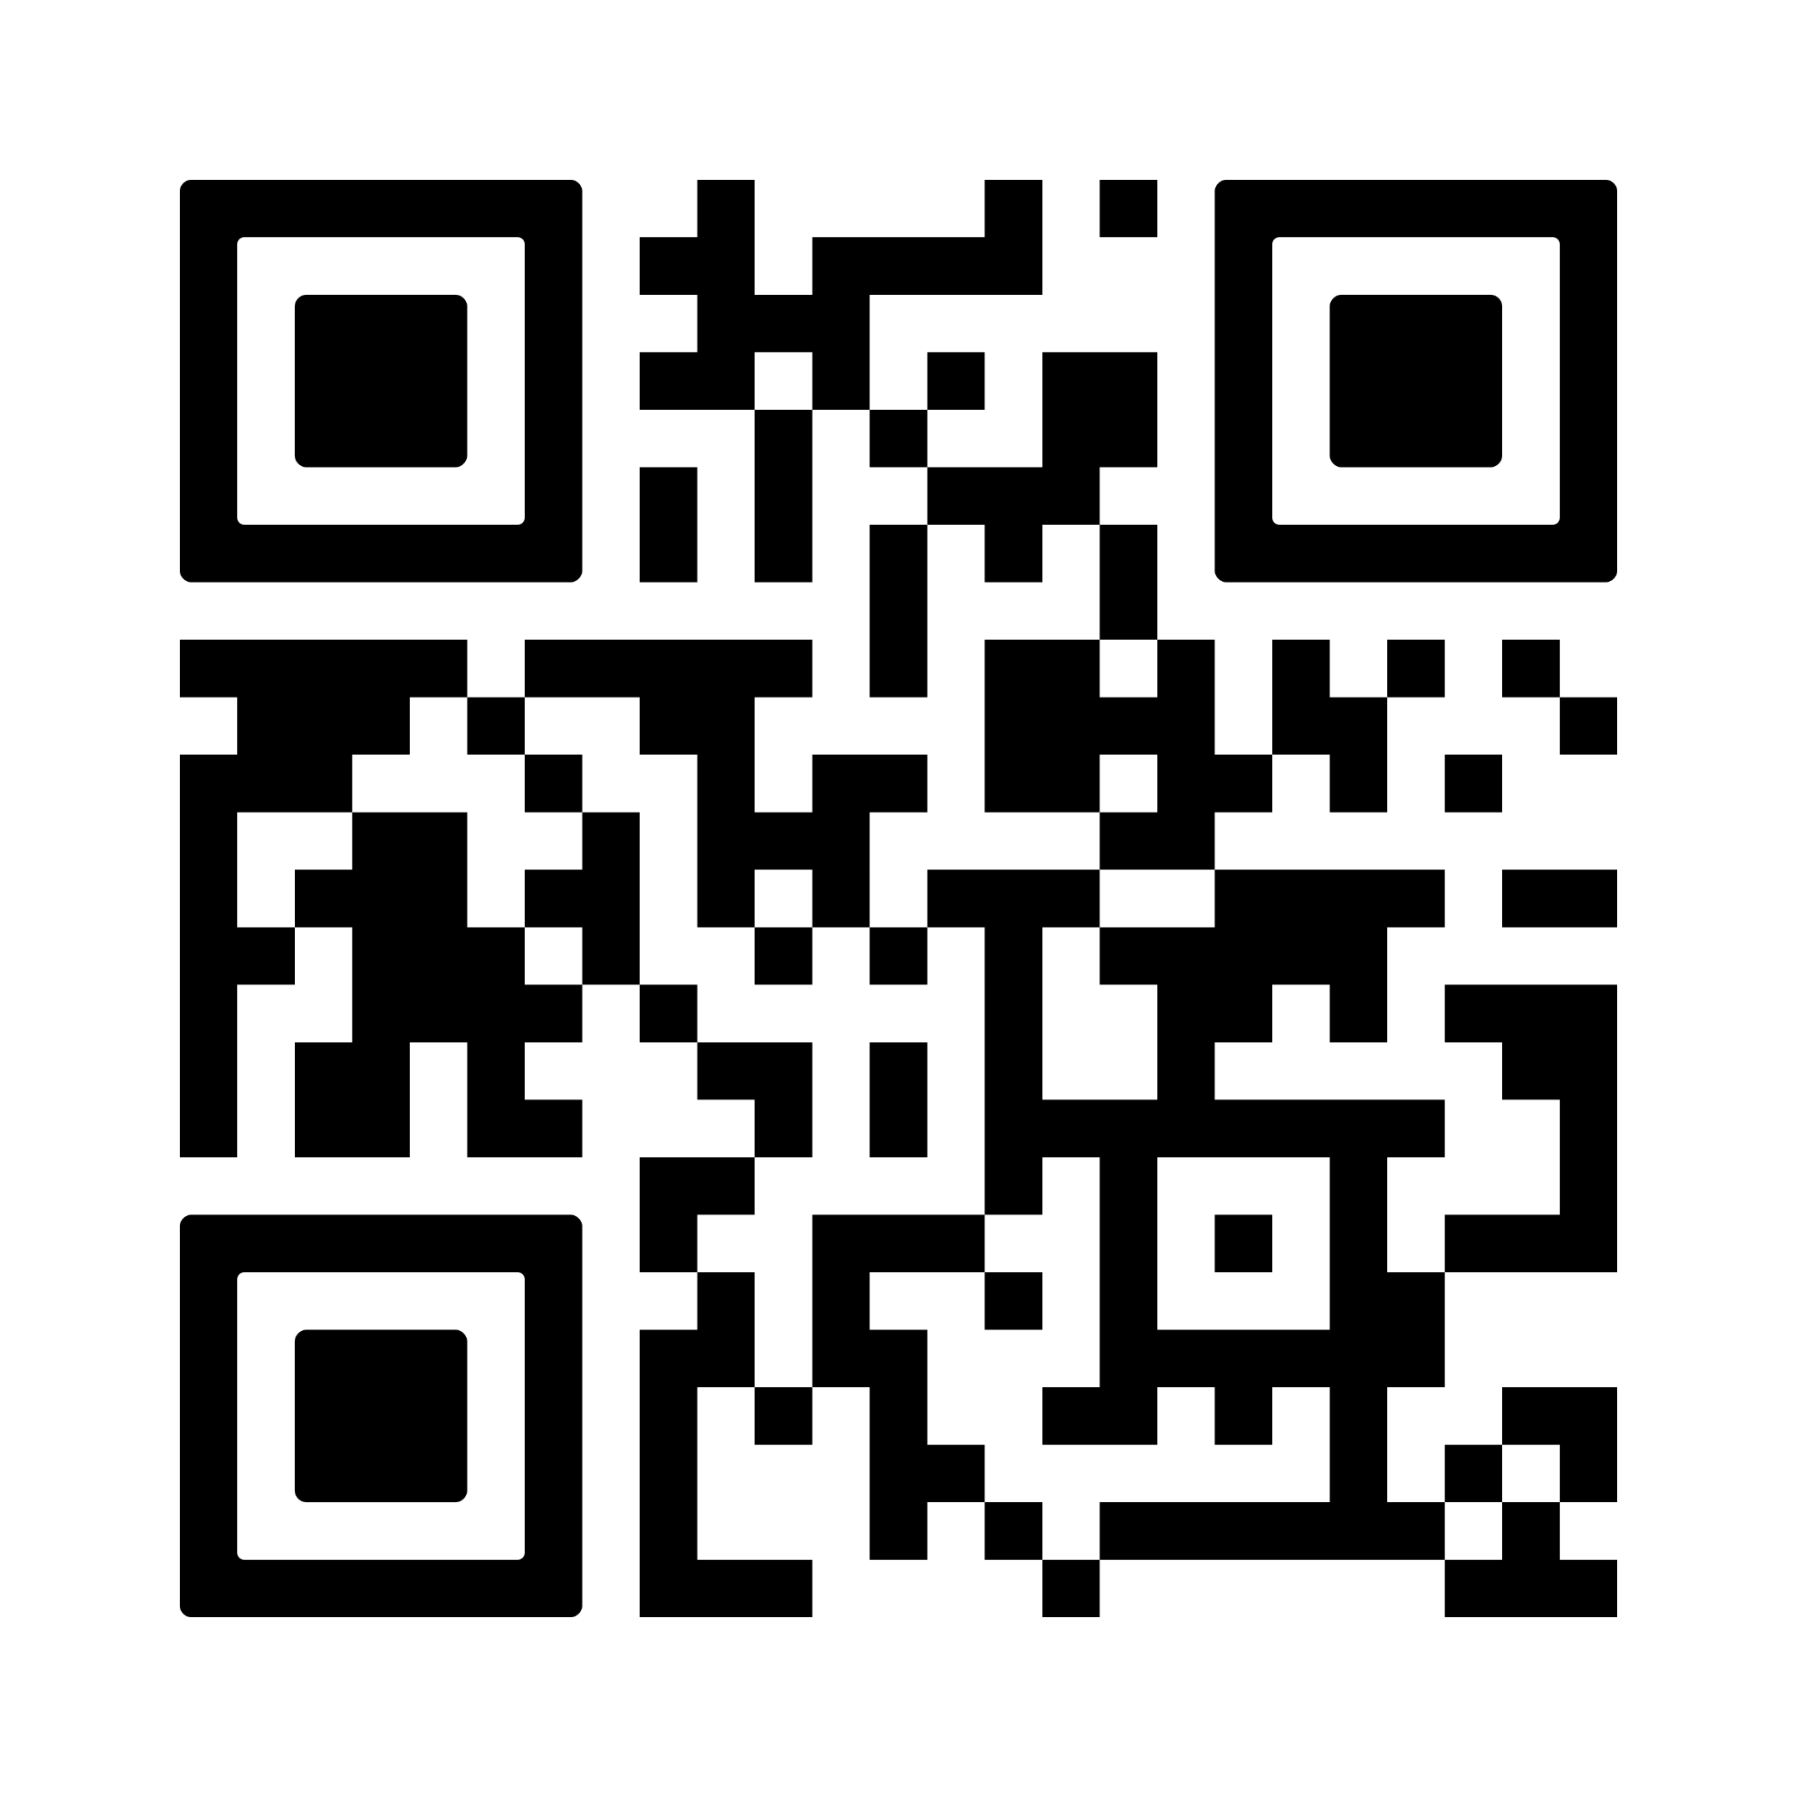
PT Makeups
Sign up here for the PT makeups or on Canvas
https://tinyurl.com/PT2324
For any questions, comments or concerns contact C/SSgt Michael Romeu @4804278080@students.ocps.net and/ or 407-790-9996
Meet at the 900 building in PT gear by 1430. I won't wait for you, Be on time
Message me if you can’t make it.

Slide 11
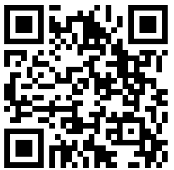
PT Rope
FLIGHT COMMANDERS!
Open the link below to fill out the form to recognize a cadet in your flight for the outstanding qualities shown for September’s PT! The winner will receive the illustrious PT rope and a merit.
https://tinyurl.com/ptcadetofthemonth
If you have any questions, or concerns please contact C/SSgt Michael Romeu @4077909996 or 4804278080@students.ocps.net
SEND PICTURES TO C/LOPEZ (321)-440-7611

Slide 12
August Gold Rope
Flight commanders! Fill out this form for the gold rope for the month of August. Nominate your best 1st year and upperclassman cadets!
Google Form: https://tinyurl.com/GoldRope
Any Questions? Contact C/Lopez at 4804132471@students.ocps.net or (321)440-7611
QR Code

Slide 13
Merit Incentives
When a cadet goes above and beyond in the proceedings of the unit, they are awarded with merits, which heavily weigh in to national award selection and group staff consideration. Those with the largest amount of merits will be rewarded.
Top 5 Cadets: Quarterly
Top Flight: Semesterly
Top Performer: Semesterly

Slide 14
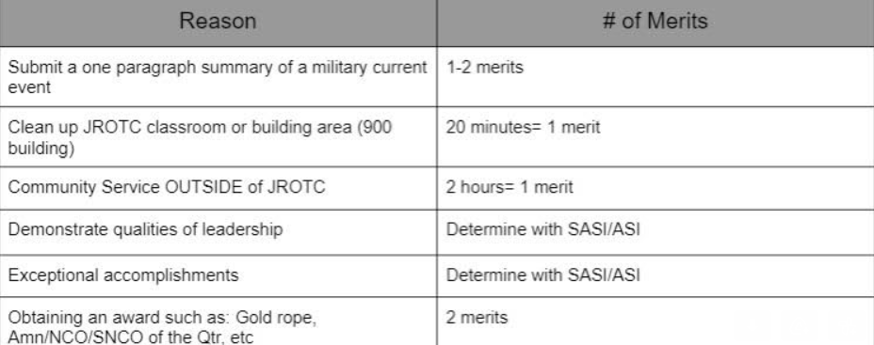
Merit Chart

Slide 15
Chief’s Quote of the Week
"Life is 10% what happens to you and 90% how you react to it."
– Charles R. Swindoll

Slide 16
Military Knowledge
Who is the governor of Florida?
Governor Ron DeSantis

Slide 17
Summary
Upcoming Events
Kitty Hawk Honor Society (9/7)
Orlando Lakes Cleanup (9/16)
Notes
Logistics Appointment Schedule
Recruiting
Honor Guard
StellarXplorers

Slide 18
Briefing Slides
If you have a slide for the briefing, contact C/ Cruz-Garcia at 4804173126@students.ocps.net
If you want something in the briefing, you must contact C/Cruz-Garcia by Monday 1700 for the Tuesday brief and Wednesday 1700 for the Thursday brief

