Slide 1
West Orange FL-802
Semi-Weekly Brief
C/ Staff Sergeant Eliud Cruz-Garcia
5 October 2023
Lead,
Serve,
Dream
Unit Motto:

Slide 2
AFJROTC Mission
Develop citizens of character dedicated to serving their nation and community
Mission:
Goals:
Instill Values Of Citizenship,
Service To The United States,
Personal Responsibility/Sense Of Accomplishment

Slide 3
Chain of Command
Commander in Chief:
Sec Def:
Sec AF:
CSAF (Acting):
AETC CC:
AU CC:
Holm Center CC:
Director, AFJROTC:
SASI:
Group CC:
Deputy Group CC:
President Joseph R. Biden Jr.
Honorable Lloyd Austin
Honorable Frank Kendall
Gen David Allvin
Lt. Gen Brian S. Robinson
Lt. Gen Andrea D. Tullos
Brig Gen Houston R. Cantwell
Col Johnny R. McGonigal
Lt. Colonel Micheal Carrizales
C/ Major Aidan Bernhard
C/ 1st Lieutenant Antonio Torre

Slide 4
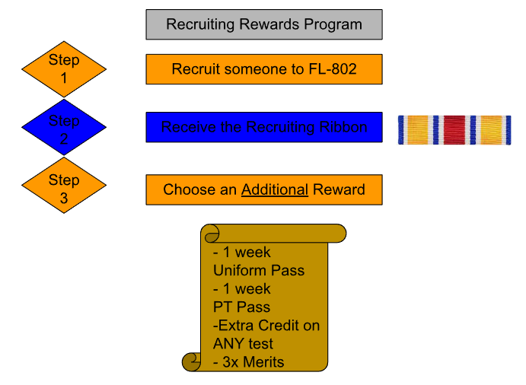
Recruiting
Possible Reasons:
No 1st yr uniforms
LDRs (Drill/Raiders)
Scholarships
Air Force Ball
Community Service hrs
Unit Picnic
Field Day
Sports Days

Slide 5
Recruiting (Contd..)
Cadets in groups of 2-4 are recruiting during A and B lunches. We greatly need help doing so!
If you would like to help, please contact C/ Tolbert at 407-259-7171 (B Lunch) or C/ Motta at 407-202-9362 (A Lunch) for more information.

Slide 6
Kitty Hawk Honor Society Meeting
Kitty Hawk meeting TODAY 5 October 1730-1830 on MICROSOFT TEAMS!
For any further details, please contact C/ 2nd Lt. Sara Mattox at (407) 242-3829 or 4804154679@students.ocps.net

Slide 7
Athletic Clearance
These Cadets below are missing the Athletic Clearance:
Aguilar - Bravo Mezime - Delta
Bermudez - Alpha Osoria - Charlie
Ceballos - Charlie Palacios - Foxtrot
Damuth - Alpha Parboo - Alpha
DeSilva - Charlie Pokras - Delta
Doyle - Alpha Rosario - Delta
Hibbert - Foxtrot Vazquez - Charlie
Madera - Bravo Weidner - Alpha
https://athleticclearance.fhsaahome.org/

Slide 8
PT Makeups
Sign up here for the PT makeups or on Canvas
https://tinyurl.com/PT2324
For any questions, comments or concerns contact
C/SSgt Michael Romeu @4804278080@students.ocps.net and 407-790-9996
Meet at the 900 building in PT gear by 1430. I won't wait for you, Be on time
Thursday’s Only, Contact me if this does not work for you

Slide 9
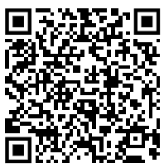
Special Olympics
Central Region Golf Competition
Time: 0700 to 1330
Date: Sunday, October 22, 2023
Where: Wedgefield Golf Club, 20550 Maxim Pkwy, Orlando, FL 32833
If you wish to participate in this event please sign up by October 12th so we can have the final headcount by October 13th. Lunch will be provided by the special olympics team. It is recommended that you bring a hat, bug spray, water bottle, and sunscreen. Please wear combo 4 (PT gear) and closed toed shoes
Please sign up here as well as the paper sign up sheet in
class. https://forms.gle/aiuoVF5ij9rz4EsG7
CIC needed for event
If you have any questions please contact C/ Vanessa Maloney @321-318-2929

Slide 10
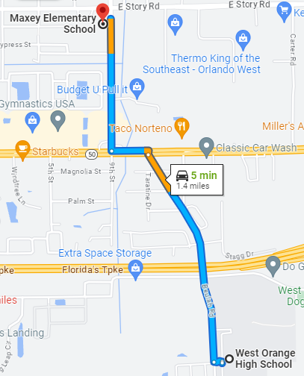
Maxey Elementary Fall Festival
October 26th, 4pm – 8pm
You will be assigned to work on concessions, parking, games, or teacher assistance
If there is enough signups, it can be divided into two shifts.
One shift = 10 – 15 volunteers (4 hours)
OR
Two shifts = 20 – 30 volunteers (2 hours)
602 E Story Rd, Winter Garden, FL 34787
For any questions, comments, or concerns, please contact
C/SrAmn Kei Seddon @ 321-888-1698

Slide 11
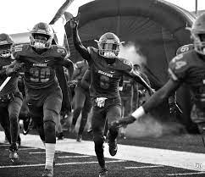
Football Parking
Time: 16:30 to 19:30
When: 13th, October
Where: Room 950(Colonel’s Room)
Uniform: COMBO 5
(you can only go if you have combo 5)
If you would like to be CIC, please contact C/Bernhard at +1(407) 408-6158

Slide 12
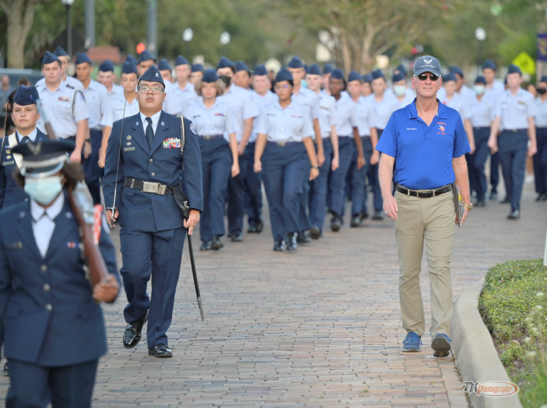
Homecoming Parade
March with us for the Homecoming Parade!
Time: 10 October at 1630 hours
Location: Downtown Winter Garden (Parking lot at 63 S Woodland St)
Uniform: Combination 1 (Blues without the tie/tie tab; REQUIRED)
Lead the parade, and represent the unit, and school, well!
Sign up in room 950.
Please Contact C/Maj. Bernhard at +1(407) 408-6158 if you would like to be CIC for this event.

Slide 13
Gold Rope Recipients
Congratulations to Cadets Hayden Dalton and Vanessa Maloney on earning the Gold Rope!
Make sure to congratulate them when you see them!

Slide 14
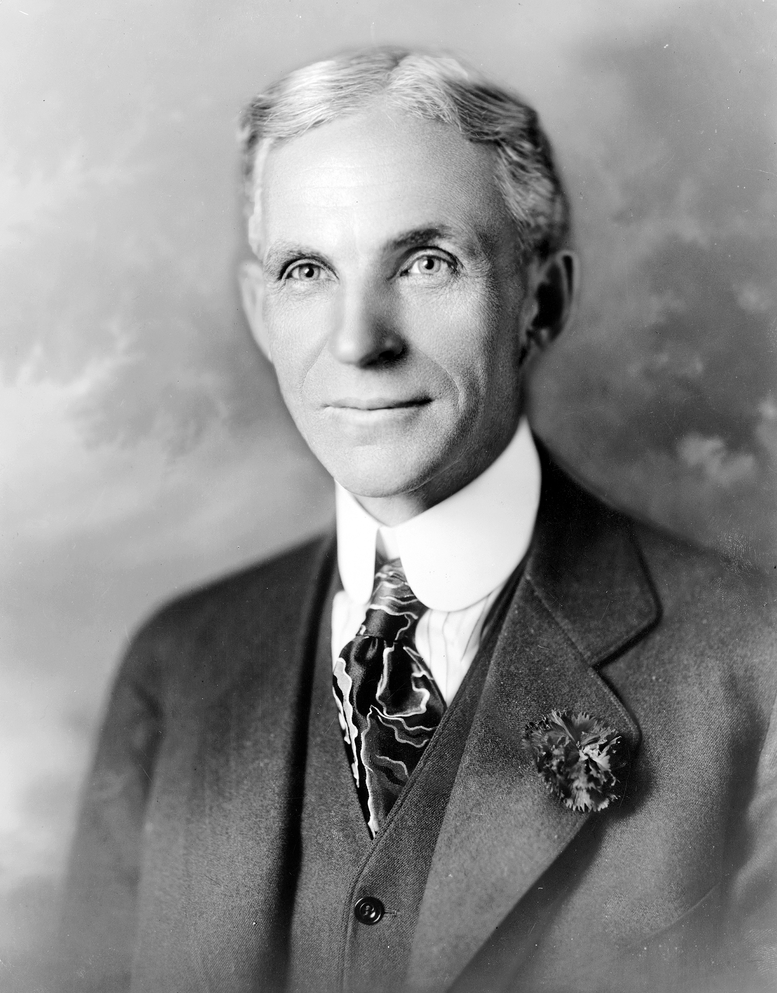
Commander’s Quote
“When everything seems to be going against you, remember that the airplane takes off against the wind, not with it.” - Henry Ford

Slide 15
Military Knowledge
From where did the U.S. Air Force originate?
The U.S. Army Air Corps

Slide 16
Summary
Upcoming Events
KHHS Meeting (10/5)
Homecoming Parade (10/10)
Football Parking (10/13)
SOCRGC (10/22)
Maxey Fall Festival (10/26)
Notes
Recruiting
Athletic Clearances
Gold Rope
Commander’s Quote

Slide 17
Briefing Slides
If you have a slide for the briefing, contact C/ Cruz-Garcia at 4804173126@students.ocps.net
If you want something in the briefing, you must contact C/ Cruz-Garcia by Monday 1700 for the Tuesday brief and Wednesday 1700 for the Thursday brief

