Slide 1
West Orange FL-802
Semi-Weekly Brief
C/ Technical Sergeant Daphne Bray
5 March 2024
Lead,
Serve,
Dream
Unit Motto:

Slide 2
AFJROTC Mission
Develop citizens of character dedicated to serving their nation and community
Mission:
Goals:
Instill Values Of Citizenship,
Service To The United States,
Personal Responsibility/Sense Of Accomplishment

Slide 3
Chain of Command
Commander in Chief:
Sec Def:
Sec AF:
CSAF:
AETC CC:
AU CC:
Holm Center CC:
Director, AFJROTC:
SASI:
Group CC:
Deputy Group CC:
President Joseph R. Biden Jr.
Honorable Lloyd Austin
Honorable Frank Kendall
Gen David Allvin
Lt. Gen Brian S. Robinson
Lt. Gen Andrea D. Tullos
Brig Gen Houston R. Cantwell
Col Johnny R. McGonigal
Lt. Colonel Micheal Carrizales
C/ Captain Agrafena Ritz
C/ Major Elias Lopez

Slide 4
Athletic Clearance
These Cadets below are missing the Athletic Clearance:
https://athleticclearance.fhsaahome.org/
Alpha | Bravo | Charlie | Delta | Foxtrot | Golf
Bermudez | Wilson | Benzakour | Busteros | Palacios | Funk
Doyle |  | DelSilva | Goldstein
Saint-Franc |  | Vasquez | Mezime
 |  |  | Rosario
 |  |  | Sanichar

Slide 5
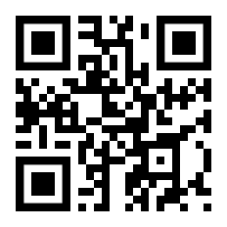
PT Makeups
Sign up here for the PT makeups or on Canvas
https://tinyurl.com/PT2324
For any questions,please contact C/A1C Ayana Putigna @4804185464@students.ocps.net
Meet at the 900 building in PT gear by 1430. Thursdays only.

Slide 6
Vertical Raise Fundraiser
We are going to have a Vertical Raise Fundraiser 11-29 March. Last year we made $10,992! We need some cadets to make a video like this one!
Cadet Coutray will be making the video TODAY after school! Please reach out to her to assist!
Also, please pick up a corporate sponsor form in room 950. Take the form to a business that might be willing to sponsor us!
Lastly, don’t forget to collect 20 emails for Monday! You’ll send out emails to family and friends for donations on Monday
For any questions, please contact C/ Coutray @4806859941@students.ocps.net or 703-397-7978

Slide 7
Group Commander Workshop
There is going to be a group commander workshop for those who applied to be group commander TOMORROW 1330-1430 in room 930.
You will have the opportunity to learn how to interview, build a resume, and make a strategic plan.
If you’re interested in applying to be the group commander or even a job at any point it’s highly recommended that you attend.
For any questions or concerns please contact C/Elias Lopez at 4804132471@students.ocps.net or (321) 440-7611

Slide 8
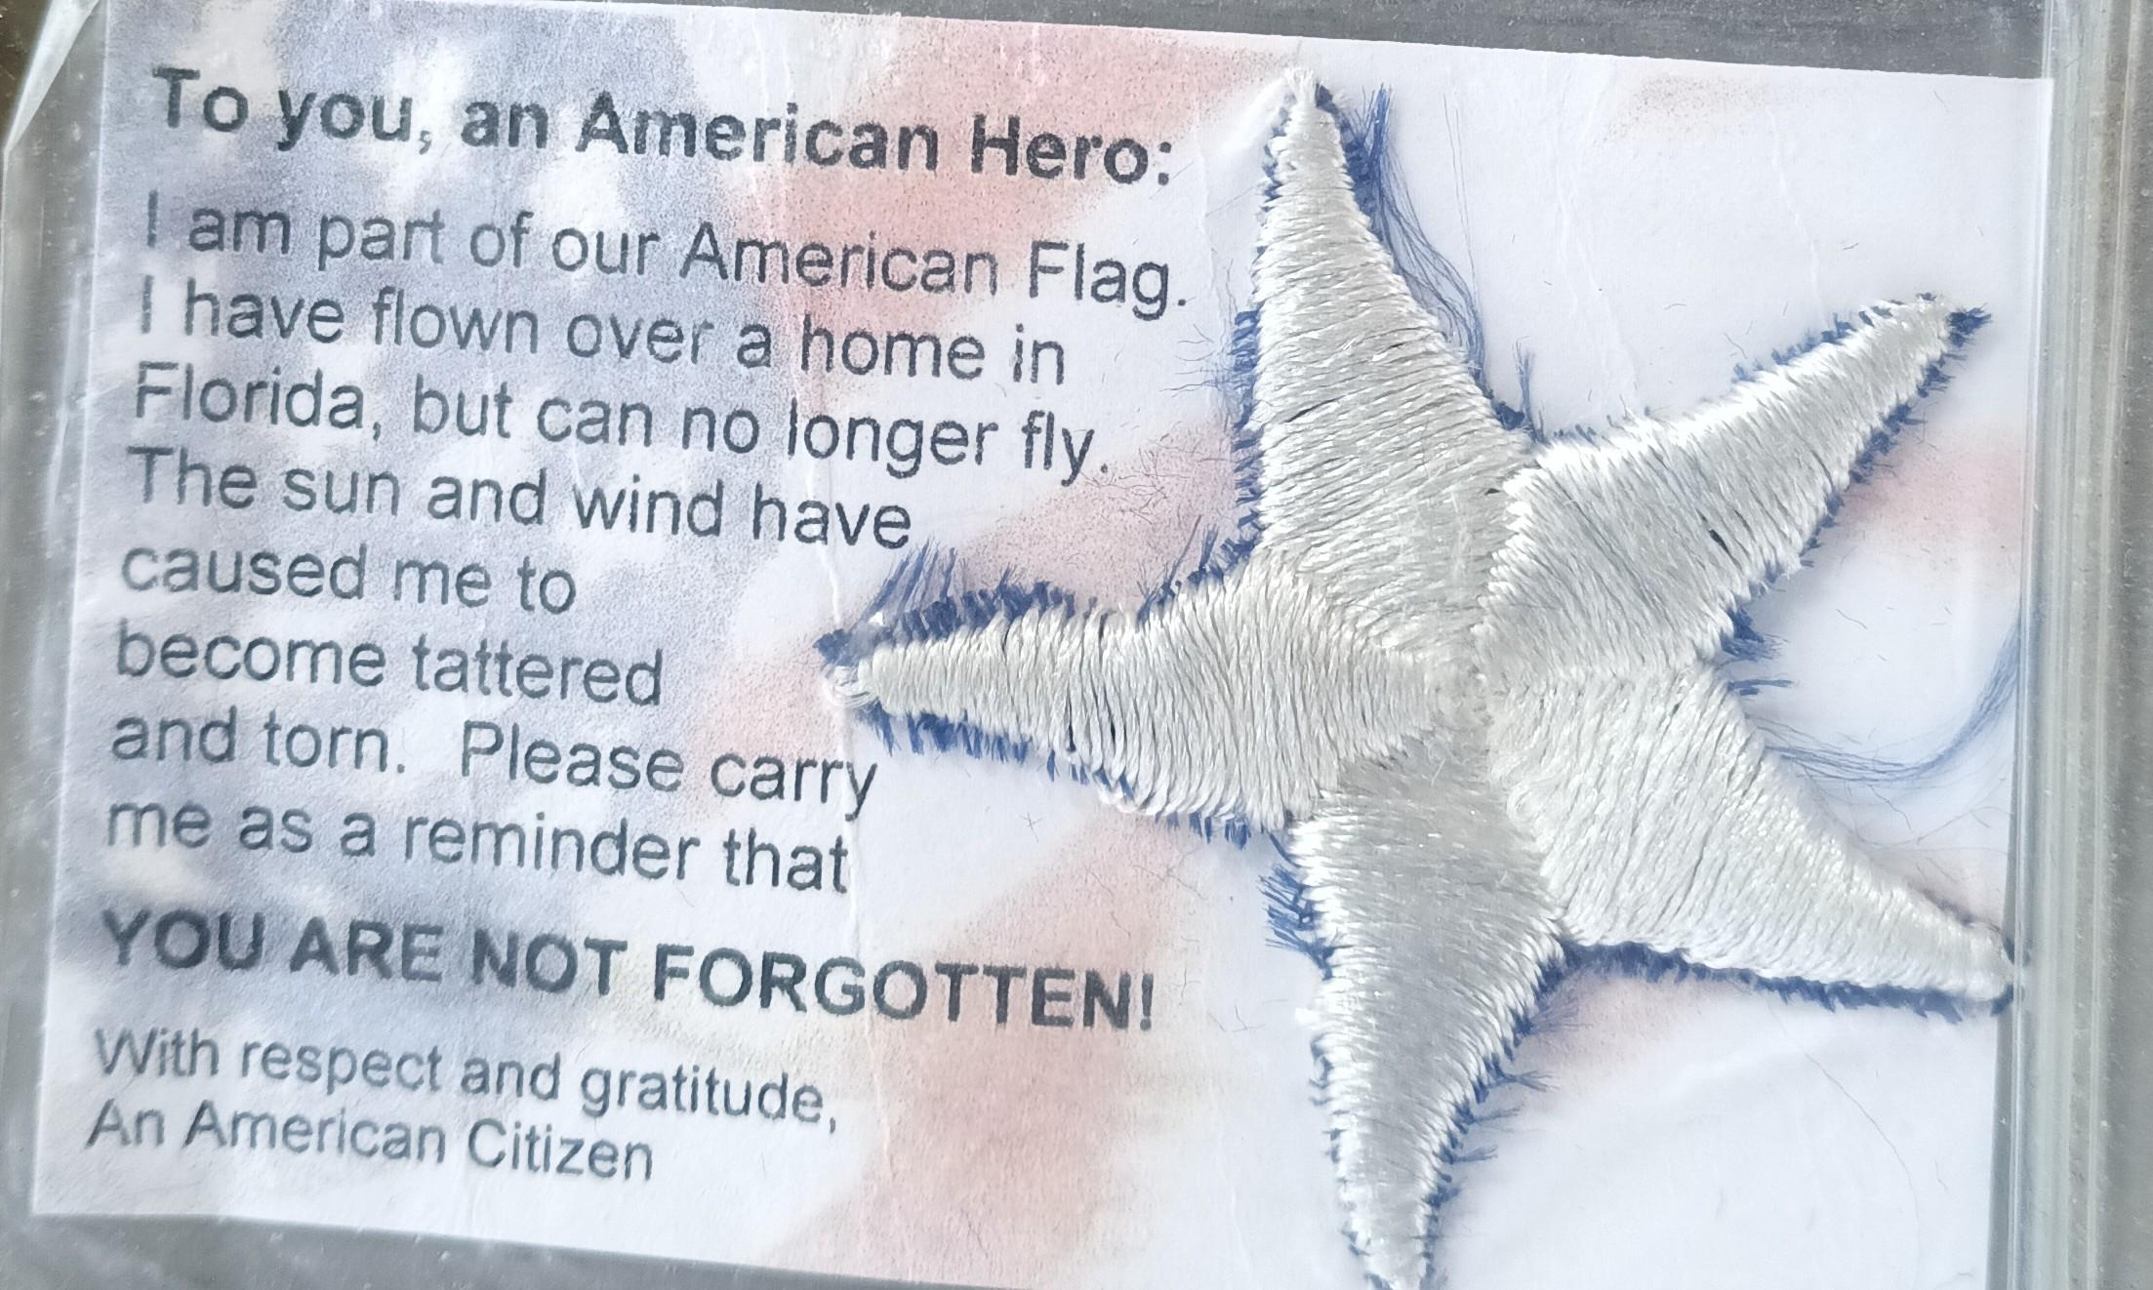
American Veterans Appreciation Service:
Project AVAS is a community service opportunity designed to show our veterans that we appreciate the sacrifices they have made. Cadets will cut out stars from our unserviceable flags. Afterwards return the stars in a ziploc bag to room 950. these stars will then be processed with cards and be given to the Veterans Administration Building for distribution. (Dates of collection: March 13th/15th.
6 Stars = (1 Community Service Hour)
18 Stars = (3 Community Service Hours)
For any questions, comments or concerns please contact
Cadet Tech/Sgt Mincel via student email or text. (Business Purposes Only!)
E-Mail: 4806822834@students.ocps.net Text: (689-276-0745)

Slide 9
ABU turn-in
If you were on the drill team and you have ABUs please turn them in by Wednesday, 6 March. Failing to turn in your ABUs will have an impact on your uniform inspection grade and your promotion opportunity. You can bring it in before school.
ABU pants
ABU blouse
Hat
Belt
Boots

Slide 10
Track and Field Event
Community Service Opportunity
Cadets are needed to work at the bus loop from 1500 hrs to 2000 hrs on Friday, 8 March. You can choose to work the entire 5 hours or work in shifts as long two cadets are covering the entire shift. A CIC is needed as well. In the meantime, contact C/TSgt Lil Motta if you’re interested.
Gabriel Motta 4804175879@students.ocps.net

Slide 11
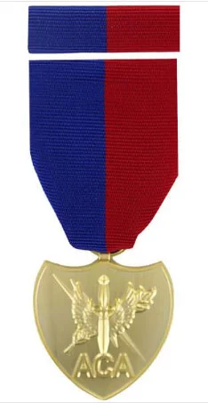
Air Commando Association Award
This award is presented annually to one cadet who most closely exemplifies the 13 critical attributes of success for Air Commandos. An essay submission is required if you’re interested in receiving the award. Please see the announcement on Canvas for more details.
Due 13 March 2024
*email your essay to micheal.carrizales@ocps.net

Slide 12
American Legion Bingo Nights
SIGN UP (QUICKLY) ON THE BOARD!!
American Legion Post 63 hosts Bingo Nights every Monday from 1730-2130 and would love help!
Consists of making and serving food, taking orders, or handing out bingo cards
Maximum of three cadets are needed per Monday
If you have any questions, comments, or concerns, please contact C/ TSgt Gabriel Motta at 4804175879@students.ocps.net or 407-202-9362. The CIC must also contact him for information.

Slide 13
Bus Loop Monitoring
The athletic department requests four cadets to monitor the bus loop:
Date: Friday, 8 March, from 3PM-8PM
Two cadets monitor a 3PM-5:30PM
Two cadets monitor 5:30PM-8PM
If you have any questions, comments, or concerns, please contact C/ TSgt Gabriel Motta at 4804175879@students.ocps.net or 407-202-9362. Please contact him if you would like to be the CIC.

Slide 14
Military Knowledge
What is reveille?
The start of the military day.

Slide 15
Summary
Upcoming Events
Arnold Palmer (3/8-3/10)
American Legion Bingo Nights (3/11)
Notes
Athletic Clearances
PT Makeups
Air Commando Association Award
ABU turn-ins
AVAS
Vertical Raise fundraiser

Slide 16
Briefing Slides
If you have a slide for the briefing, contact C/ Bray at 4804208068@students.ocps.net or (689)-229-0443
If you want something in the briefing, you must contact C/ Bray by Monday 1700 for the Tuesday brief and Wednesday 1700 for the Thursday brief

