Slide 1
West Orange FL-802
Semi-Weekly Brief
C/ Staff Sergeant Eliud Cruz-Garcia
4 May 2023
Lead,
Serve,
Dream
Unit Motto:

Slide 2
AFJROTC Mission
Develop citizens of character dedicated to serving their nation and community
Mission:
Goals:
Instill Values Of Citizenship,
Service To The United States,
Personal Responsibility/Sense Of Accomplishment

Slide 3
Chain of Command
Commander in Chief:
Sec Def:
Sec AF:
CSAF:
AETC CC:
AU CC:
Holm Center CC:
Director, AFJROTC:
SASI:
Group CC:
Deputy Group CC:
President Joseph R. Biden Jr.
Honorable Lloyd Austin
Honorable Frank Kendall
Gen Charles Q. Brown Jr.
Lt Gen Brian S. Robinson
Lt Gen Andrea D. Tullos
Brig Gen Houston R. Cantwell
Col Johnny R. McGonigal
Colonel Stuart Rhoades
C/ Captain Aidan Bernhard
C/ 2nd Lieutenant Antonio Torre

Slide 4
Chief’s Quote of the Week
“The greatest glory in living lies not in never falling, but in rising every time we fall.”
– Nelson Mandela

Slide 5
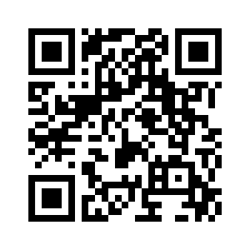
BCT Cadre Application
Sign up to apply to be a Cadre at BCT. It will be held on 24-28 July. Only apply if you will strive to make a positive impact on the incoming freshmen. Applications are open to everyone.
https://tinyurl.com/BCTCadre2324
Any questions? Contact C/ 2nd Lieutenant Antonio Torre at (407)-773-0450 (For awesome epic purposes only)

Slide 6
Flag Detail
Want to help start and end the military day? Join Flag Detail every morning at 0655 and after school to learn how to set up and take down our nations flag!
Earn 5 points and you can receive the respected Patriotic Flag ribbon, as well as community service hours!
0.25 points per reveille/retreat.
0.25 hours of community service per reveille/retreat.
If you have any questions, or concerns please contact C/TSgt Lorenzo Motta @4075678283 BUSINESS PURPOSES ONLY

Slide 7
Military Knowledge
How are the stars arranged on the flag?
4 rows of 5, 5 rows of 6

Slide 8
Summary
Upcoming Events
CLC
BCT
Notes
Flag Detail

Slide 9
Briefing Slides
If you have a slide for the briefing, contact C/ Cruz-Garcia at 4804173126@students.ocps.net
If you want something in the briefing, you must contact C/Cruz-Garcia by Monday 1700 for the Tuesday brief and Wednesday 1700 for the Thursday brief

