Slide 1
West Orange FL-802
Semi-Weekly Brief
C/ Staff Sergeant Eliud Cruz-Garcia
3 October 2023
Lead,
Serve,
Dream
Unit Motto:

Slide 2
AFJROTC Mission
Develop citizens of character dedicated to serving their nation and community
Mission:
Goals:
Instill Values Of Citizenship,
Service To The United States,
Personal Responsibility/Sense Of Accomplishment

Slide 3
Chain of Command
Commander in Chief:
Sec Def:
Sec AF:
CSAF (Acting):
AETC CC:
AU CC:
Holm Center CC:
Director, AFJROTC:
SASI:
Group CC:
Deputy Group CC:
President Joseph R. Biden Jr.
Honorable Lloyd Austin
Honorable Frank Kendall
Gen David Allvin
Lt. Gen Brian S. Robinson
Lt. Gen Andrea D. Tullos
Brig Gen Houston R. Cantwell
Col Johnny R. McGonigal
Lt. Colonel Micheal Carrizales
C/ Major Aidan Bernhard
C/ 1st Lieutenant Antonio Torre

Slide 4
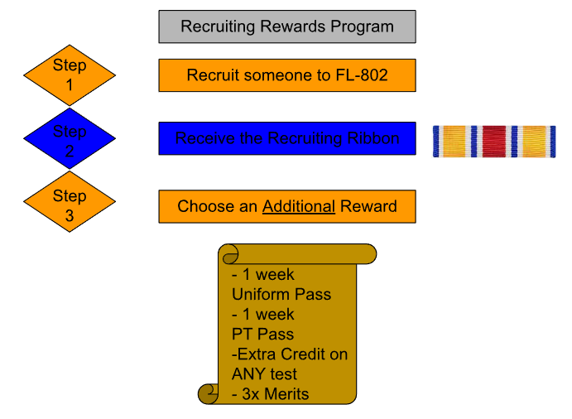
Recruiting
Possible Reasons:
No 1st yr uniforms
LDRs (Drill/Raiders)
Scholarships
Air Force Ball
Community Service hrs
Unit Picnic
Field Day
Sports Days

Slide 5
Kitty Hawk Honor Society Meeting
Kitty Hawk meeting THIS WEEK 5 October 1730-1830 on MICROSOFT TEAMS!
For any further details, please contact C/ 2nd Lt. Sara Mattox at (407) 242-3829 or 4804154679@students.ocps.net

Slide 6
Orange and PT Rope
Flight Commanders, please remember to award Orange Rope to the upperclassman and first-year with the highest average uniform wear over the last two weeks on Wednesday. Also remember to award PT Rope. First-years with no Combo 1 are not eligible.
Take pictures and send to C/Lopez at (321) 440-7611

Slide 7
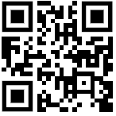
September Gold Rope
Flight commanders! Fill out this form for the gold rope for the month of September. Nominate your best 1st year and upperclassman cadets! Please return the ropes if you have them.
Google Form: https://tinyurl.com/GoldRope
QR Code
Any Questions? Contact C/Lopez at 4804132471@students.ocps.net or (321) 440-7611

Slide 8
Athletic Clearance
These Cadets below are missing the Athletic Clearance:
Aguilar - Bravo Mezime - Delta
Bermudez - Alpha Osoria - Charlie
Ceballos - Charlie Palacios - Foxtrot
Damuth - Alpha Parboo - Alpha
DeSilva - Charlie Pokras - Delta
Doyle - Alpha Rosario - Delta
Hibbert - Foxtrot Vazquez - Charlie
Madera - Bravo Weidner - Alpha
https://athleticclearance.fhsaahome.org/

Slide 9
Military Knowledge
How many HAP ARNOLDS (buttons) are on the dress coat?
3

Slide 10
Summary
Upcoming Events
KHHS Meeting (10/5)
Notes
Recruiting
Gold, Orange, and PT Ropes

Slide 11
Briefing Slides
If you have a slide for the briefing, contact C/ Cruz-Garcia at 4804173126@students.ocps.net
If you want something in the briefing, you must contact C/ Cruz-Garcia by Monday 1700 for the Tuesday brief and Wednesday 1700 for the Thursday brief

