Slide 1
West Orange FL-802
Semi-Weekly Brief
C/ Technical Sergeant Daphne Bray
30 January 2024
Lead,
Serve,
Dream
Unit Motto:

Slide 2
AFJROTC Mission
Develop citizens of character dedicated to serving their nation and community
Mission:
Goals:
Instill Values Of Citizenship,
Service To The United States,
Personal Responsibility/Sense Of Accomplishment

Slide 3
Chain of Command
Commander in Chief:
Sec Def:
Sec AF:
CSAF:
AETC CC:
AU CC:
Holm Center CC:
Director, AFJROTC:
SASI:
Group CC:
Deputy Group CC:
President Joseph R. Biden Jr.
Honorable Lloyd Austin
Honorable Frank Kendall
Gen David Allvin
Lt. Gen Brian S. Robinson
Lt. Gen Andrea D. Tullos
Brig Gen Houston R. Cantwell
Col Johnny R. McGonigal
Lt. Colonel Micheal Carrizales
C/ Captain Agrafena Ritz
C/ Captain Elias Lopez

Slide 4
Athletic Clearance
These Cadets below are missing the Athletic Clearance:
Mezime - Delta
Bermudez - Alpha
Ceballos - Charlie Palacios - Foxtrot
Damuth - Alpha Parboo - Alpha
DeSilva - Charlie Rosario - Delta
Doyle - Alpha Vazquez- Charlie
Funk - Golf Saint Franc - Alpha
Madera - Bravo
https://athleticclearance.fhsaahome.org/

Slide 5
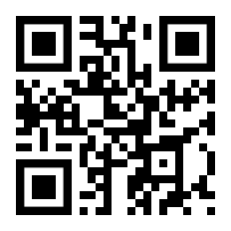
PT Makeups
Sign up here for the PT makeups or on Canvas
https://tinyurl.com/PT2324
For any questions,please contact C/A1C Ayana Putigna @4804185464@students.ocps.net
Meet at the 900 building in PT gear by 1430. Thursdays only.

Slide 6
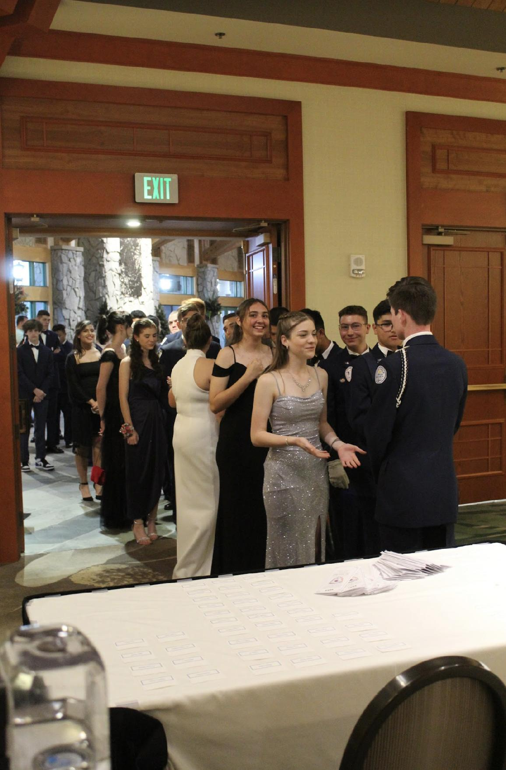
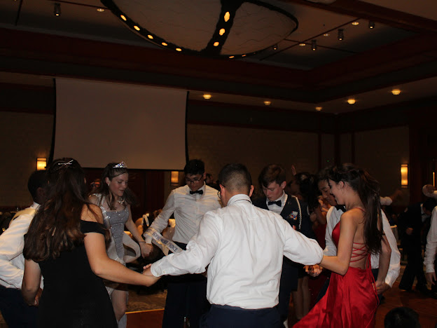
FL-802 Air Force Ball
Air Force Ball is our unit’s very own dance! It is a fun filled night with ceremonies, food, and lots of dancing! This years AFB is 10 February 2024 at Rosen Plaza from 1800 to 2200!
https://www.schoolpay.com/pay/for/Air-Force-Ball-Tickets-2324/SbGcCl
Ticket prices are as follows (ticket sales close 3 February!):
Cadets: $45
Guests: $50
If you have any questions or concerns, please contact C/ 1st Lt Sara Mattox @ 4072423829 or at 4804154679@students.ocps.net

Slide 7
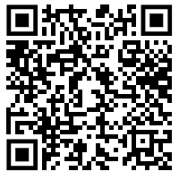
Air Force Ball RSVP
Here is a link to fill out an RSVP for the Air Force Ball on February 10th.
If you have any questions or concerns please contact C/SSgt Vanessa Maloney at 321-318-2929 or 4804210309@students.ocps.net

Slide 8
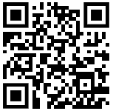
AFB Sabre Team Interest
We still need people for the Sabre team for Air Force Ball next weekend! If you have ANY interest in being on the team PLEASE fill the form out below!
If you are on the final voting for Royal Court you WILL NOT be placed on the team!!
http://tinyurl.com/SabreTeamInterest
If you have any questions or concerns, please contact C/ CMSgt Diego Cuevas @ 407-575-3811

Slide 9
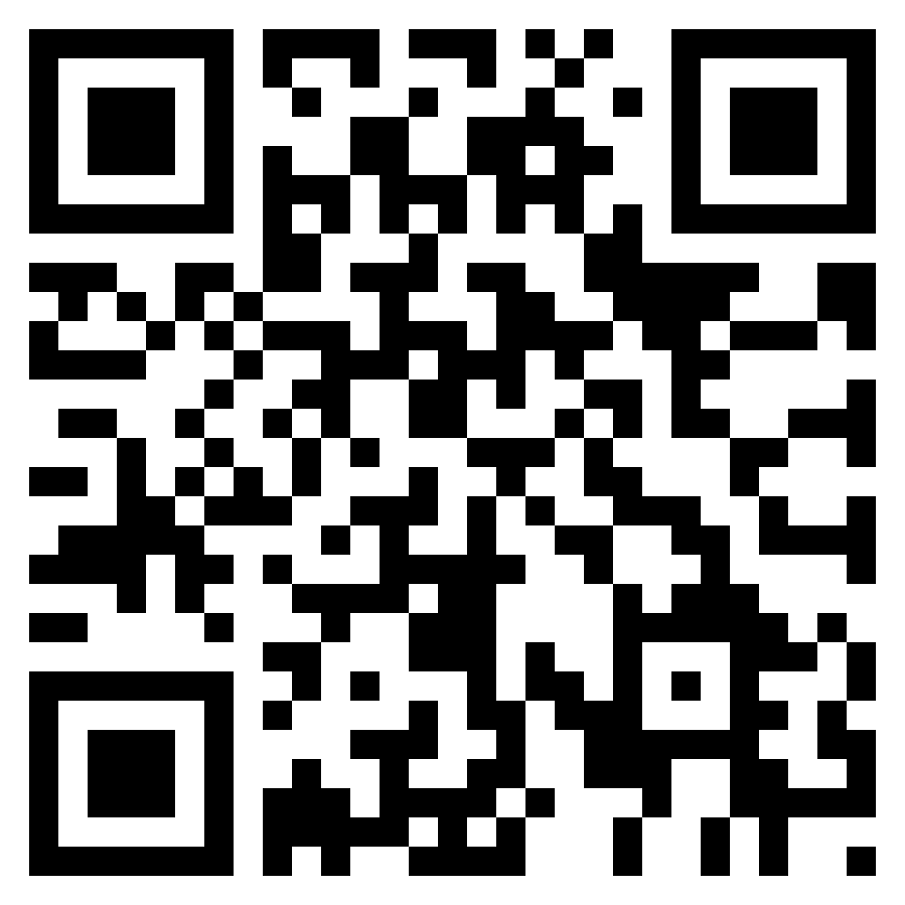
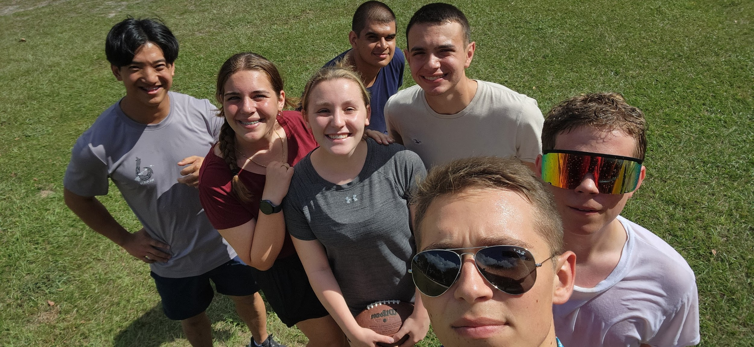
Unit Video
If you have any photos from the unit throughout the year, add them to this drive!
Share memories with your friends at the Air Force Ball!
Drive link: http://tinyurl.com/AFBUnitVideo24
If you have any questions, please contact C/Major Aidan Bernhard at 4804148902@students.ocps.net or +1(407) 408-6158 (For business purposes only)

Slide 10
Recruiting
Upcoming Events:
Parent Night (1/30/24)
Sunridge Middle School visit (2/19/24)
Lakeview Middle School visit (2/19/24)
Hamlin Middle School visit (2/27/24)
To join recruiting Remind: Text @fl802re to 81010
Contact C/Amn David Peebles at 4804407123@students.ocps.net

Slide 11
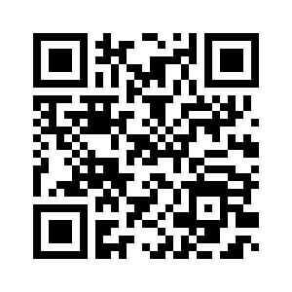
Middle School Visits
Do you want to visit the middle schools for recruiting? Fill out this form if you are interested: https://forms.gle/NKtCGFhXaynhrFu59
Questions? Contact c/A1C David Peebles 407-799-7063
4804407123@students.ocps.net

Slide 12
PB&J Sandwich-Making w/ FFA
FFA is making PB&J sandwiches for the Matthew’s Hope organization and would love for us to help out.
When: 31 January, after school
Where: In the Agriscience building
Uniform: Combo 5
If you would like to be the CIC for this event, please contact C/ 1st Lt. Sara Mattox at 4804154679@students.ocps.net

Slide 13
Model Rocketry
Interested in building model rockets? This is for you!
Model Rocketry is a STEM-based LDR in which you build launchable rockets. You will earn the Model Rocketry badge if you successfully launch 3 rockets.
Please contact C/ TSgt Princess Tolbert at 407-259-7171 or 4804191858@students.ocps.net if you are interested or have any questions.

Slide 14
Turn In your Orange/PT Rope!
If you have an orange or PT rope, please turn it in to Lt. Col Carrizales or SMSgt Spencer so that they can be rewarded to other cadets in the future!

Slide 15
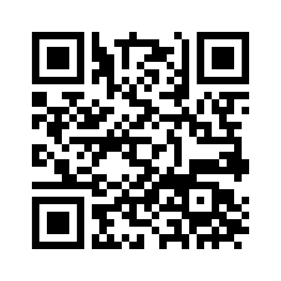
January Gold Rope
Flight Commanders,
Please submit your choices for Gold Rope for January from your respective flights by 2 Feb using the QR code below. Send in one first year and one upperclassmen recommendation. This award in an honor, so please be sure to submit cadets that represent our core values.
If you still have your Gold Rope from a previous win, please turn them in by 2 Feb to Lt. Col Carrizales or SMSgt Spencer.
Contact C/CMSgt Karynn Stewart at 407-797-7223 or 4804169963@students.ocps.net if you have any questions

Slide 16
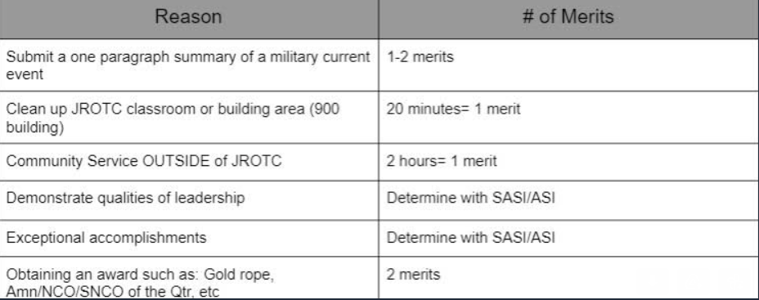
Merit Incentive Winners for Semester 1!
The following slide is the list of people who achieved Overall Merit Leader, Top 4 Merit Leaders, and the Top Merit Flight for Semester 1 of the 2023-2024 school year!
If you would like to receive this for semester 2 of this year, make sure to earn more merits, and encourage others in your flight to earn merits too! Look below to see how you can earn merits (take a picture)! This chart can also be found on our Unit’s website.
Any Cadet Senior NCO or Officer along with the instructors may give out merits and demerits

Slide 17
Merit Incentive Winners for Semester 1!
For the Overall Merit Winner and Top Four Merit Winners, please contact C/CMSgt Karynn Stewart at 407-797-7223 or 4804169963@students.ocps.net and let me know if you would like a $5 gift card to a place of your choosing OR your choice of candy!
For the Top Flight Merit Winner, please decide as a flight if you would like cookies OR cake and have your Flight Commander contact me!
*If you do not contact me by 2 Feb, you will not receive your reward!*
Congratulations!
Overall Merit Winner:
C/ Princess Tolbert
Top Four Merit Winners:
C/ Raleigh Brown
C/ Noah Abney
C/ Terran Davidson
C/ Zander Tawil
Top Flight Merit Winner:
Foxtrot Flight

Slide 18
Military Knowledge
What is the maximum number of devices that can be worn on a ribbon?
4

Slide 19
Summary
Upcoming Events
PB&J Sandwich making (1/31)
AFB (2/10)
Notes
Athletic Clearances
PT Makeups
CIC/DCIC form
Unit Video
Middle School Visits
Gold/Orange/PT Ropes
Merit Incentive Winners

Slide 20
Briefing Slides
If you have a slide for the briefing, contact C/ Bray at 4804208068@students.ocps.net or (689)-229-0443
If you want something in the briefing, you must contact C/ Bray by Monday 1700 for the Tuesday brief and Wednesday 1700 for the Thursday brief

