Slide 1
West Orange FL-802
Semi-Weekly Brief
C/ Technical Sergeant Daphne Bray
29 February 2024
Lead,
Serve,
Dream
Unit Motto:

Slide 2
AFJROTC Mission
Develop citizens of character dedicated to serving their nation and community
Mission:
Goals:
Instill Values Of Citizenship,
Service To The United States,
Personal Responsibility/Sense Of Accomplishment

Slide 3
Chain of Command
Commander in Chief:
Sec Def:
Sec AF:
CSAF:
AETC CC:
AU CC:
Holm Center CC:
Director, AFJROTC:
SASI:
Group CC:
Deputy Group CC:
President Joseph R. Biden Jr.
Honorable Lloyd Austin
Honorable Frank Kendall
Gen David Allvin
Lt. Gen Brian S. Robinson
Lt. Gen Andrea D. Tullos
Brig Gen Houston R. Cantwell
Col Johnny R. McGonigal
Lt. Colonel Micheal Carrizales
C/ Captain Agrafena Ritz
C/ Major Elias Lopez

Slide 4
Athletic Clearance
These Cadets below are missing the Athletic Clearance:
https://athleticclearance.fhsaahome.org/
Alpha | Bravo | Charlie | Delta | Foxtrot | Golf
Bermudez | Wilson | Benzakour | Busteros | Palacios | Funk
Doyle |  | DelSilva | Goldstein
Saint-Franc |  | Vasquez | Mezime
 |  |  | Rosario
 |  |  | Sanichar

Slide 5
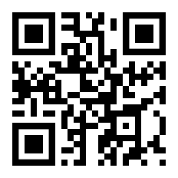
PT Makeups
Sign up here for the PT makeups or on Canvas
https://tinyurl.com/PT2324
For any questions,please contact C/A1C Ayana Putigna @4804185464@students.ocps.net
Meet at the 900 building in PT gear by 1430. Thursdays only.

Slide 6
Foxtrot Flight Merit Celebration
Foxtrot Flight,
Congratulations again on receiving the most merits for last semester! The day of your celebration will be Thursday, 29 February during class! If you would like to have cake and celebrate with your flight, make sure you’re there that day! It is also on the unit calendar if you forget the date. Keep up the good work!

Slide 7
Vertical Raise Fundraiser
We are going to have a Vertical Raise Fundraiser 11-29 March. Last year we made $10,992! We need some cadets to make a video like this one!
Cadet Coutray will be making the video. Please reach out to her to assist!

Slide 8
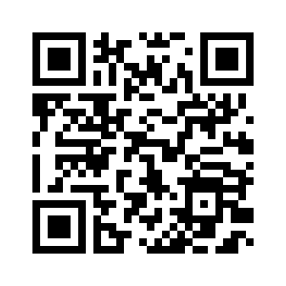
In-Class Morale Event
In every flight on 7 March, there is going to be an in-class bonding event (or “party”) to get closer with the people in your flight!
Flight Commanders, please talk to your flight and decide what you would like to do in class that day, and then fill out the google form by scanning the QR code to the right.
If you or someone else in your flight would like to bring in food OR games, that is allowed as long as the food is sealed and store-bought and the games are school appropriate. There is a sign up sheet on the board that is open to everyone if they would like to bring something. Please keep in mind that if you sign up to bring something, you need to bring it. This event is what you make of it, so bring something in!

Slide 9
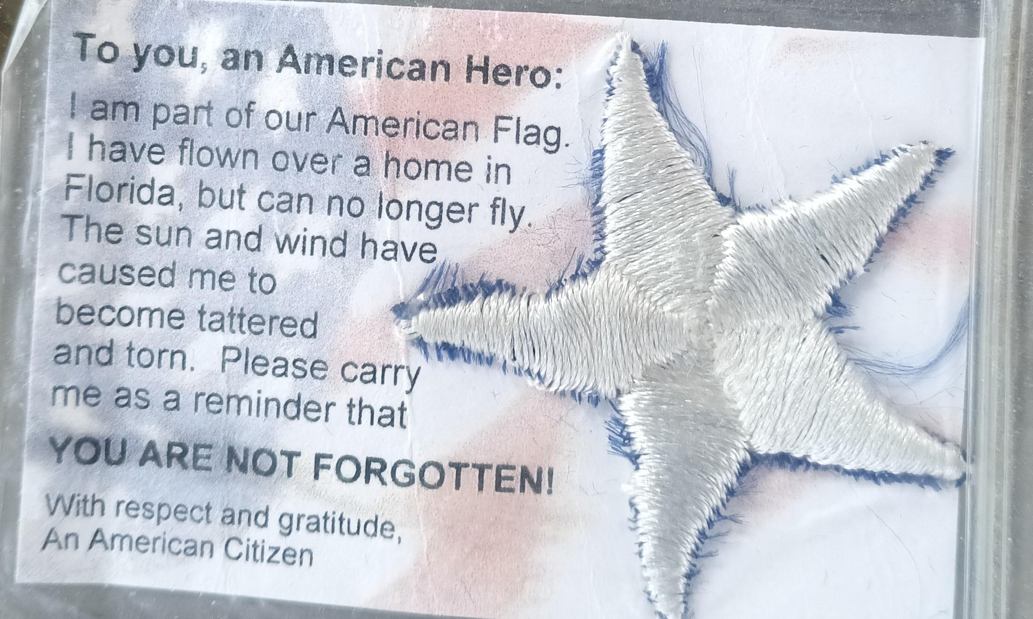
American Veterans Appreciation Service:
Project AVAS is a community service opportunity designed to show our veterans that we appreciate the sacrifices they have made. Cadets will cut out stars from our unserviceable flags. Afterwards return the stars in a ziploc bag to room 950. these stars will then be processed with cards and be given to the Veterans Administration Building for distribution. (Dates of collection: March 13th/15th.
6 Stars = (1 Community Service Hour)
18 Stars = (3 Community Service Hours)
For any questions, comments or concerns please contact
Cadet Tech/Sgt Mincel via student email or text. (Business Purposes Only!)
E-Mail: 4806822834@students.ocps.net Text: (689-276-0745)

Slide 10
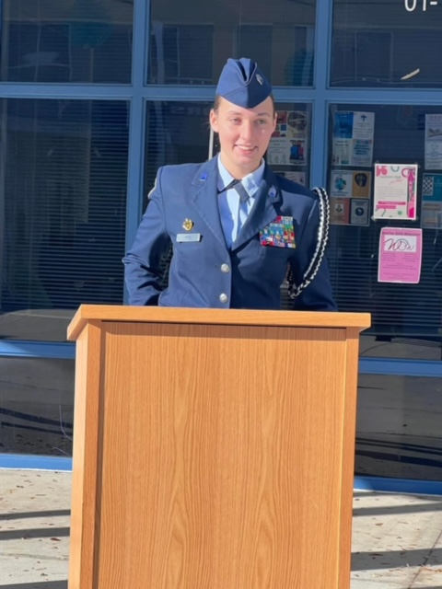
Group Commander
If you are interested in applying for the group commander position please email SMSgt Spencer NLT 28 Feb 2024
You must be:
sophomore or junior
at least 2.5 gpa
no disciplinary issues
no missing uniform grades

Slide 11
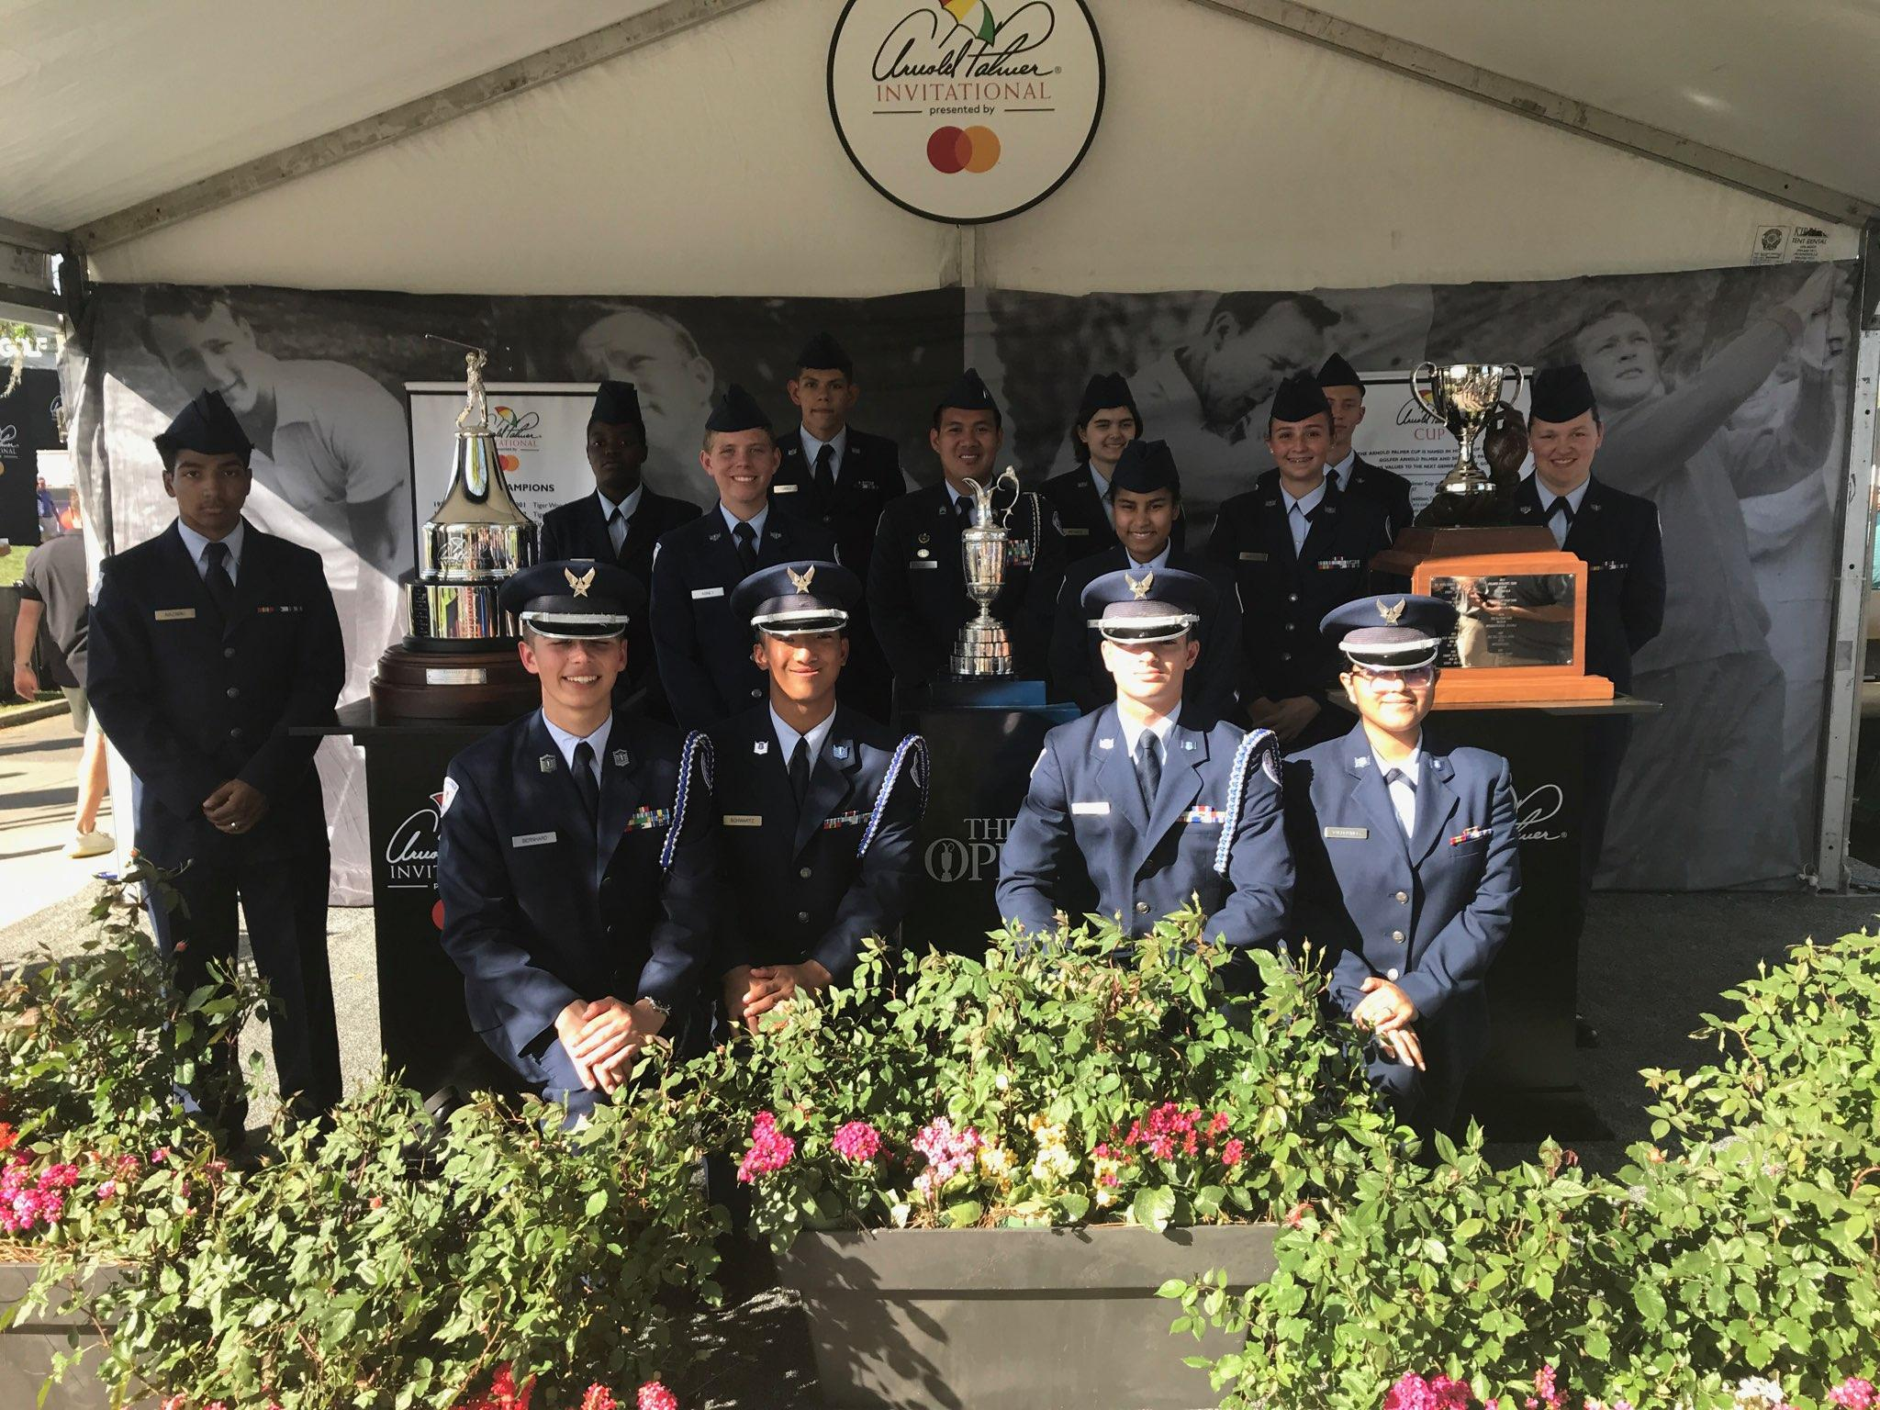
Arnold Palmer Invitational
Guard trophies for the Arnold Palmer Invitational golf tournament
Friday 3/8 and/or Sunday 3/10
Meet at Hyatt Grand Cypress 1 Grand Cypress Blvd, Orlando, FL 32836 at 0815. Have your parents pick you up around 1630
Wear your Combo 2
Sign up sheet is on the board
Questions? Contact Sara Mattox at 407-242-3829/4804154679@students.ocps.net for March 8th or Antonio Torre at 407-773-0450/4804182497@students.ocps.net for March 10th

Slide 12
ABU turn-in
If you were on the drill team and you have ABUs please turn them in by Wednesday, 6 March. Failing to turn in your ABUs will have an impact on your uniform inspection grade and your promotion opportunity. You can bring it in before school.
ABU pants
ABU blouse
hat
Belt
Boots

Slide 13
Air Commando Association Award
This award is presented annually to one cadet who most closely exemplifies the 13 critical attributes of success for Air Commandos. An essay submission is required if you’re interested in receiving the award. Please see the announcement on Canvas for more details.
Due 13 March 2024
*email your essay to micheal.carrizales@ocps.net

Slide 14
KHHS Meeting
KHHS meeting this week 29 February (today) 1430-1530 in 950!
Questions, comments, or concerns? Please contact C/ 1st Lt. Sara Mattox at 407-242-3829 or 4804154679@students.ocps.net

Slide 15
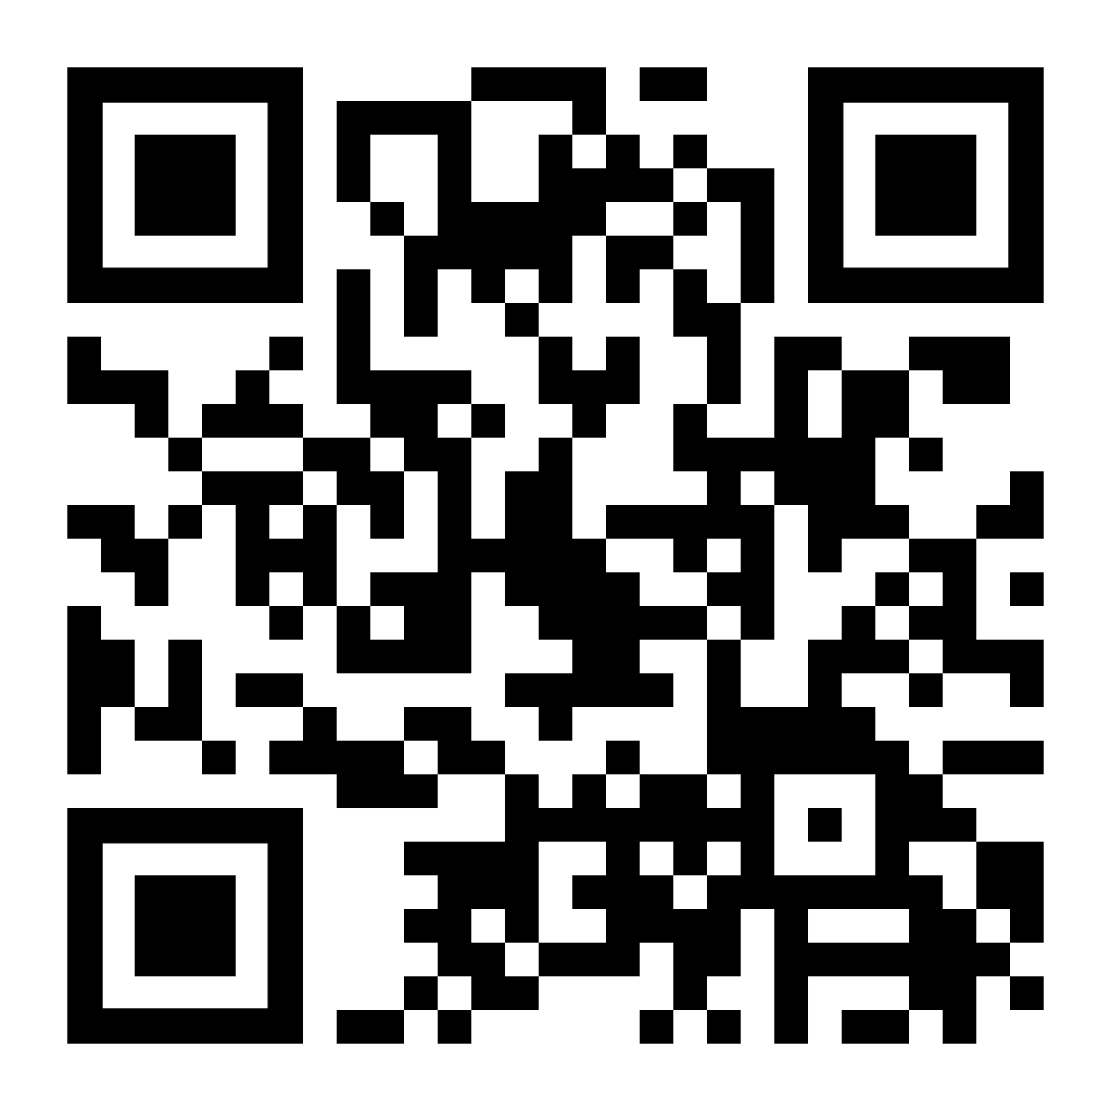
Model Rocketry
Interested in building model rockets? This is for you!
Model Rocketry is a STEM-based LDR in which you build launchable rockets. You will earn the Model Rocketry badge if you successfully launch 3 rockets and pass the Model Rocketry test with a minimum 85%.
Please contact C/ TSgt Princess Tolbert at 407-259-7171 or 4804191858@students.ocps.net if you are interested or have any questions.
https://forms.gle/3vkHdfPi5JHmExrX9

Slide 16
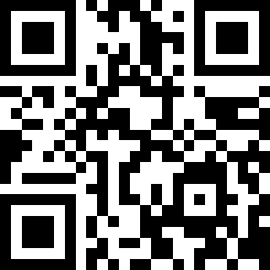
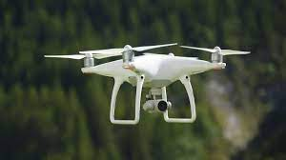
Unmanned-Aircraft Systems
Would you be interested in in flying drones?
Would you like to complete missions with drones?
Sign up below to show interest in the Unmanned Aircraft Systems LDR (coming soon)!
http://tinyurl.com/UAS2024
If your interested or have any questions, comments please contact C/SMSgt NOAH ABNEY @407-961-2474

Slide 17
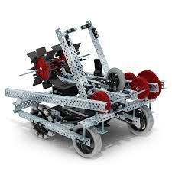
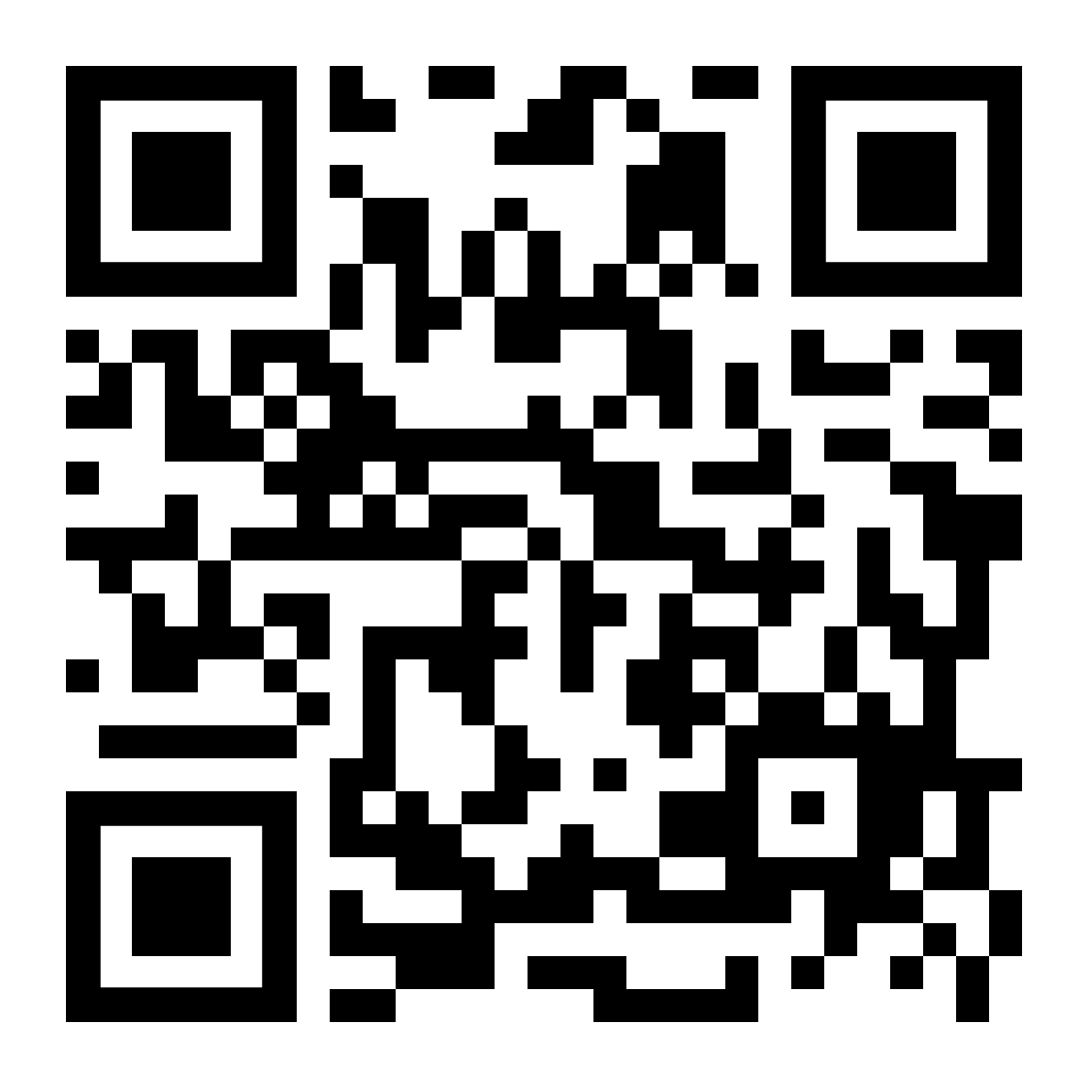
Robotics
Interested in robots? Join Robotics! Show interest by completing the form.
ROBOTICS WILL BE ON MONDAYS AND WEDNESDAYS STARTING NEXT WEEK ON 26 FEBRUARY!!
https://forms.gle/VZLiq2ngsWqU6pxW7
If your interested or have any questions, comments please contact C/TSgt Ian Kristona at 407-576-6406.

Slide 18
American Legion Bingo Nights
SIGN UP (QUICKLY) ON THE BOARD!!
American Legion Post 63 hosts Bingo Nights every Monday from 1730-2130 and would love help!
Consists of making and serving food, taking orders, or handing out bingo cards
Maximum of three cadets are needed per Monday
If you have any questions, comments, or concerns, please contact C/ TSgt Gabriel Motta at 4804175879@students.ocps.net or 407-202-9362.

Slide 19
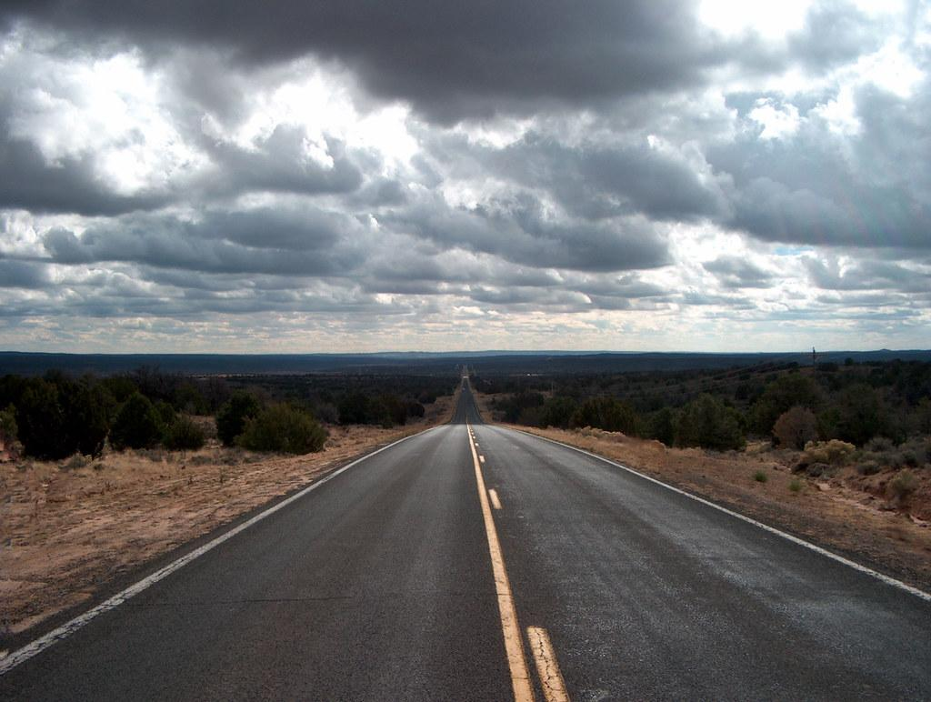
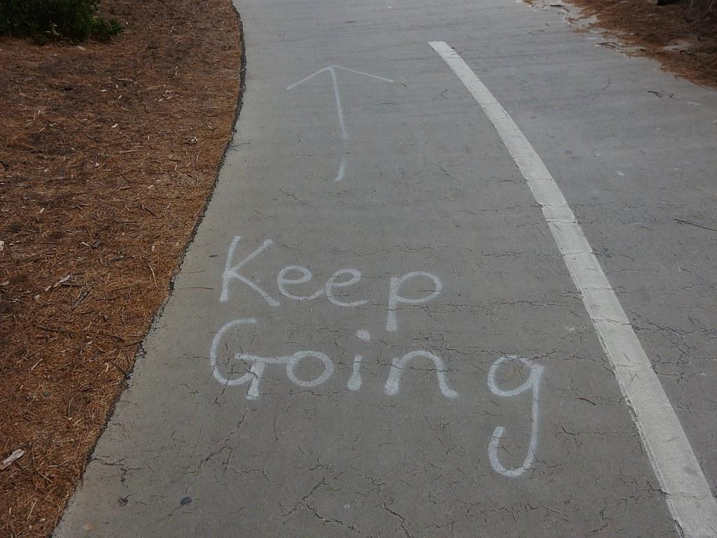
Chief’s Quote of the Week
"Motivation is what gets you started. Habit is what keeps you going."
Jim Rohn

Slide 20
Military Knowledge
First year females were allowed to join JROTC?
1972

Slide 21
Summary
Upcoming Events
Kitty Hawk meeting (2/29)
Arnold Palmer (3/8-3/10)
American Legion Bingo Nights (3/4)
Notes
Athletic Clearances
PT Makeups
Air Commando Association Award
Group Commander
ABU turn-ins

Slide 22
Briefing Slides
If you have a slide for the briefing, contact C/ Bray at 4804208068@students.ocps.net or (689)-229-0443
If you want something in the briefing, you must contact C/ Bray by Monday 1700 for the Tuesday brief and Wednesday 1700 for the Thursday brief

