Slide 1
West Orange FL-802
Semi-Weekly Brief
C/ Staff Sergeant Eliud Cruz-Garcia
24 August 2023
Lead,
Serve,
Dream
Unit Motto:

Slide 2
AFJROTC Mission
Develop citizens of character dedicated to serving their nation and community
Mission:
Goals:
Instill Values Of Citizenship,
Service To The United States,
Personal Responsibility/Sense Of Accomplishment

Slide 3
Chain of Command
Commander in Chief:
Sec Def:
Sec AF:
CSAF:
AETC CC:
AU CC:
Holm Center CC:
Director, AFJROTC:
SASI:
Group CC:
Deputy Group CC:
President Joseph R. Biden Jr.
Honorable Lloyd Austin
Honorable Frank Kendall
Gen Charles Q. Brown Jr.
Lt. Gen Brian S. Robinson
Lt. Gen Andrea D. Tullos
Brig Gen Houston R. Cantwell
Col Johnny R. McGonigal
Lt. Colonel Michael Carrizales
C/ Major Aidan Bernhard
C/ 1st Lieutenant Antonio Torre

Slide 4
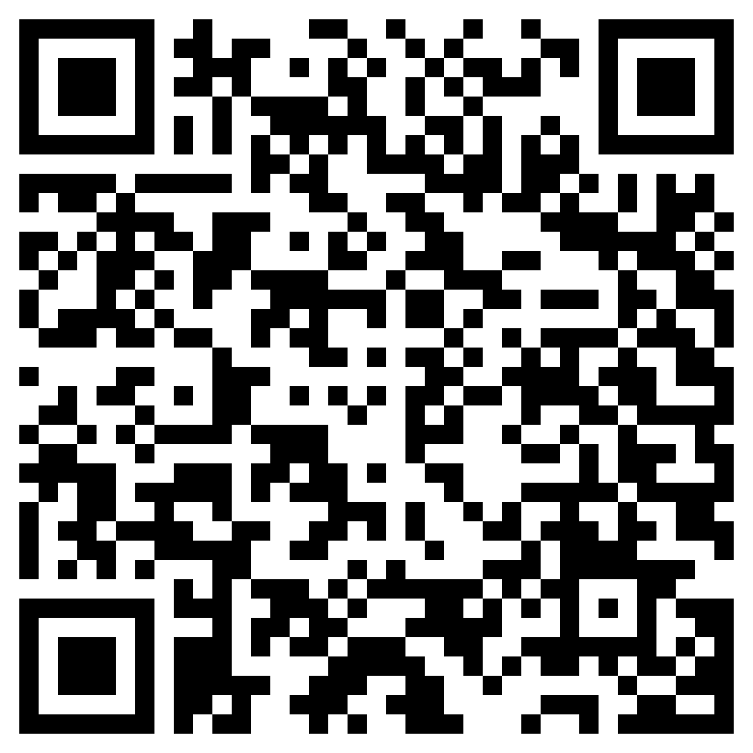
Join Recruiting!
If you are interested in helping our unit recruit new cadets, join the recruiting team.
If you would like to go out to schools and help boost our unit numbers and have the opportunity to earn the recruiting ribbon, scan the QR code provided.
Any questions, please contact C/ TSgt Princess Tolbert at 4804191858@students.ocps.net or (407) 259-717.

Slide 5
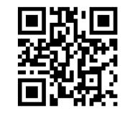
Logistics Appointment Schedule
New 2023-2024 Logistics appointment link
Logistics Appointment Form:
Monday: 1420-1500
Tuesday: 1420-1500
Thursday: 1420-1500
https://tinyurl.com/FL-802LSS
Questions, comments, concerns, contact C/SMSgt Anthony Torres at (775) 544-0842 or 4806810625@studnets.ocps.net

Slide 6
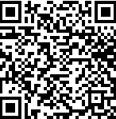
KHHS Interest Meeting
Kitty Hawk is an Honor Society within AFJROTC and is one of our many LDRs. If you have any interest in joining there will be a meeting TODAY 24 August from 1430 to 1515.
For any further details, please contact C/ 2nd Lt. Sara Mattox at (407) 242-3829 or 4804154679@students.ocps.net
https://tinyurl.com/KHHSInterestMeeting

Slide 7
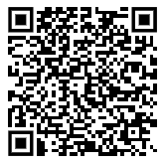
Join Honor Guard!!
Sharpen your marching and drill movements
Make friends in a team environment
Go to competitions
Earn awards
Honor Guard counts as a varsity sport!
Honor Guard conditioning starts 28 August through 1 September after school.
NOTE: You need an athletic clearance to participate!
If you have any questions, please contact C/ CMSgt Ritz at 386-344-9452.

Slide 8
Football Parking
TAKE A PICTURE!
Who: Our Cadet Corps
What: Direct people and their vehicles
When: 16:30, 25 August
Where: Room 950(Colonel’s Room)
Why:To help out our school
Wear: PT Uniform
Sign up:On the paper!
If you have any questions,please contact C/ SrAmn Gabriel Motta at 407-202-9362 or 4804175879@students.ocps.net

Slide 9
Chief’s Quote of the Week
“The mediocre teacher tells. The good teacher explains. The superior teacher demonstrates. The great teacher inspires.”
– William Arthur Ward

Slide 10
Military Knowledge
What number was Florida to join the Union?
27th

Slide 11
Summary
Upcoming Events
Kitty Hawk Interest Meeting (8/24)
Football Parking (8/25)
Notes
Logistics Appointment Schedule
Recruiting
Honor Guard

Slide 12
Briefing Slides
If you have a slide for the briefing, contact C/ Cruz-Garcia at 4804173126@students.ocps.net
If you want something in the briefing, you must contact C/Cruz-Garcia by Monday 1700 for the Tuesday brief and Wednesday 1700 for the Thursday brief

