Slide 1
West Orange FL-802
Semi-Weekly Brief
C/ Staff Sergeant Daphne Bray
23 January 2024
Lead,
Serve,
Dream
Unit Motto:

Slide 2
AFJROTC Mission
Develop citizens of character dedicated to serving their nation and community
Mission:
Goals:
Instill Values Of Citizenship,
Service To The United States,
Personal Responsibility/Sense Of Accomplishment

Slide 3
Chain of Command
Commander in Chief:
Sec Def:
Sec AF:
CSAF:
AETC CC:
AU CC:
Holm Center CC:
Director, AFJROTC:
SASI:
Group CC:
Deputy Group CC:
President Joseph R. Biden Jr.
Honorable Lloyd Austin
Honorable Frank Kendall
Gen David Allvin
Lt. Gen Brian S. Robinson
Lt. Gen Andrea D. Tullos
Brig Gen Houston R. Cantwell
Col Johnny R. McGonigal
Lt. Colonel Micheal Carrizales
C/ Captain Agrafena Ritz
C/ Captain Elias Lopez

Slide 4
Athletic Clearance
These Cadets below are missing the Athletic Clearance:
Mezime - Delta
Bermudez - Alpha Osoria - Charlie
Ceballos - Charlie Palacios - Foxtrot
Damuth - Alpha Parboo - Alpha
DeSilva - Charlie Rosario - Delta
Doyle - Alpha Vazquez- Charlie
Funk - Golf Saint Franc - Alpha
Madera - Bravo
https://athleticclearance.fhsaahome.org/

Slide 5
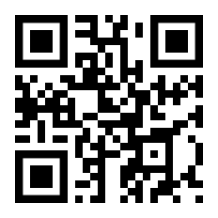
PT Makeups
Sign up here for the PT makeups or on Canvas
https://tinyurl.com/PT2324
For any questions,please contact C/A1C Ayana Putigna @4804185464@students.ocps.net
Meet at the 900 building in PT gear by 1430. Thursdays only.

Slide 6
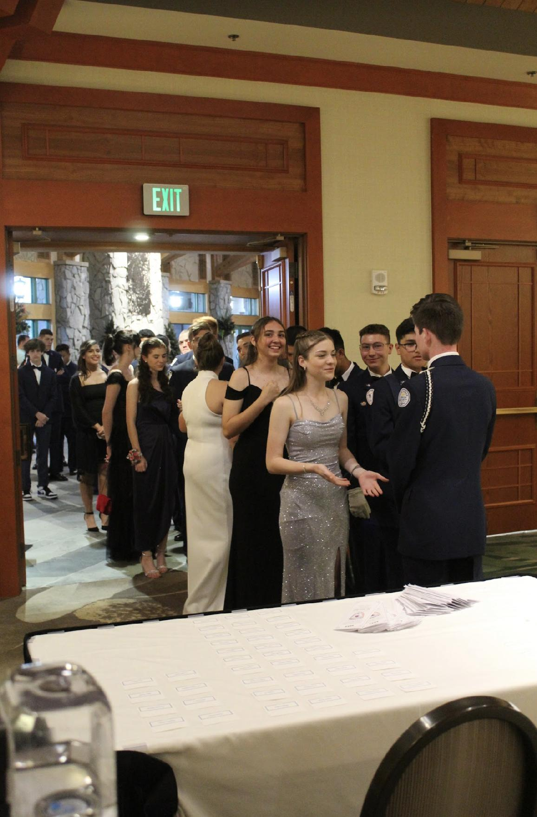
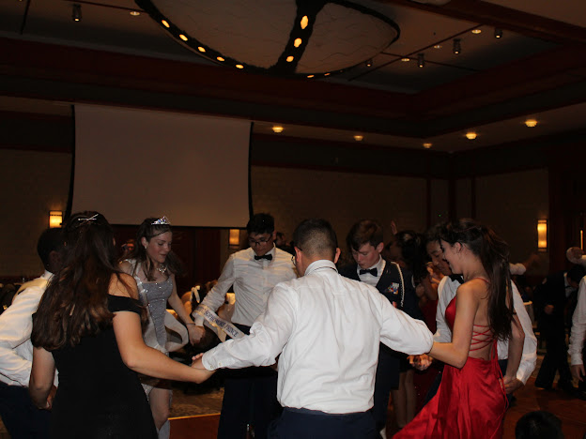
FL-802 Air Force Ball
Air Force Ball is our unit’s very own dance! It is a fun filled night with ceremonies, food, and lots of dancing! This years AFB is 10 February 2024 at Rosen Plaza from 1800 to 2200!
https://www.schoolpay.com/pay/for/Air-Force-Ball-Tickets-2324/SbGcCl
Ticket prices are as follows (ticket sales close 3 February!):
Cadets: $45
Guests: $50
If you have any questions or concerns, please contact C/ 1st Lt Sara Mattox @ 4072423829 or at 4804154679@students.ocps.net

Slide 7
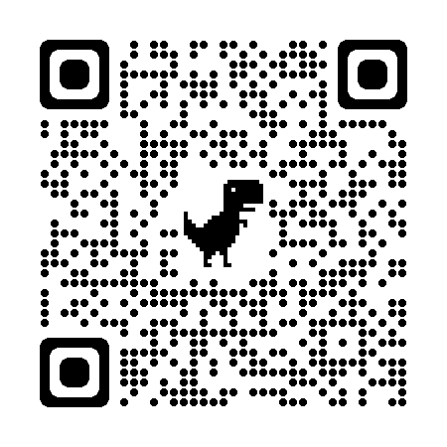
FL-802 Air Force Ball
Use this QR code to vote for your royal court!
If you have any questions or concerns, please contact C/ 1st Lt Sara Mattox @ 4072423829 or at 4804154679@students.ocps.net

Slide 8
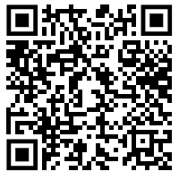
Air Force Ball RSVP
Here is a link to fill out an RSVP for the Air Force Ball on February 10th.
If you have any questions or concerns please contact C/SSgt Vanessa Maloney at 321-318-2929 or 4804210309@students.ocps.net

Slide 9
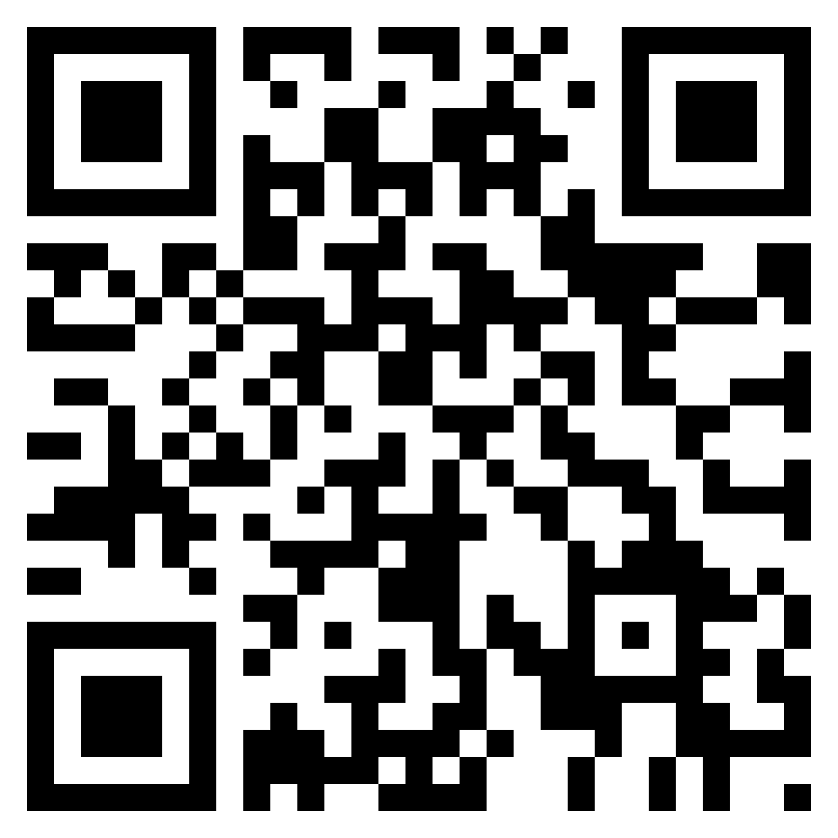
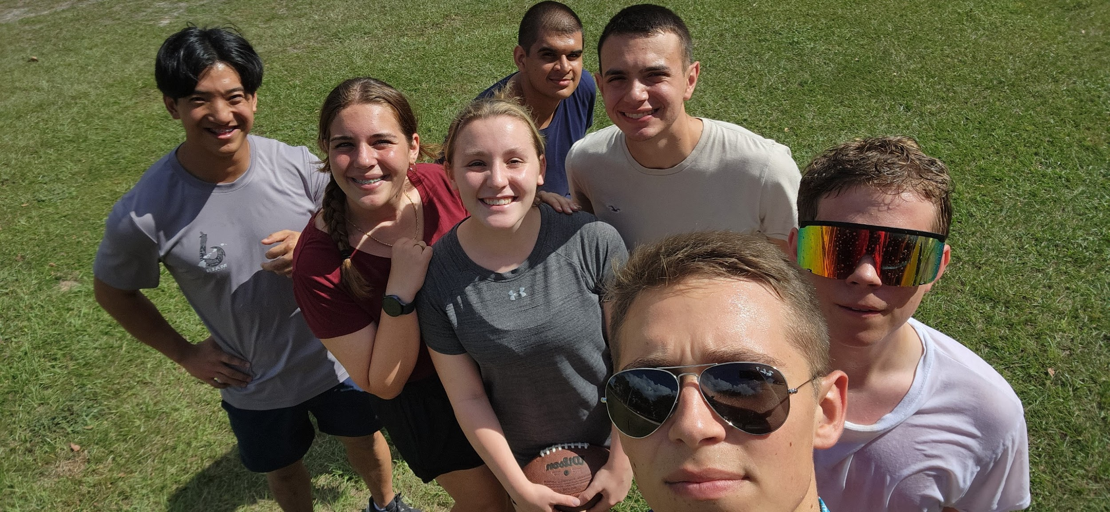
Unit Video
If you have any photos from the unit throughout the year, add them to this drive!
Share memories with your friends at the Air Force Ball!
Drive link: http://tinyurl.com/AFBUnitVideo24
If you have any questions, please contact C/Major Aidan Bernhard at 4804148902@students.ocps.net or +1(407) 408-6158 (For business purposes only)

Slide 10
Recruiting
Upcoming Events:
Rising Sophomore meeting (1/19/24)
Parent Night (1/30/24)
Sunridge Middle School visit (2/19/24)
Lakeview Middle School visit (2/19/24)
Hamlin Middle School visit (2/27/24)
To join recruiting Remind: Text @fl802re to 81010
Contact C/Amn David Peebles at 4804407123@students.ocps.net

Slide 11
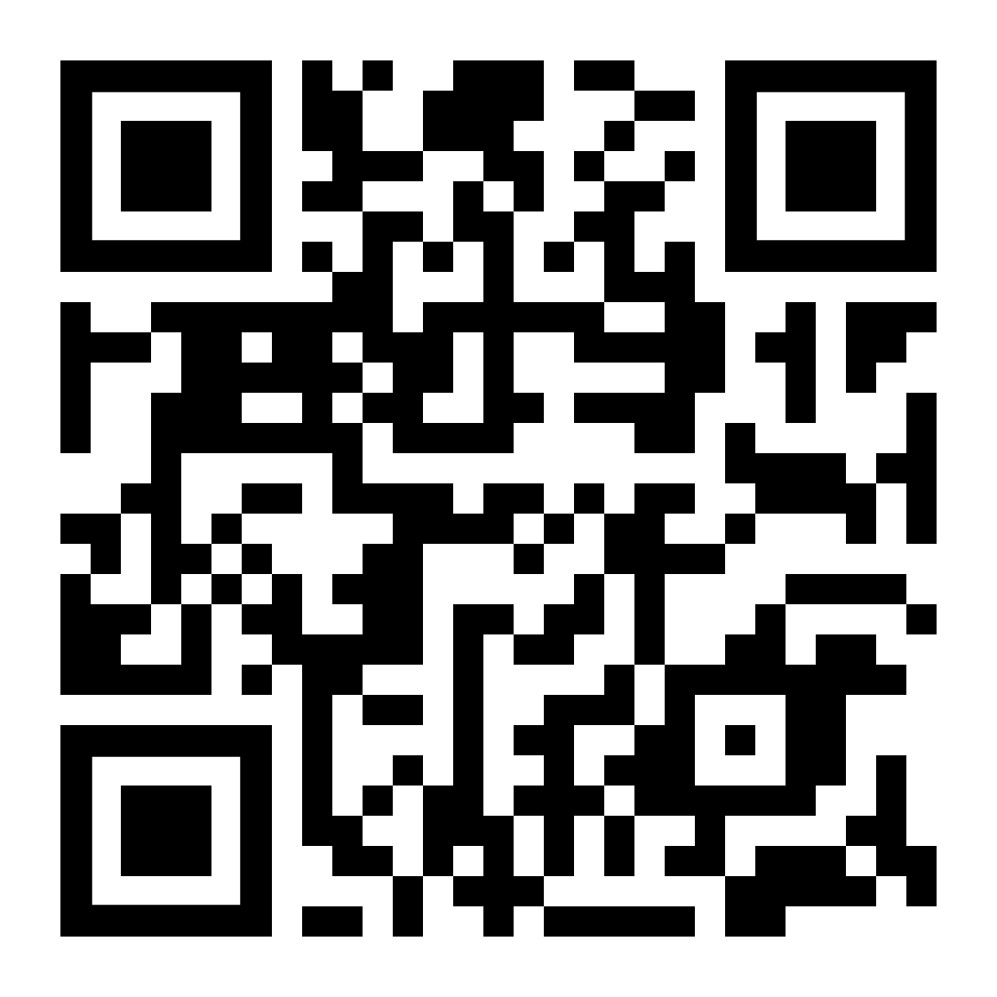
CICs/ DCICs
If you have been a CIC or DCIC, please fill out the google form by scanning the QR code or going to the link below.
http://tinyurl.com/f8bdhnv5
If you have any questions, please contact C/ SSgt Gabriel Motta at 4804175879@students.ocps.net

Slide 12
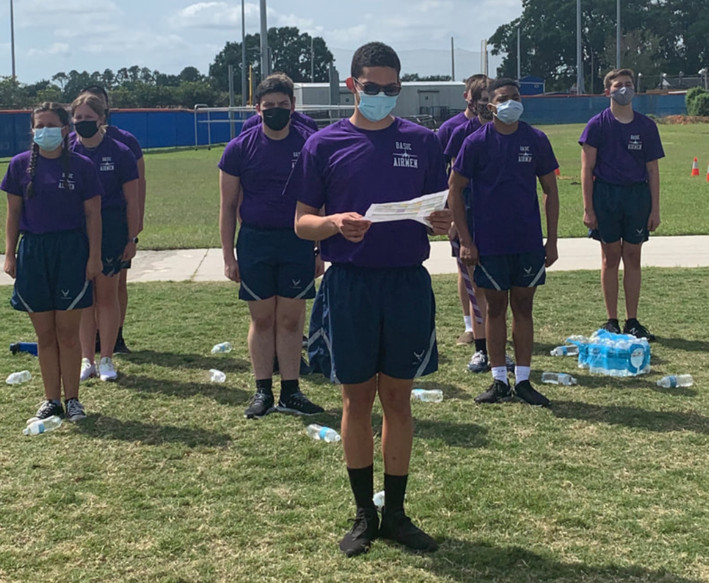
Planning Committee
Seniors!
There will be a planning committee meeting this Friday(1/26/2024) to discuss Field Day.
It will begin at 1430 and run until 1515.
Come prepared with ideas for the event.
If you have any questions, or cannot make it, please contact C/Major Aidan Bernhard at 4804148902@students.ocps.net or +1(407) 408-6158 (For business purposes only)

Slide 13
Orange Rope/PT Rope
Flight Commanders,
Please remember to award Orange Rope and PT Rope every other Wednesday. Look at the unit calendar on the website to keep track of when they should be awarded.
Do not forget to send me your flight’s pictures! If you do not send them, there will be consequences. And remember: one first year, one upperclassmen for orange rope, and one PT rope per flight.
The next time you will award orange/PT rope is Jan 24th!
Contact C/CMSgt Karynn Stewart at 4804169963@students.ocps.net or 407-797-7223 if you have any questions (business purposes only).

Slide 14
Military Knowledge
What are the four standards of wearing the uniform?
Neatness, cleanness, safety, military image

Slide 15
Summary
Upcoming Events
Planning Committee (1/26)
AFB (2/10)
Notes
Athletic Clearances
PT Makeups
CIC/DCIC form
Orange/PT ropes
Unit Video

Slide 16
Briefing Slides
If you have a slide for the briefing, contact C/ Bray at 4804208068@students.ocps.net or (689)-229-0443
If you want something in the briefing, you must contact C/ Bray by Monday 1700 for the Tuesday brief and Wednesday 1700 for the Thursday brief

