Slide 1
West Orange FL-802
Semi-Weekly Brief
C/ Staff Sergeant Eliud Cruz-Garcia
21 September 2023
Lead,
Serve,
Dream
Unit Motto:

Slide 2
AFJROTC Mission
Develop citizens of character dedicated to serving their nation and community
Mission:
Goals:
Instill Values Of Citizenship,
Service To The United States,
Personal Responsibility/Sense Of Accomplishment

Slide 3
Chain of Command
Commander in Chief:
Sec Def:
Sec AF:
CSAF:
AETC CC:
AU CC:
Holm Center CC:
Director, AFJROTC:
SASI:
Group CC:
Deputy Group CC:
President Joseph R. Biden Jr.
Honorable Lloyd Austin
Honorable Frank Kendall
Gen Charles Q. Brown Jr.
Lt. Gen Brian S. Robinson
Lt. Gen Andrea D. Tullos
Brig Gen Houston R. Cantwell
Col Johnny R. McGonigal
Lt. Colonel Micheal Carrizales
C/ Major Aidan Bernhard
C/ 1st Lieutenant Antonio Torre

Slide 4
Kitty Hawk Honor Society Meeting
Kitty Hawk meeting TODAY 21 September 1430-1530 in room 950!
For any further details, please contact C/ 2nd Lt. Sara Mattox at (407) 242-3829 or 4804154679@students.ocps.net

Slide 5
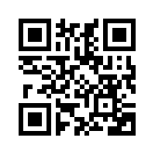
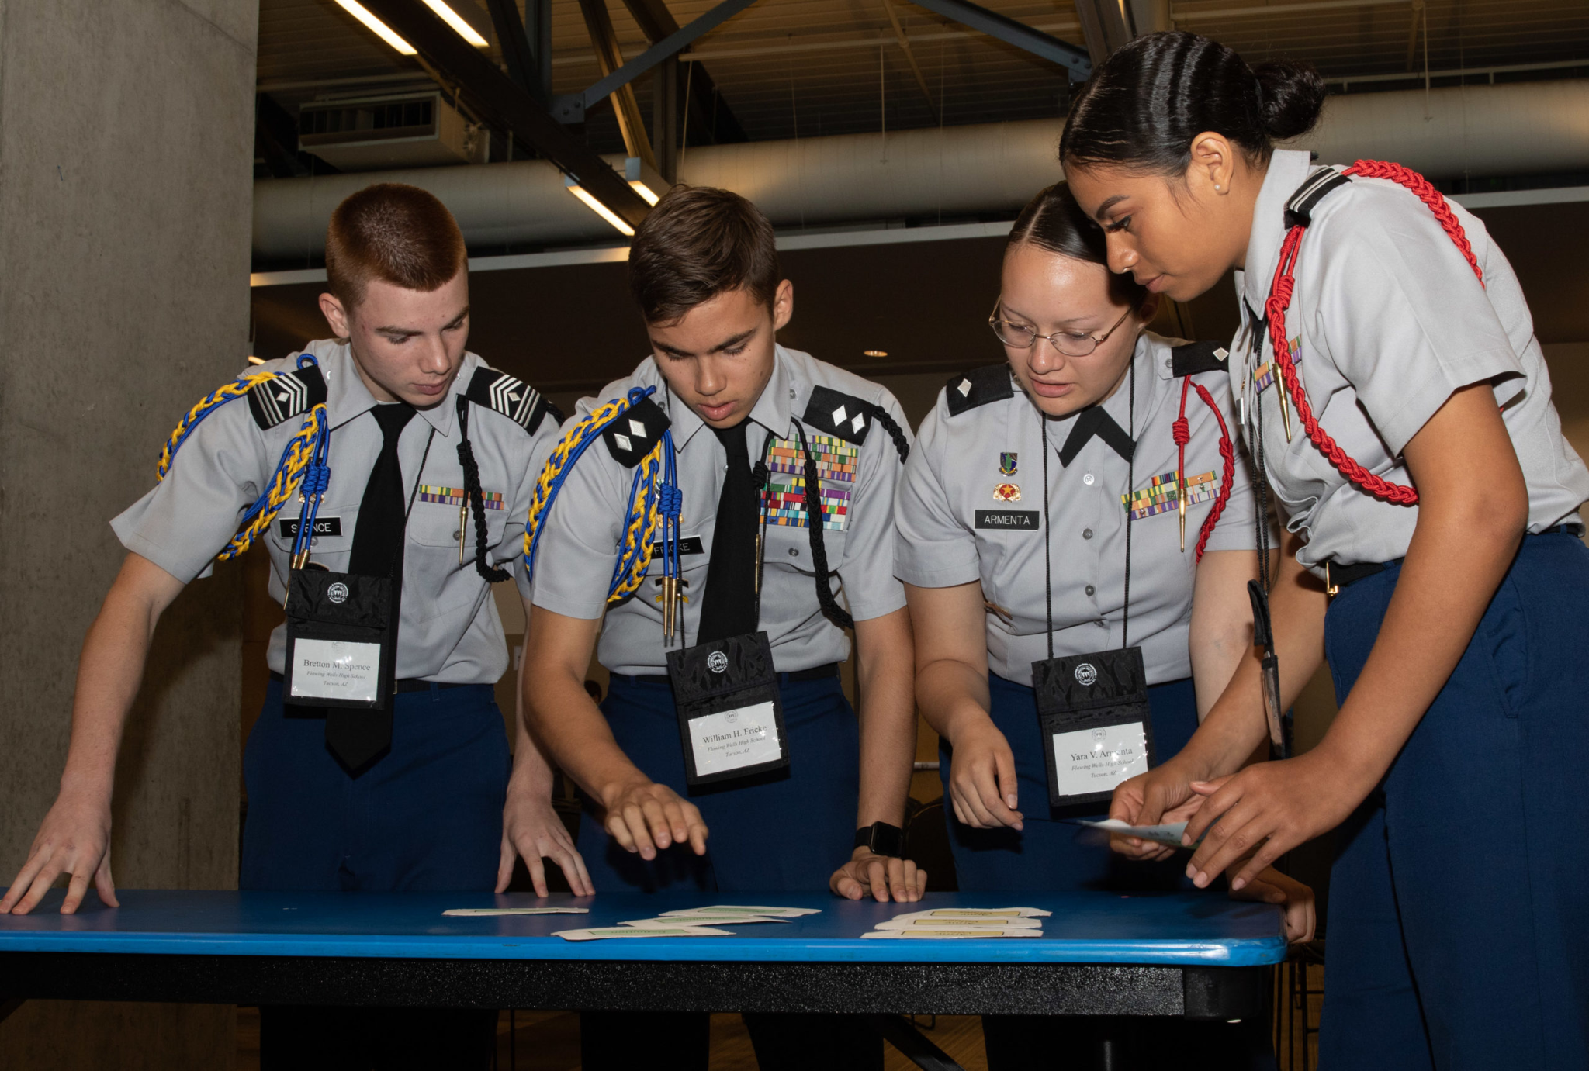
JLAB Interest Form
Junior Leadership & Academic bowl is a national competition that is comprised academic questions that vary from SAT based questions to current events.
Example Question: The function g(x) is defined by g(x) = x²+ 9 For which value of x is g(x) = 25 ? “
If you are interested in JLAB please fill out the interest form.
https://tinyurl.com/JLABFL802
For any questions, comments or concerns contact C/Staff Sergeant Ian Kristona @4804098968@students.ocps.net

Slide 6
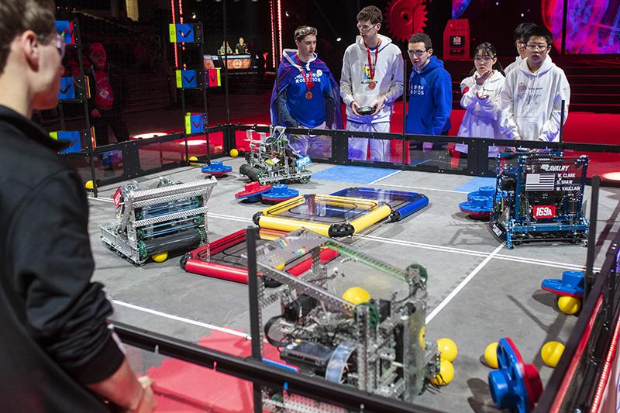
Robotics
Are you interested in engineering, robotics, or programming? Join the robotics LDR. For more information join Remind @fl802rec
Questions, comments, concerns, contact C/SMSgt Anthony Torres at (775) 544-0842 or 4806810625@studnets.ocps.net

Slide 7
Football Parking
TAKE A PICTURE!
Who: Our Cadet Corps
What: Direct people and their vehicles
When: 22 September
Where: Room 950(Colonel’s Room)
Why: To help out our school
Sign up: On the paper!
If you have any questions, contact C/Abney at +1(407) 961-2474.

Slide 8
PT Makeups
Sign up here for the PT makeups or on Canvas
https://tinyurl.com/PT2324
For any questions, comments or concerns contact C/SSgt Michael Romeu @4804278080@students.ocps.net and/ or 407-790-9996
Meet at the 900 building in PT gear by 1430. I won't wait for you, Be on time
Message me if you can’t make it.

Slide 9
Military Knowledge
What is the angle the feet should be at in attention?
45 degrees

Slide 10
Summary
Upcoming Events
KHHS Meeting (9/21)
Football Parking (9/22)
Notes
Robotics
PT Makeups
JLAB

Slide 11
Briefing Slides
If you have a slide for the briefing, contact C/ Cruz-Garcia at 4804173126@students.ocps.net
If you want something in the briefing, you must contact C/ Cruz-Garcia by Monday 1700 for the Tuesday brief and Wednesday 1700 for the Thursday brief

