Slide 1
West Orange FL-802
Semi-Weekly Brief
C/ Technical Sergeant Daphne Bray
1 February 2024
Lead,
Serve,
Dream
Unit Motto:

Slide 2
AFJROTC Mission
Develop citizens of character dedicated to serving their nation and community
Mission:
Goals:
Instill Values Of Citizenship,
Service To The United States,
Personal Responsibility/Sense Of Accomplishment

Slide 3
Chain of Command
Commander in Chief:
Sec Def:
Sec AF:
CSAF:
AETC CC:
AU CC:
Holm Center CC:
Director, AFJROTC:
SASI:
Group CC:
Deputy Group CC:
President Joseph R. Biden Jr.
Honorable Lloyd Austin
Honorable Frank Kendall
Gen David Allvin
Lt. Gen Brian S. Robinson
Lt. Gen Andrea D. Tullos
Brig Gen Houston R. Cantwell
Col Johnny R. McGonigal
Lt. Colonel Micheal Carrizales
C/ Captain Agrafena Ritz
C/ Major Elias Lopez

Slide 4
Athletic Clearance
These Cadets below are missing the Athletic Clearance:
Mezime - Delta
Bermudez - Alpha Osoria - Charlie
Ceballos - Charlie Palacios - Foxtrot
Damuth - Alpha Parboo - Alpha
DeSilva - Charlie Rosario - Delta
Doyle - Alpha Vazquez- Charlie
Funk - Golf Saint Franc - Alpha
Madera - Bravo
https://athleticclearance.fhsaahome.org/

Slide 5
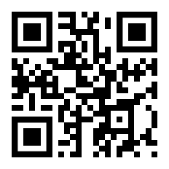
PT Makeups
Sign up here for the PT makeups or on Canvas
https://tinyurl.com/PT2324
For any questions,please contact C/A1C Ayana Putigna @4804185464@students.ocps.net
Meet at the 900 building in PT gear by 1430. Thursdays only.

Slide 6
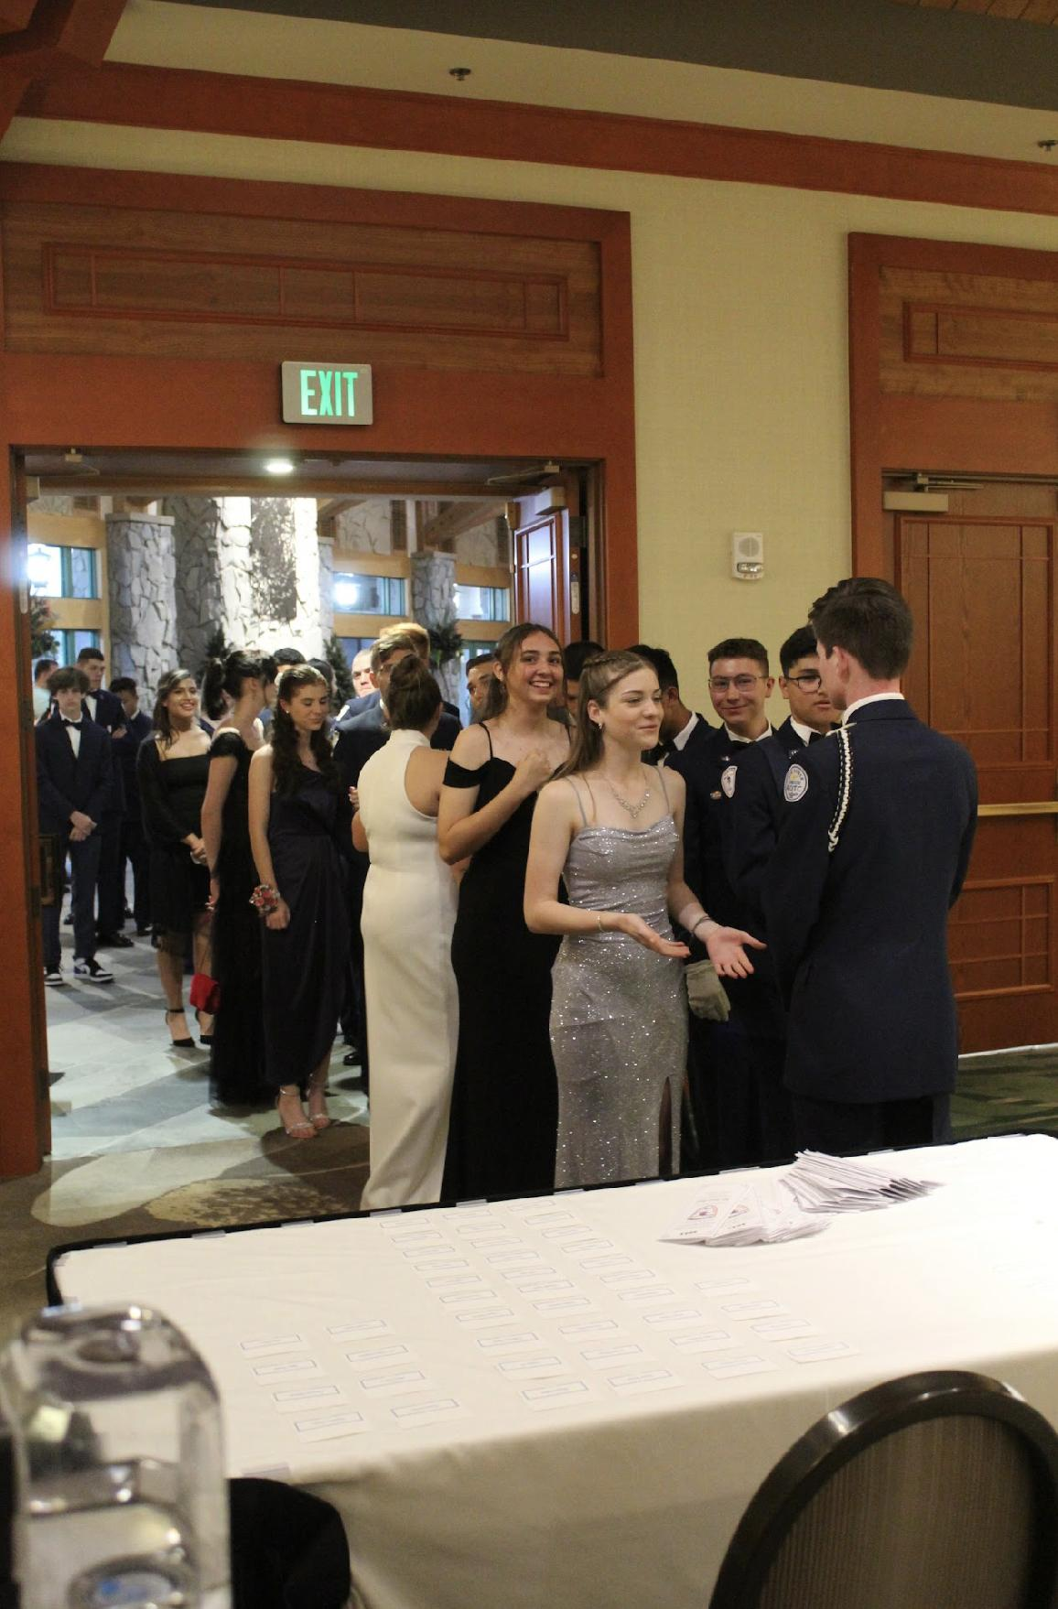
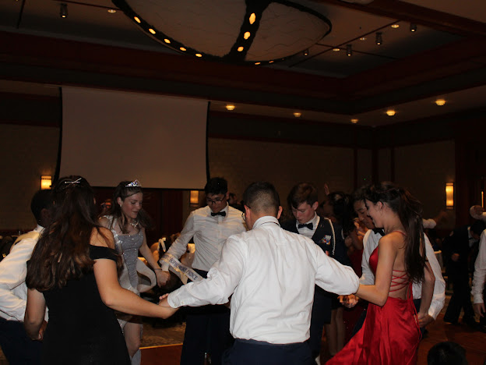
FL-802 Air Force Ball
Air Force Ball is our unit’s very own dance! It is a fun filled night with ceremonies, food, and lots of dancing! This years AFB is 10 February 2024 at Rosen Plaza from 1800 to 2200!
https://www.schoolpay.com/pay/for/Air-Force-Ball-Tickets-2324/SbGcCl
Ticket prices are as follows (ticket sales close 3 February!):
Cadets: $45
Guests: $50
If you have any questions or concerns, please contact C/ 1st Lt Sara Mattox @ 4072423829 or at 4804154679@students.ocps.net

Slide 7
Air Force Ball
This year’s Air Force Ball is going to be held at Rosen Plaza on 10 February from 1800-2200 hours. Dinner will be provided in a buffet style.
There is a dress code for Air Force Ball.
Males: JROTC uniform; service coat, dark blue pants, JROTC shoes, a white long-sleeve button down shirt AND a bow tie.
Logistics has bow ties, you have to make a Logistics appointment to borrow one and must return it after the ball. The appointments to get one will be as the ball gets closer. The white button down must be your own.
Females: appropriate formal attire (LONG dresses or JROTC uniform)
If you have any questions, or concerns please contact C/Sara Mattox at 4804154679@students.ocps.net or 407-242-3829.

Slide 8
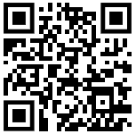
AFB Sabre Team Interest
We still need people for the Sabre team for Air Force Ball next weekend! If you have ANY interest in being on the team PLEASE fill the form out below!
If you are on the final voting for Royal Court you WILL NOT be placed on the team!!
http://tinyurl.com/SabreTeamInterest
If you have any questions or concerns, please contact C/ CMSgt Diego Cuevas @ 407-575-3811

Slide 9
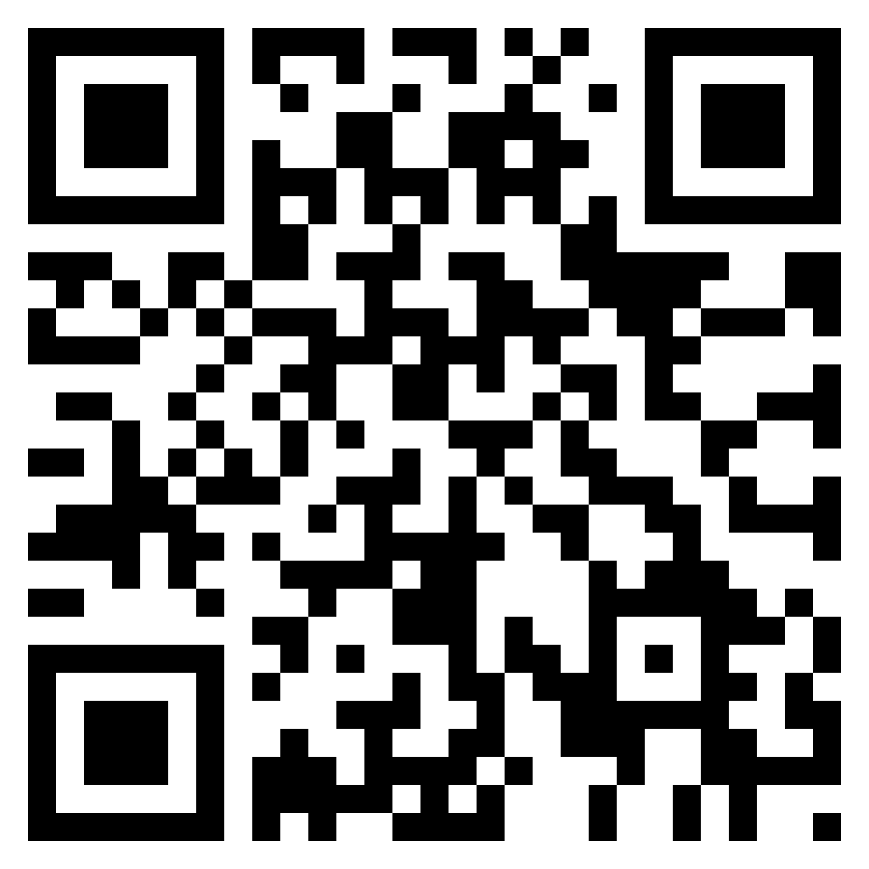
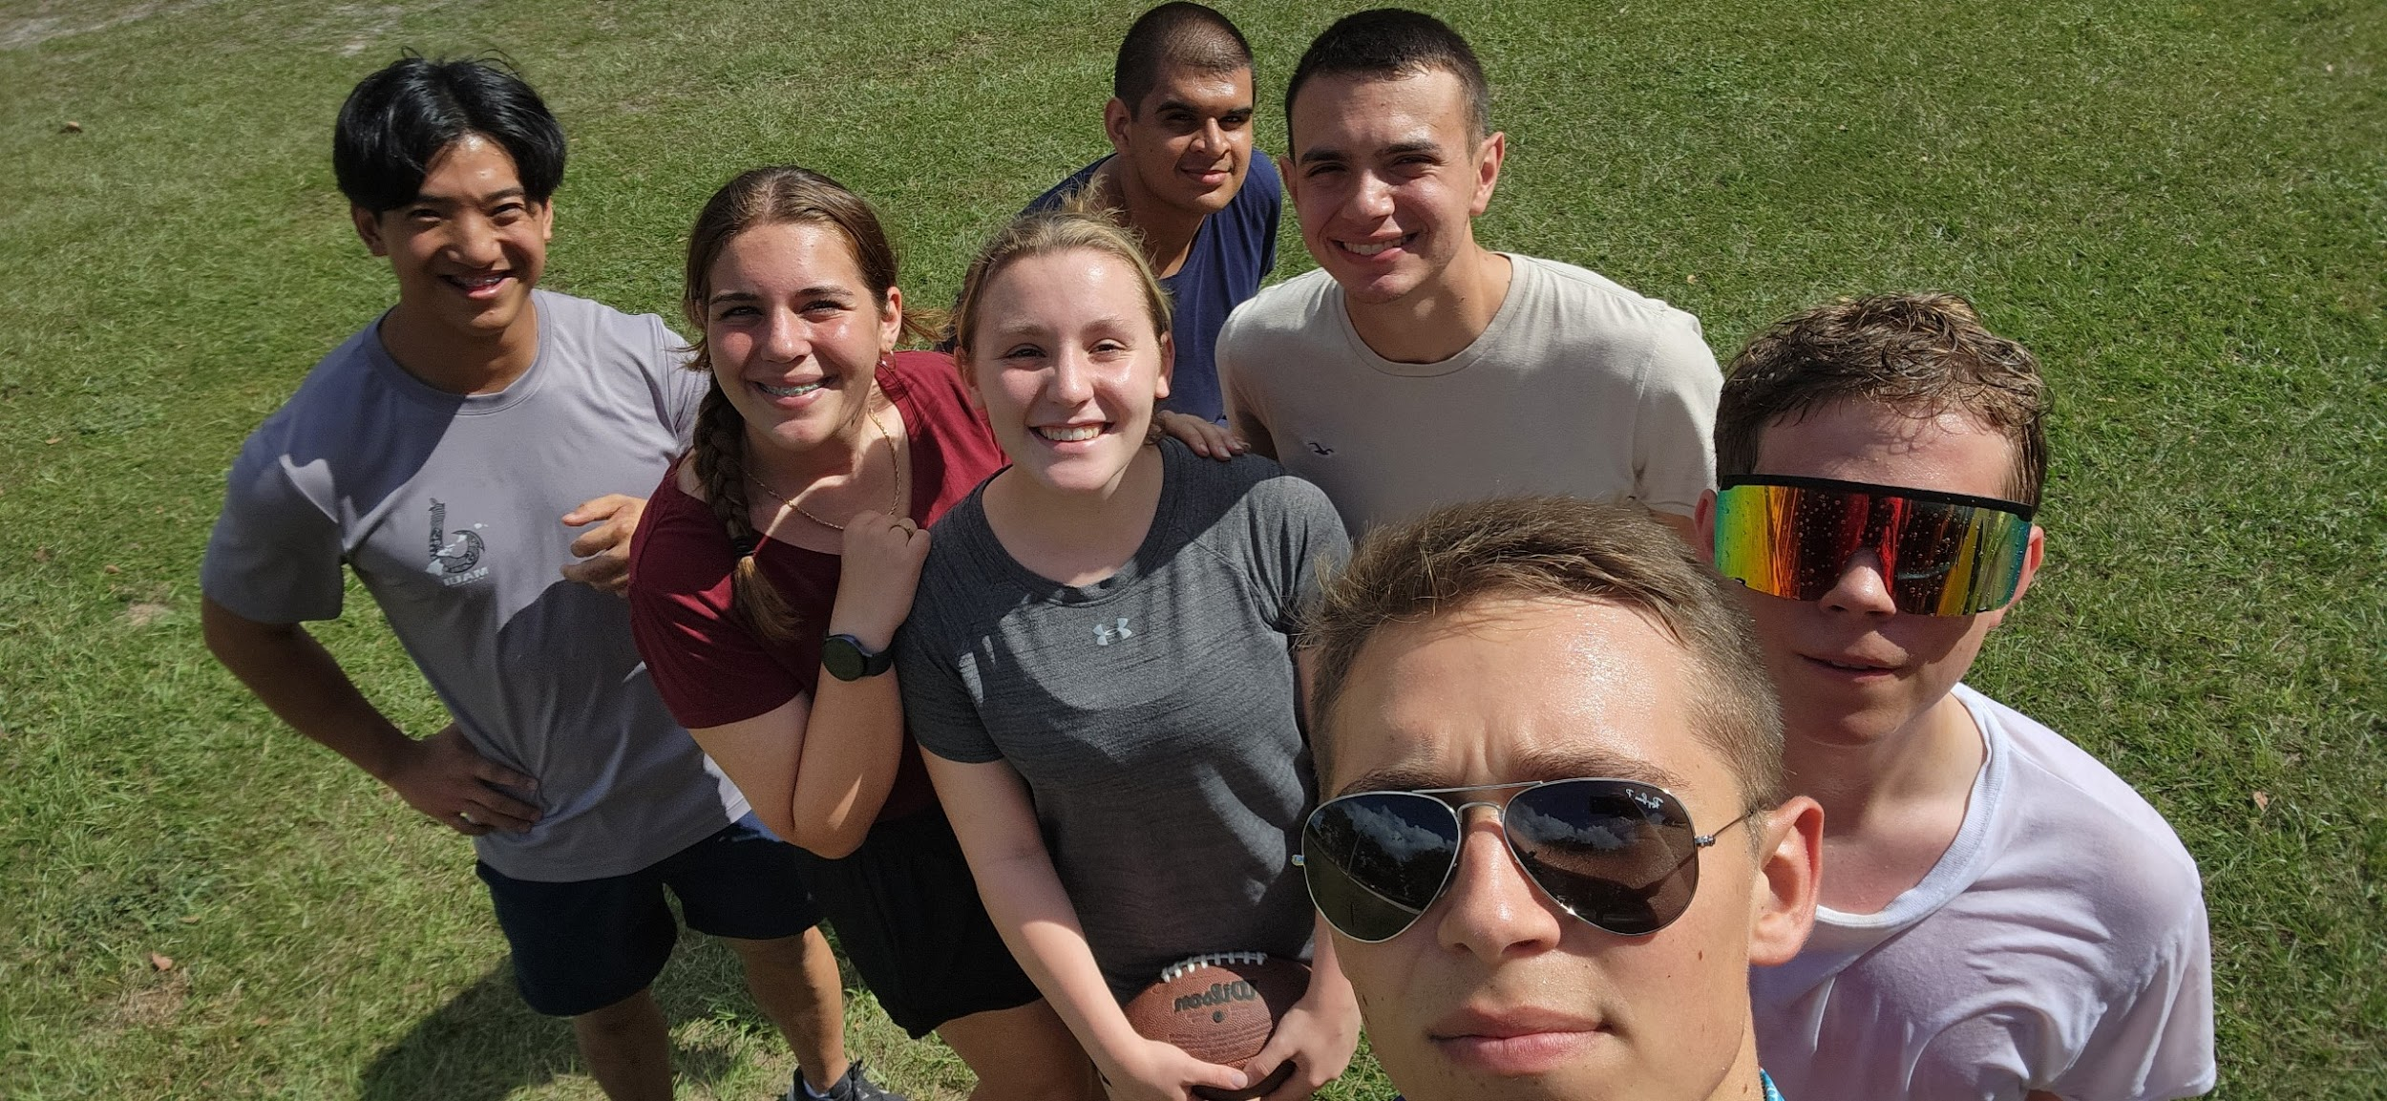
Unit Video
If you have any photos from the unit throughout the year, add them to this drive!
Share memories with your friends at the Air Force Ball!
Drive link: http://tinyurl.com/AFBUnitVideo24
If you have any questions, please contact C/Major Aidan Bernhard at 4804148902@students.ocps.net or +1(407) 408-6158 (For business purposes only)

Slide 10
Recruiting
Upcoming Events:
Sunridge Middle School visit (2/19/24)
Lakeview Middle School visit (2/19/24)
Hamlin Middle School visit (2/27/24)
To join recruiting Remind: Text @fl802re to 81010
Contact C/Amn David Peebles at 4804407123@students.ocps.net

Slide 11
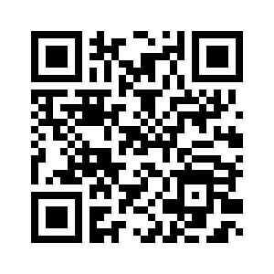
Middle School Visits
Do you want to visit the middle schools for recruiting? Fill out this form if you are interested: https://forms.gle/NKtCGFhXaynhrFu59
Questions? Contact c/A1C David Peebles 407-799-7063
4804407123@students.ocps.net

Slide 12
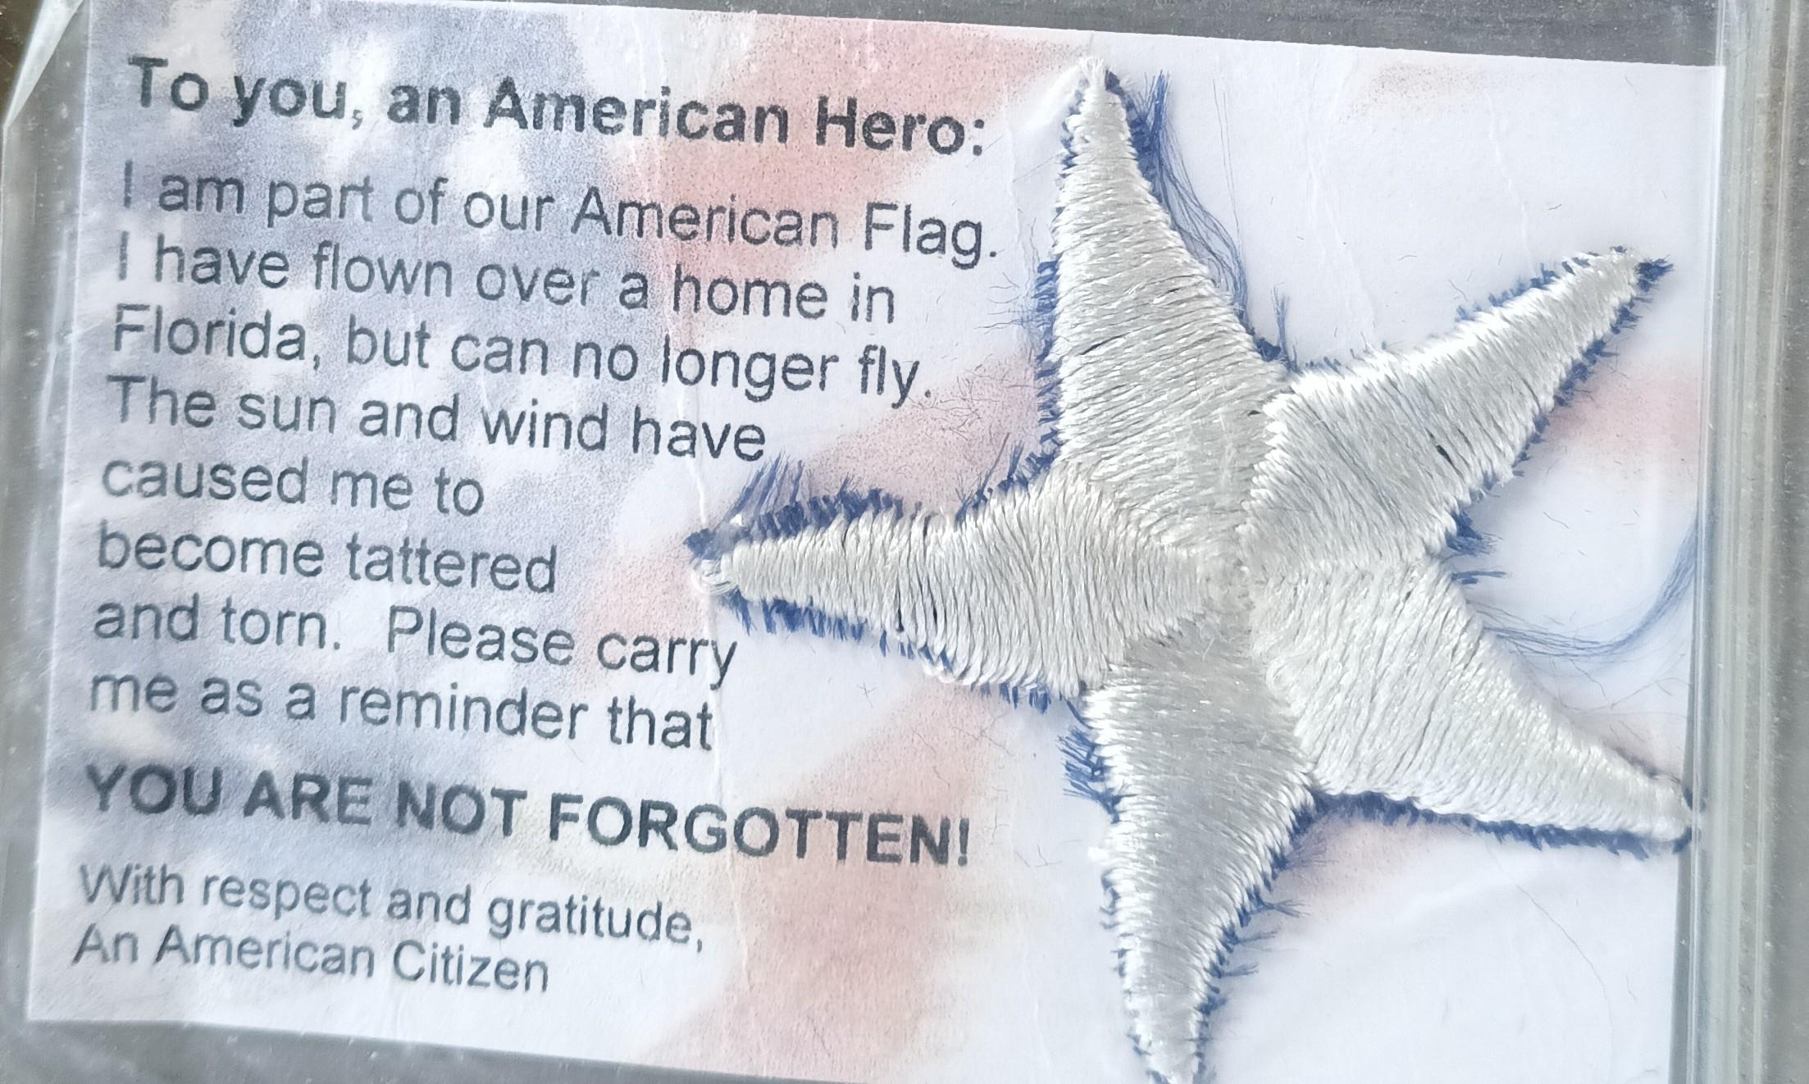
American Veterans Appreciation Service:
Project AVAS is a community service opportunity designed to show our veterans that we appreciate the sacrifices they have made. Cadets will receive craft kits to create the card pictured below. Once made, these cards will then be given to the Veterans Administration Building for distribution. (Date of Collection for finished projects pending.)
6 Cards = (1 Community Service Hour)
18 Cards = (3 Community Service Hours)
For any questions, comments or concerns please contact
Cadet Tech/Sgt Mincel via student email or text. (Business Purposes Only!)
E-Mail: 4806822834@students.ocps.net Text: (689-276-0745)

Slide 13
Blaze Spirit Night
We are having a spirit night at Blaze Pizza! If you attend, you will receive one merit!
When: 16 February, 6PM-9PM
Where: Blaze Pizza on West Colonial Drive (13599 W Colonial Dr).
Why: To raise money for our unit! :)
If you have any questions, comments, or concerns, please contact C/ CMSgt Diego Cuevas at 407-575-3811.

Slide 14
Model Rocketry
Interested in building model rockets? This is for you!
Model Rocketry is a STEM-based LDR in which you build launchable rockets. You will earn the Model Rocketry badge if you successfully launch 3 rockets.
Please contact C/ TSgt Princess Tolbert at 407-259-7171 or 4804191858@students.ocps.net if you are interested or have any questions.

Slide 15
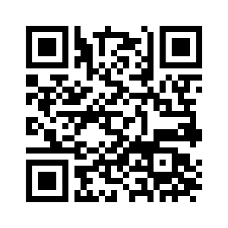
January Gold Rope
Flight Commanders,
Please submit your choices for Gold Rope for January from your respective flights by 2 Feb using the QR code below. Send in one first year and one upperclassmen recommendation. This award in an honor, so please be sure to submit cadets that represent our core values.
If you still have your Gold Rope from a previous win, please turn them in by 2 Feb to Lt. Col Carrizales or SMSgt Spencer.
Contact C/CMSgt Karynn Stewart at 407-797-7223 or 4804169963@students.ocps.net if you have any questions

Slide 16
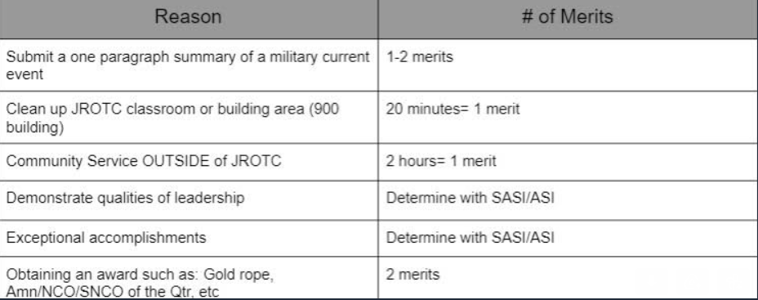
Merit Incentive Winners for Semester 1!
The following slide is the list of people who achieved Overall Merit Leader, Top 4 Merit Leaders, and the Top Merit Flight for Semester 1 of the 2023-2024 school year!
If you would like to receive this for semester 2 of this year, make sure to earn more merits, and encourage others in your flight to earn merits too! Look below to see how you can earn merits (take a picture)! This chart can also be found on our Unit’s website.
Any Cadet Senior NCO or Officer along with the instructors may give out merits and demerits

Slide 17
Merit Incentive Winners for Semester 1!
For the Overall Merit Winner and Top Four Merit Winners, please contact C/CMSgt Karynn Stewart at 407-797-7223 or 4804169963@students.ocps.net and let me know if you would like a $5 gift card to a place of your choosing OR your choice of candy!
For the Top Flight Merit Winner, please decide as a flight if you would like cookies OR cake and have your Flight Commander contact me!
*If you do not contact me by 2 Feb, you will not receive your reward!*
Congratulations!
Overall Merit Winner:
C/ Princess Tolbert
Top Four Merit Winners:
C/ Raleigh Brown
C/ Noah Abney
C/ Terran Davidson
C/ Zander Tawil
Top Flight Merit Winner:
Foxtrot Flight

Slide 18
Chief’s Quote of the Week
"For me, becoming isn’t about arriving somewhere or achieving a certain aim. I see it instead as forward motion, a means of evolving, a way to reach continuously toward a better self. The journey doesn't end."
Michelle Obama

Slide 19
Military Knowledge
Which state was last to join the Union and when?
Hawaii, 1959

Slide 20
Summary
Upcoming Events
AFB (2/10)
Notes
Athletic Clearances
PT Makeups
Unit Video
Middle School Visits
Gold Rope
Merit Incentive Winners
AFVS

Slide 21
Briefing Slides
If you have a slide for the briefing, contact C/ Bray at 4804208068@students.ocps.net or (689)-229-0443
If you want something in the briefing, you must contact C/ Bray by Monday 1700 for the Tuesday brief and Wednesday 1700 for the Thursday brief

