Slide 1
West Orange FL-802
Semi-Weekly Brief
C/ Staff Sergeant Eliud Cruz-Garcia
17 August 2023
Lead,
Serve,
Dream
Unit Motto:

Slide 2
AFJROTC Mission
Develop citizens of character dedicated to serving their nation and community
Mission:
Goals:
Instill Values Of Citizenship,
Service To The United States,
Personal Responsibility/Sense Of Accomplishment

Slide 3
Chain of Command
Commander in Chief:
Sec Def:
Sec AF:
CSAF:
AETC CC:
AU CC:
Holm Center CC:
Director, AFJROTC:
SASI:
Group CC:
Deputy Group CC:
President Joseph R. Biden Jr.
Honorable Lloyd Austin
Honorable Frank Kendall
Gen Charles Q. Brown Jr.
Lt Gen Brian S. Robinson
Lt Gen Andrea D. Tullos
Brig Gen Houston R. Cantwell
Col Johnny R. McGonigal
Lt. Colonel Michael Carrizales
C/ Major Aidan Bernhard
C/ 1st Lieutenant Antonio Torre

Slide 4
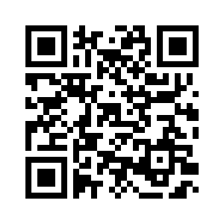
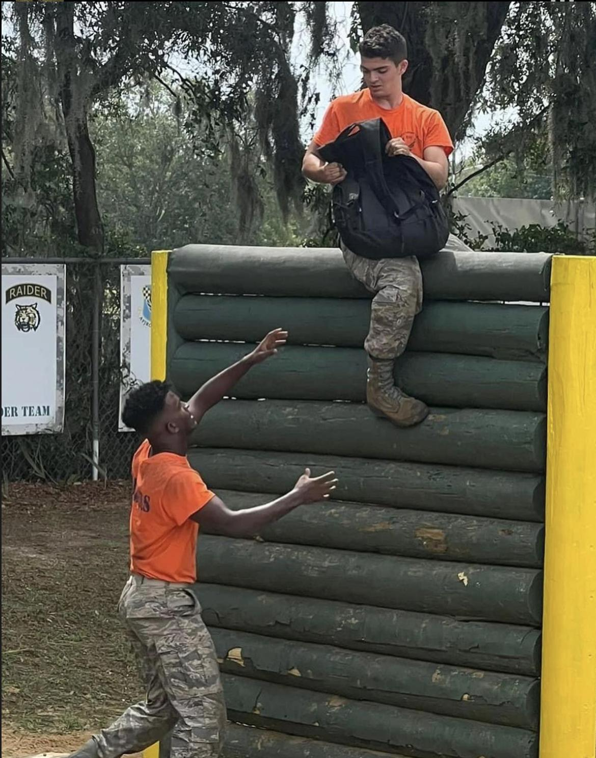
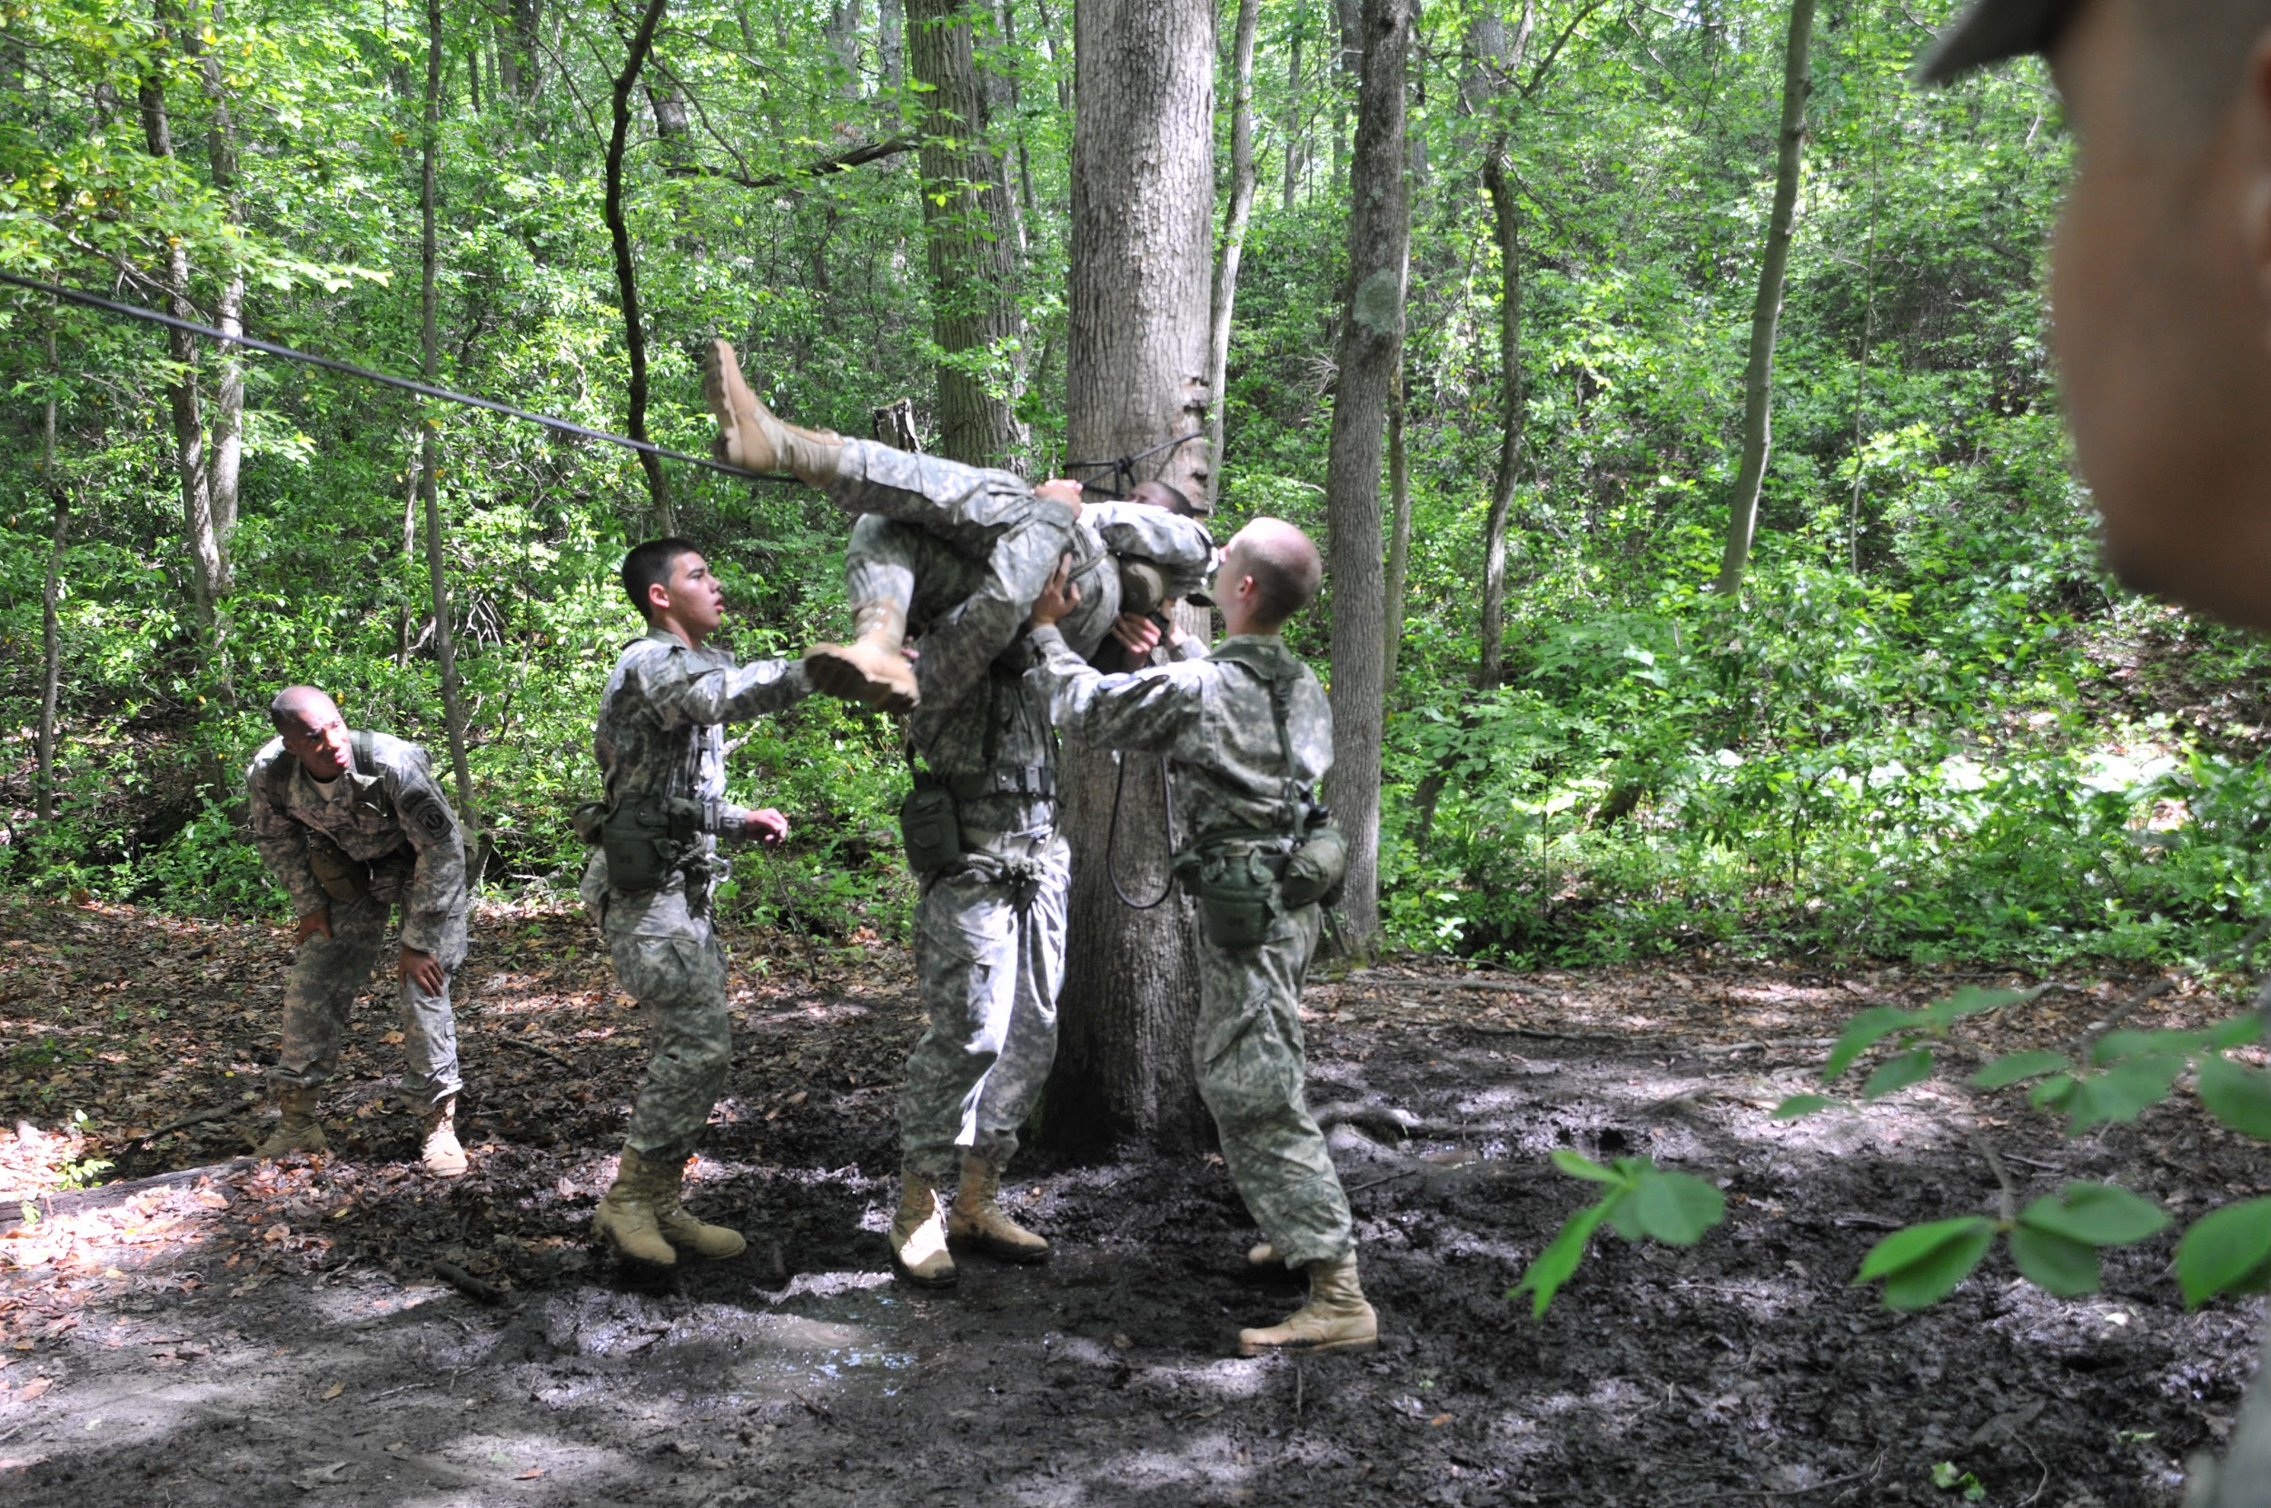
Raiders Interest Form and Interest Meeting
Raiders is a competitive athletic LDR. If you are interested in learning more about it or joining, there will be a meeting next Tuesday, 22 August, @ room 950 from 1430 to 1500.
https://tinyurl.com/joinraiders
For more details, please contact C/1st Lt. Antonio Torre at 4804182497@students.ocps.net or (407) 773-0450 for any questions about Raiders.
Take a Picture & Sign up!!

Slide 5
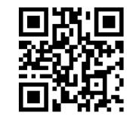
Logistics Appointment Schedule
New 2023-2024 Logistics appointment link
Logistics Appointment Form:
Monday: 1420-1500
Tuesday: 1420-1500
Thursday: 1420-1500
https://tinyurl.com/FL-802LGS
Questions, comments, concerns, contact C/SMSgt Anthony Torres at (775) 544-0842 or 4806810625@studnets.ocps.net

Slide 6
Football Parking
TAKE A PICTURE!
Who: Our Cadet Corps
What: Direct people and their vehicles
When: 25 August
Where: Room 950(Colonel’s Room)
Why:To help out our school
Sign up:On the paper!
If you would like to be CIC, please contact
C/Major Aidan Bernhard @ (407) 408-6158

Slide 7
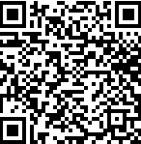
KHHS Interest Meeting
Kitty Hawk is an honors society within AFJROTC and is one of our many LDRs. If you have any interest in joining there will be a meeting 24 August from 1430 to 1515.
For any further details, please contact C/ 2nd Lt. Sara Mattox at (407) 242-3829 or 4804154679@students.ocps.net
https://tinyurl.com/KHHSInterestMeeting

Slide 8
Chief’s Quote of the Week
“Perfection is not attainable, but if we chase perfection we can catch excellence.”
Vince Lombardi

Slide 9
Military Knowledge
Who was the first president of the U.S.?
George Washington

Slide 10
Summary
Upcoming Events
Raiders Interest Meeting (8/22)
Football Parking (8/25)
Notes
Logistics Appointment Schedule

Slide 11
Briefing Slides
If you have a slide for the briefing, contact C/ Cruz-Garcia at 4804173126@students.ocps.net
If you want something in the briefing, you must contact C/Cruz-Garcia by Monday 1700 for the Tuesday brief and Wednesday 1700 for the Thursday brief

