Slide 1
Semi-Weekly Brief
C/ Staff Sergeant Eliud Cruz-Garcia
Unit Motto:
Lead,
Serve,
Dream
15 August 2023

Slide 2
AFJROTC Mission
Mission
Develop citizens of character dedicated to serving their nation and community.
Goals:
Instill Values Of Citizenship,
Service To The United States,
Personal Responsibility/Sense Of Accomplishment
Notes:
Why did you decide to join JROTC? (look around the room…ask around)
Field trips! Awesome! We do take trips throughout the year. We go to Kennedy Space Center, IITSEC, Sun and Fun…
Hopefully you’ll think this class is an Easy A IF you wear your uniform correctly. Uniform wear is worth 35% of your grade. If you wear it right and get your athletic clearance you should be able to do well in JROTC
Did your parents force you to take JROTC? Some cadets that came to JROTC may have a different idea of what we are. This is strictly a voluntary elective so if you don’t want to be here it’s not too late to ask for a schedule change. Hopefully though by the end of this briefing you’ll find that it’ll be worth it for you to give us a try.
Do you have friends or family in JROTC? Well I’m sure if they like it they’ll be happy to help you learn the ropes. If not, we will become friends and family anyway
Just for fun? Good…JROTC is fun
Because you could? Glad you joined

Slide 3
Chain of Command
Commander in Chief:
Sec Def:
Sec AF:
CSAF:
AETC CC:
AU CC:
Holm Center CC:
Director, AFJROTC:
SASI:
Group CC:
Deputy Group CC:
President Joseph R. Biden Jr.
Honorable Lloyd Austin
Honorable Frank Kendall
Gen Charles Q. Brown Jr.
Lt Gen Brian S. Robinson
Lt Gen Andrea D. Tullos
Brig Gen Houston R. Cantwell
Col Johnny R. McGonigal
Lt. Colonel Michael Carizalles
C/ Major Aidan Bernhard
C/ 1st Lieutenant Antonio Torre
Notes:
Why did you decide to join JROTC? (look around the room…ask around)
Field trips! Awesome! We do take trips throughout the year. We go to Kennedy Space Center, IITSEC, Sun and Fun…
Hopefully you’ll think this class is an Easy A IF you wear your uniform correctly. Uniform wear is worth 35% of your grade. If you wear it right and get your athletic clearance you should be able to do well in JROTC
Did your parents force you to take JROTC? Some cadets that came to JROTC may have a different idea of what we are. This is strictly a voluntary elective so if you don’t want to be here it’s not too late to ask for a schedule change. Hopefully though by the end of this briefing you’ll find that it’ll be worth it for you to give us a try.
Do you have friends or family in JROTC? Well I’m sure if they like it they’ll be happy to help you learn the ropes. If not, we will become friends and family anyway
Just for fun? Good…JROTC is fun
Because you could? Glad you joined

Slide 4
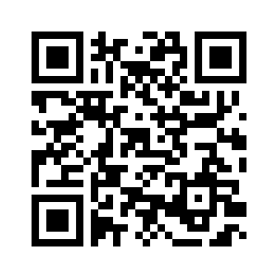
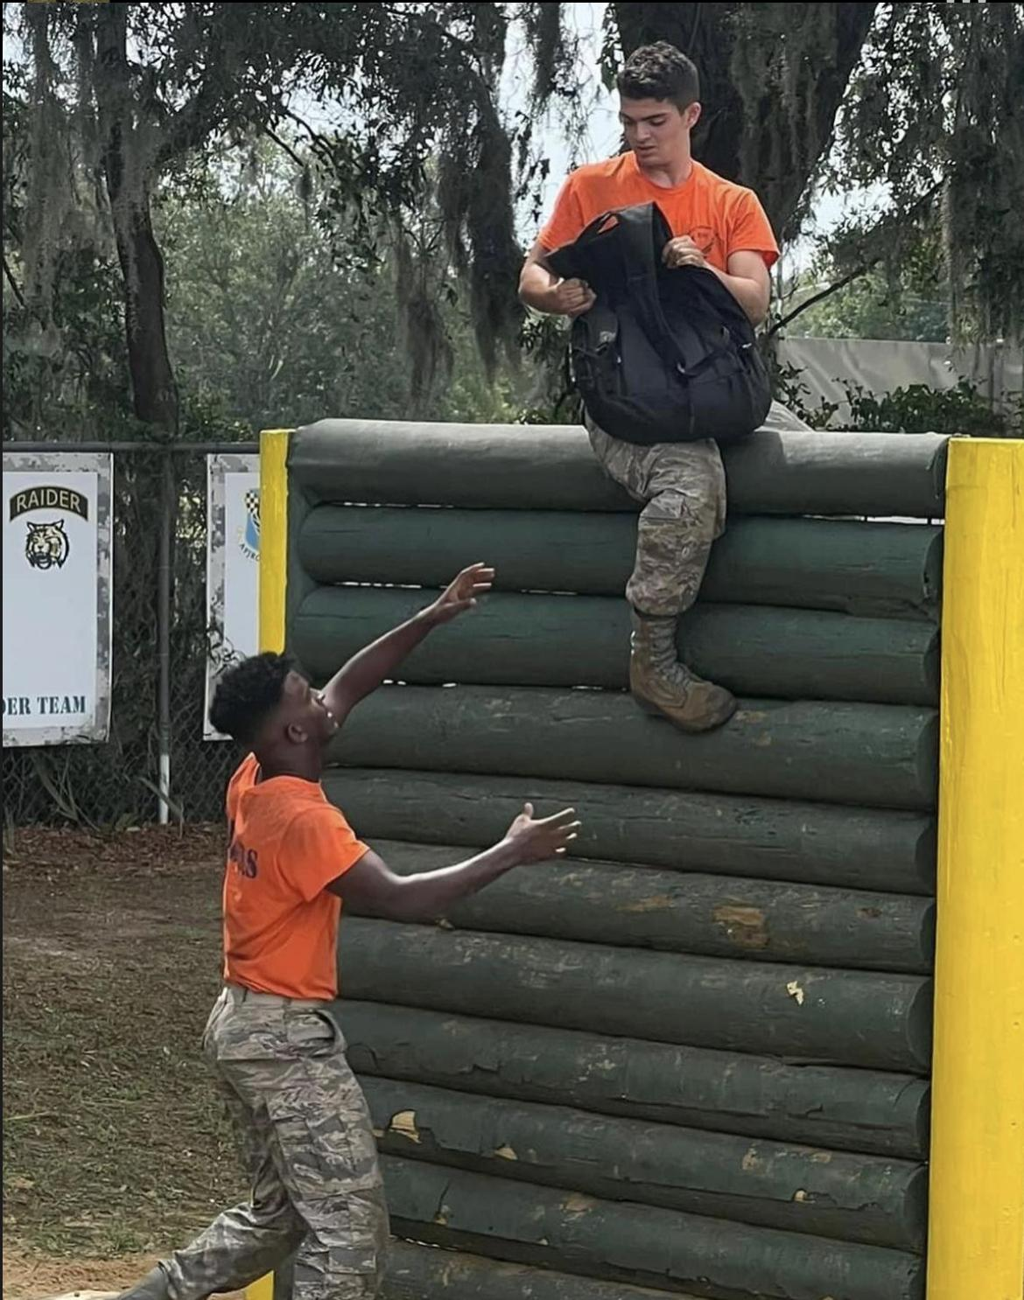
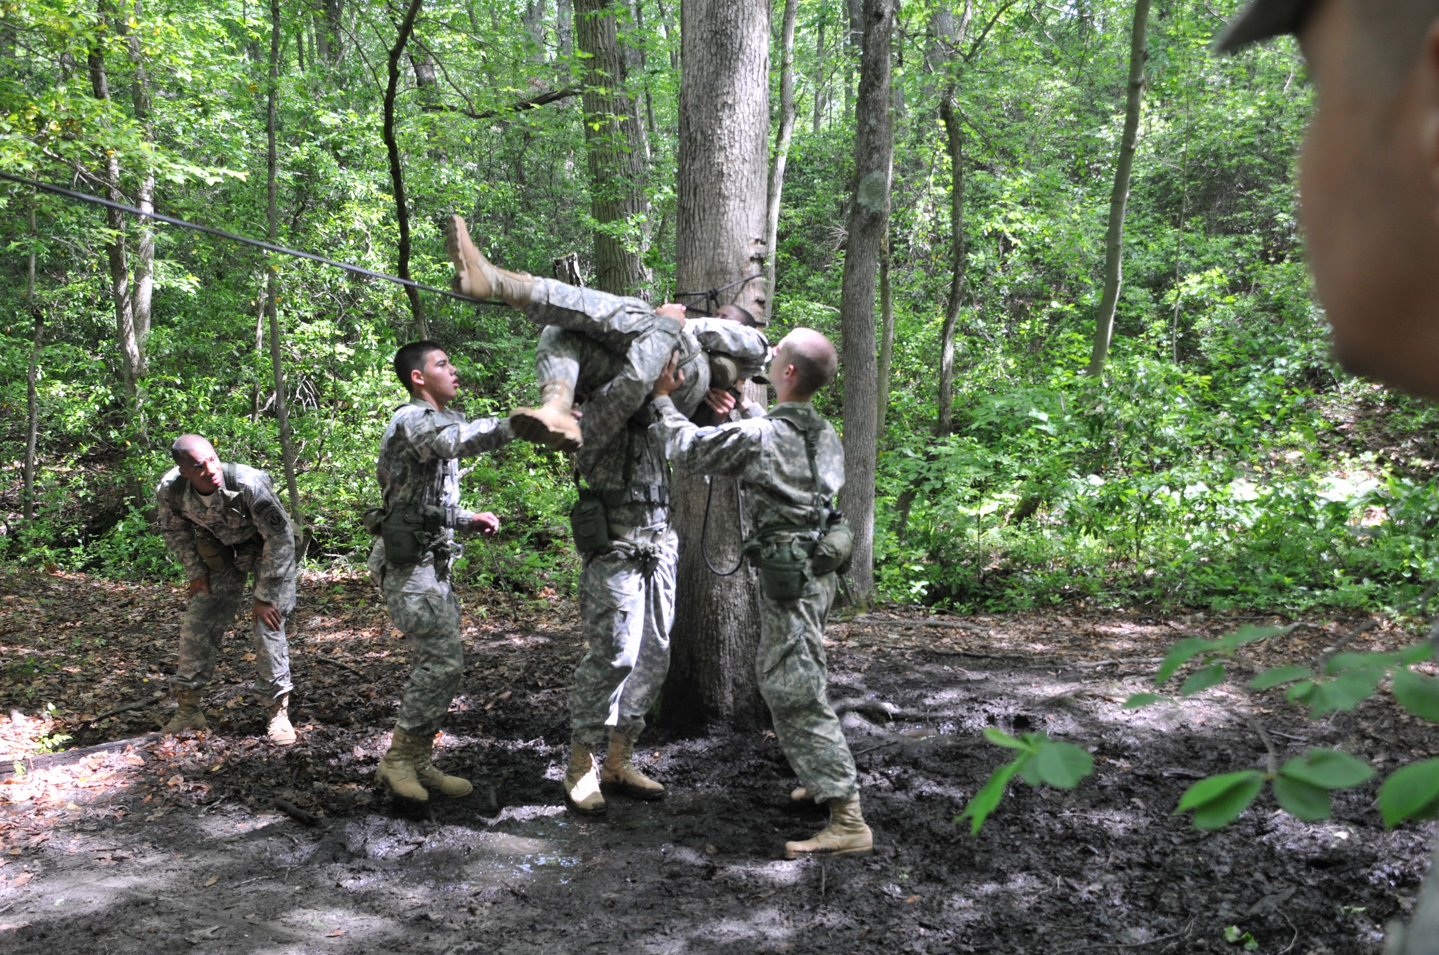
Raiders Interest Form and Interest Meeting
Raiders is a competitive athletic LDR. If you are interested in learning more about it or joining, there will be a meeting next Tuesday, 22 August, @ room 950 from 1430 to 1500.
https://tinyurl.com/joinraiders
For more details, please contact C/1st Lt. Antonio Torre at 4804182497@students.ocps.net or (407) 773-0450 for any questions about Raiders.

Slide 5
Sports Day!!!
This Friday there will be a Sports Day! Be prepared to have fun and compete with your flight… most importantly, remember to have your ATHLETIC CLEARANCE!!!

Slide 6
Logistics Appointment Schedule
New 2023-2024 Logistics appointment link
Logistics Appointment Form: https://tinyurl.com/FL-802LGS
Monday: 1420-1500
Tuesday: 1420-1500
Thursday: 1420-1500
Questions, comments, concerns, contact C/SMSgt Anthony Torres at (775) 544-0842 or 4806810625@studnets.ocps.net
Notes:
Why did you decide to join JROTC? (look around the room…ask around)
Field trips! Awesome! We do take trips throughout the year. We go to Kennedy Space Center, IITSEC, Sun and Fun…
Hopefully you’ll think this class is an Easy A IF you wear your uniform correctly. Uniform wear is worth 35% of your grade. If you wear it right and get your athletic clearance you should be able to do well in JROTC
Did your parents force you to take JROTC? Some cadets that came to JROTC may have a different idea of what we are. This is strictly a voluntary elective so if you don’t want to be here it’s not too late to ask for a schedule change. Hopefully though by the end of this briefing you’ll find that it’ll be worth it for you to give us a try.
Do you have friends or family in JROTC? Well I’m sure if they like it they’ll be happy to help you learn the ropes. If not, we will become friends and family anyway
Just for fun? Good…JROTC is fun
Because you could? Glad you joined

Slide 7
Military Knowledge
How many stars are on the flag and what do they mean?
50; they represent all 50 states
Notes:
Why did you decide to join JROTC? (look around the room…ask around)
Field trips! Awesome! We do take trips throughout the year. We go to Kennedy Space Center, IITSEC, Sun and Fun…
Hopefully you’ll think this class is an Easy A IF you wear your uniform correctly. Uniform wear is worth 35% of your grade. If you wear it right and get your athletic clearance you should be able to do well in JROTC
Did your parents force you to take JROTC? Some cadets that came to JROTC may have a different idea of what we are. This is strictly a voluntary elective so if you don’t want to be here it’s not too late to ask for a schedule change. Hopefully though by the end of this briefing you’ll find that it’ll be worth it for you to give us a try.
Do you have friends or family in JROTC? Well I’m sure if they like it they’ll be happy to help you learn the ropes. If not, we will become friends and family anyway
Just for fun? Good…JROTC is fun
Because you could? Glad you joined

Slide 8
Football Parking
TAKE A PICTURE!
Who: Our Cadet Corps
What: Direct people and their vehicles
When: 25 August
Where: Room 950(Colonel’s Room)
Why:To help out our school
Sign up:On the paper!
If you would like to be CIC, please contact C/Bernhard @ (407) 408-6158

Slide 9
Summary
- Upcoming Events:
Sports Day 8/18
Raiders Interest Meeting 8/22
Football Game 8/25
- Notes
Logistics Appointments
Notes:
Why did you decide to join JROTC? (look around the room…ask around)
Field trips! Awesome! We do take trips throughout the year. We go to Kennedy Space Center, IITSEC, Sun and Fun…
Hopefully you’ll think this class is an Easy A IF you wear your uniform correctly. Uniform wear is worth 35% of your grade. If you wear it right and get your athletic clearance you should be able to do well in JROTC
Did your parents force you to take JROTC? Some cadets that came to JROTC may have a different idea of what we are. This is strictly a voluntary elective so if you don’t want to be here it’s not too late to ask for a schedule change. Hopefully though by the end of this briefing you’ll find that it’ll be worth it for you to give us a try.
Do you have friends or family in JROTC? Well I’m sure if they like it they’ll be happy to help you learn the ropes. If not, we will become friends and family anyway
Just for fun? Good…JROTC is fun
Because you could? Glad you joined

Slide 10
Briefing Slides
If you have a slide for the briefing, contact C/ Cruz-Garcia at 4804173126@students.ocps.net
If you want something in the briefing, you must contact C/Cruz-Garcia by Monday 1700 for the Tuesday brief and Wednesday 1700 for the Thursday brief
Notes:
Why did you decide to join JROTC? (look around the room…ask around)
Field trips! Awesome! We do take trips throughout the year. We go to Kennedy Space Center, IITSEC, Sun and Fun…
Hopefully you’ll think this class is an Easy A IF you wear your uniform correctly. Uniform wear is worth 35% of your grade. If you wear it right and get your athletic clearance you should be able to do well in JROTC
Did your parents force you to take JROTC? Some cadets that came to JROTC may have a different idea of what we are. This is strictly a voluntary elective so if you don’t want to be here it’s not too late to ask for a schedule change. Hopefully though by the end of this briefing you’ll find that it’ll be worth it for you to give us a try.
Do you have friends or family in JROTC? Well I’m sure if they like it they’ll be happy to help you learn the ropes. If not, we will become friends and family anyway
Just for fun? Good…JROTC is fun
Because you could? Glad you joined

