Slide 1
West Orange FL-802
Semi-Weekly Brief
C/ Staff Sergeant Daphne Bray
11 January 2024
Lead,
Serve,
Dream
Unit Motto:

Slide 2
AFJROTC Mission
Develop citizens of character dedicated to serving their nation and community
Mission:
Goals:
Instill Values Of Citizenship,
Service To The United States,
Personal Responsibility/Sense Of Accomplishment

Slide 3
Chain of Command
Commander in Chief:
Sec Def:
Sec AF:
CSAF:
AETC CC:
AU CC:
Holm Center CC:
Director, AFJROTC:
SASI:
Group CC:
Deputy Group CC:
President Joseph R. Biden Jr.
Honorable Lloyd Austin
Honorable Frank Kendall
Gen David Allvin
Lt. Gen Brian S. Robinson
Lt. Gen Andrea D. Tullos
Brig Gen Houston R. Cantwell
Col Johnny R. McGonigal
Lt. Colonel Micheal Carrizales
C/ Captain Agrafena Ritz
C/ Captain Elias Lopez

Slide 4
Athletic Clearance
These Cadets below are missing the Athletic Clearance:
Aguilar - Bravo Mezime - Delta
Bermudez - Alpha Osoria - Charlie
Ceballos - Charlie Palacios - Foxtrot
Damuth - Alpha Parboo - Alpha
DeSilva - Charlie Rosario - Delta
Doyle - Alpha Vazquez- Charlie
Go- Golf Almodovar-Charlie
Madera - Bravo Saint Franc-Alpha
https://athleticclearance.fhsaahome.org/

Slide 5
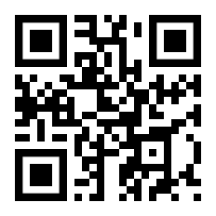
PT Makeups
Sign up here for the PT makeups or on Canvas
https://tinyurl.com/PT2324
For any questions,please contact C/A1C Ayana Putigna @4804185464@students.ocps.net
Meet at the 900 building in PT gear by 1430. Thursdays only.

Slide 6
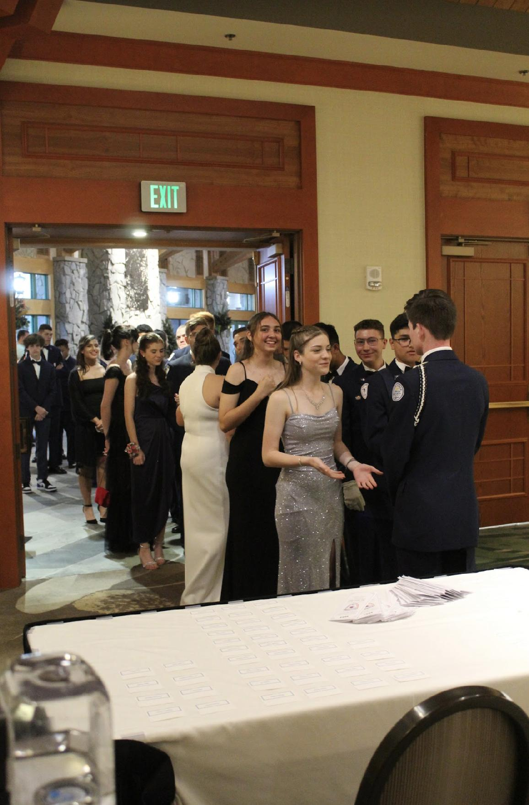
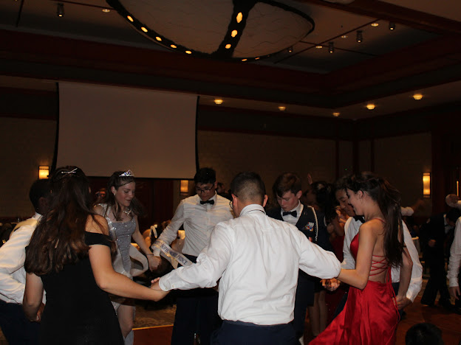
FL-802 Air Force Ball
Air Force Ball is our unit’s very own dance! It is a fun filled night with ceremonies, food, and lots of dancing! This years AFB is 10 February 2024 at Rosen Plaza from 1800 to 2200!
https://www.schoolpay.com/pay/for/Air-Force-Ball-Tickets-2324/SbGcCl
Ticket prices are as follows:
Cadets: $45
Guests: $50
If you have any questions or concerns, please contact C/ 1st Lt Sara Mattox @ 4072423829 or at 4804154679@students.ocps.net

Slide 7
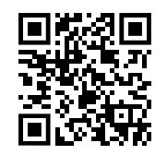
AFB Ceremonial Teams Interest
AFB is full of ceremonies and we need cadets to perform them! If you have interest in being part of our Color Guard, POW/MIA, or sabre teams, please fill out the google form below!
If you are a female, please keep in mind that you will NOT be placed on a team UNLESS you are wearing your uniform to the whole dance! GOOGLE FORM CLOSES 12 JANUARY!!!
http://tinyurl.com/AFBTeamInterest
If you have any questions or concerns, please contact C/ CMSgt Diego Cuevas @ 407-575-3811

Slide 8
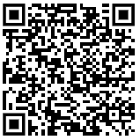
Air Force Ball Playlist
Please fill out this Google Form with songs that you would like to be added to this year’s Air Force Ball Playlist! GOOGLE FORM CLOSES 17 JANUARY!!
Songs must be PG.
*Note: not all songs will be played.*
If you have any questions or concerns, please contact C/ 1st Lt. Sara Mattox @ 4072423829 or 4804154679@students.ocps.net
http://tinyurl.com/AFBSongs2024

Slide 9
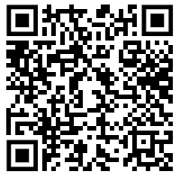
Air Force Ball RSVP
Here is a link to fill out an RSVP for the Air Force Ball on February 10th.
If you have any questions or concerns please contact C/SSgt Vanessa Maloney at 321-318-2929 or 4804210309@students.ocps.net

Slide 10
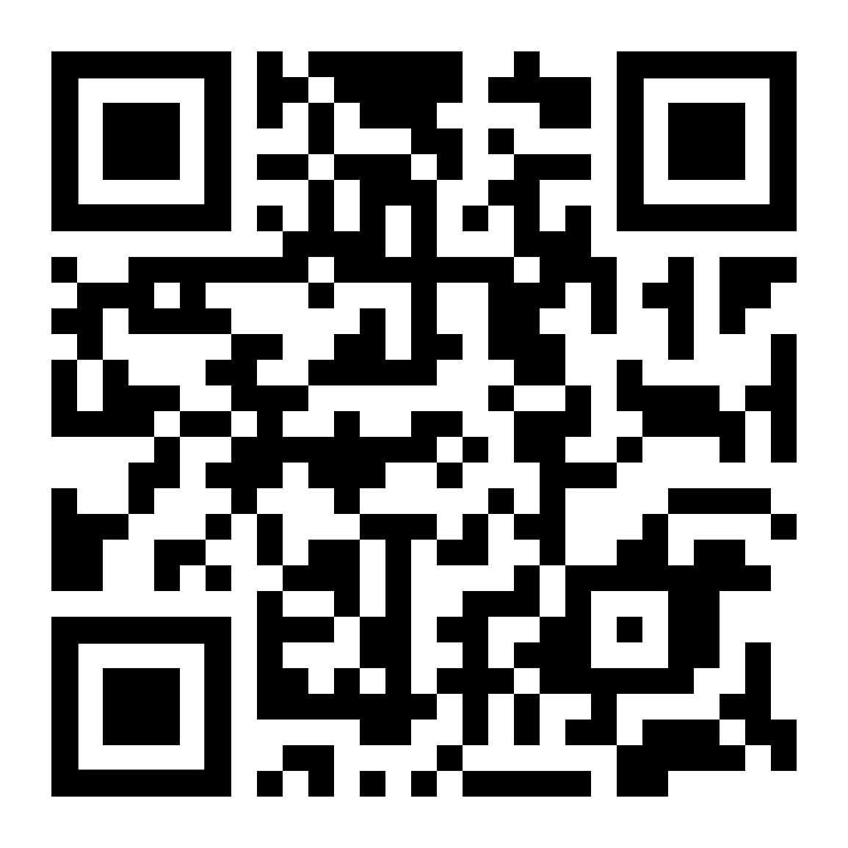
CICs/ DCICs
If you have been a CIC or DCIC, please fill out the google form by scanning the QR code or going to the link below.
http://tinyurl.com/3p4khh8s
If you have any questions, please contact C/ SSgt Gabriel Motta at 4804175879@students.ocps.net

Slide 11
Recruiting Interest Meeting
Have some recruiting ideas for 2024?
Log in and share!
We will discuss current projects, upcoming events, and new ideas!
Microsoft teams meeting at 6:30 PM
Held on 1/11/2024 (today)
Any and all ideas are welcome!
Have an idea but can’t be there?
Please contact… 4804407123@students.ocps.net

Slide 12
Bataan Death March
TAKE A PICTURE!
Who: Our Cadet Corps, Dr. Phillips and Ocoee Cadet Corps
What: 14.4 Mile March on the West Orange Trail
When: 20 January, from 0730-1330
Where: Killarney Station to Chapin Station (Round Trip)
Why: To Honor Prisoners of War
Uniform: Combo 4 (PT Clothes and Orange Shirt)
Sign Up: Sheet on the Board
If you have any questions, please contact C/ MSgt Noah Abney @ 407-961-2474 or 4804172400@students.ocps.net.

Slide 13
Chief’s Quote of the Week
“Humility leads to strength and not to weakness. It is the highest form of self-respect to admit mistakes and to make amends for them.”
– John J. McCloy

Slide 14
Military Knowledge
What are the two types of drill formation?
Column and line formations

Slide 15
Summary
Upcoming Events
Recruiting Interest Meeting (1/11)
Bataan Death March (1/20)
Notes
Athletic Clearances
AFB
PT Makeups

Slide 16
Briefing Slides
If you have a slide for the briefing, contact C/ Bray at 4804208068@students.ocps.net or (689)-229-0443
If you want something in the briefing, you must contact C/ Bray by Monday 1700 for the Tuesday brief and Wednesday 1700 for the Thursday brief

