Slide 1
West Orange FL-802
Semi-Weekly Brief
C/ Staff Sergeant Eliud Cruz-Garcia
10 October 2023
Lead,
Serve,
Dream
Unit Motto:

Slide 2
AFJROTC Mission
Develop citizens of character dedicated to serving their nation and community
Mission:
Goals:
Instill Values Of Citizenship,
Service To The United States,
Personal Responsibility/Sense Of Accomplishment

Slide 3
Chain of Command
Commander in Chief:
Sec Def:
Sec AF:
CSAF (Acting):
AETC CC:
AU CC:
Holm Center CC:
Director, AFJROTC:
SASI:
Group CC:
Deputy Group CC:
President Joseph R. Biden Jr.
Honorable Lloyd Austin
Honorable Frank Kendall
Gen David Allvin
Lt. Gen Brian S. Robinson
Lt. Gen Andrea D. Tullos
Brig Gen Houston R. Cantwell
Col Johnny R. McGonigal
Lt. Colonel Micheal Carrizales
C/ Major Aidan Bernhard
C/ 1st Lieutenant Antonio Torre

Slide 4
Athletic Clearance
These Cadets below are missing the Athletic Clearance:
Aguilar - Bravo Mezime - Delta Almodovar-Charlie
Bermudez - Alpha Osoria - Charlie
Ceballos - Charlie Palacios - Foxtrot
Damuth - Alpha Parboo - Alpha
DeSilva - Charlie Rosario - Delta
Doyle - Alpha Vazquez- Charlie
Hibbert - Foxtrot Weidner - Alpha
Madera - Bravo James- Golf
https://athleticclearance.fhsaahome.org/

Slide 5
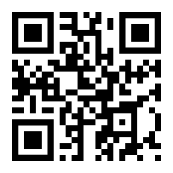
PT Makeups
Sign up here for the PT makeups or on Canvas
https://tinyurl.com/PT2324
For any questions, comments or concerns contact
C/SSgt Michael Romeu @4804278080@students.ocps.net and 407-790-9996
Meet at the 900 building in PT gear by 1430. I won't wait for you, Be on time
Thursday’s Only, Contact me if this does not work for you

Slide 6
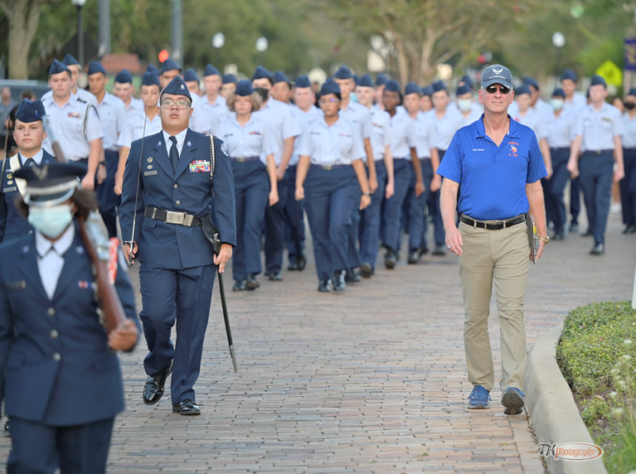
Homecoming Parade
March with us for the Homecoming Parade!
Time: 10 October at 1630 hours
Location: Downtown Winter Garden (Parking lot at 63 S Woodland St)
Uniform: Combination 1 (Blues without the tie/tie tab; REQUIRED)
Lead the parade, and represent the unit, and school well!
Sign up in room 950.
Please Contact C/Maj. Bernhard at +1(407) 408-6158 if you would like to be CIC for this event.

Slide 7
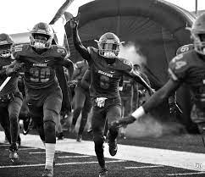
Football Parking
Time: 16:30 to 19:30
When: 13th, October
Where: Room 950(Colonel’s Room)
Uniform: COMBO 5
(you can only go if you have combo 5)
If you would like to be CIC, please contact C/Bernhard at +1(407) 408-6158

Slide 8
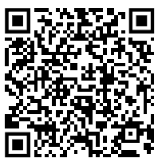
Special Olympics
Central Region Golf Competition
Time: 0700 to 1330
Date: Sunday, October 22, 2023
Where: Wedgefield Golf Club, 20550 Maxim Pkwy, Orlando, FL 32833
If you wish to participate in this event please sign up by October 12th so we can have the final headcount by October 13th. Lunch will be provided by the special olympics team. It is recommended that you bring a hat, bug spray, water bottle, and sunscreen. Please wear combo 4 (PT gear) and closed toed shoes
Please sign up here as well as the paper sign up sheet in
class. https://forms.gle/aiuoVF5ij9rz4EsG7
CIC needed for event
If you have any questions please contact C/ Vanessa Maloney @321-318-2929

Slide 9
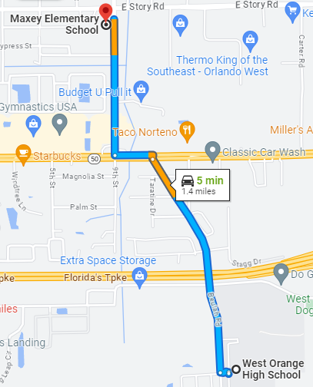
Maxey Elementary Fall Festival
October 26th, 4pm – 8pm
You will be assigned to work on concessions, parking, games, or teacher assistance
If there is enough signups, it can be divided into two shifts.
One shift = 10 – 15 volunteers (4 hours)
OR
Two shifts = 20 – 30 volunteers (2 hours)
602 E Story Rd, Winter Garden, FL 34787
For any questions, comments, or concerns, please contact
C/SrAmn Kei Seddon @ 321-888-1698

Slide 10
FL-802 Unit Picnic!!
The unit picnic is the first time during the school year the whole unit is invited out to meet one another and boost morale! Food, fun, and friends is what this event is all about!
Parents and family are more than welcome to come and hang out for the duration of the picnic. (more information on the next slide.)
Date: 28 October
Time: 1100-1400
Location: Veterans Memorial Park (420 S Park Ave, Winter Garden, FL)

Slide 11
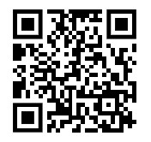
FL-802 Unit Picnic!!
If you are interested in going please fill out the google form below as well as fill out the perfect potluck link!
https://tinyurl.com/802UnitPicnicInterest
https://tinyurl.com/PerfectPotluck802
If you have any questions or concerns, please contact C/ 2nd Lt Sara Mattox @ 4072423829

Slide 12
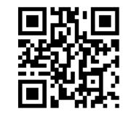
Service Coats
Questions, comments, concerns, contact C/SMSgt Anthony Torres at (775) 544-0842 or 4806810625@studnets.ocps.net
If you do not yet have a service coat please make a logistics appointment at https://tinyurl.com/FL-802LSS

Slide 13
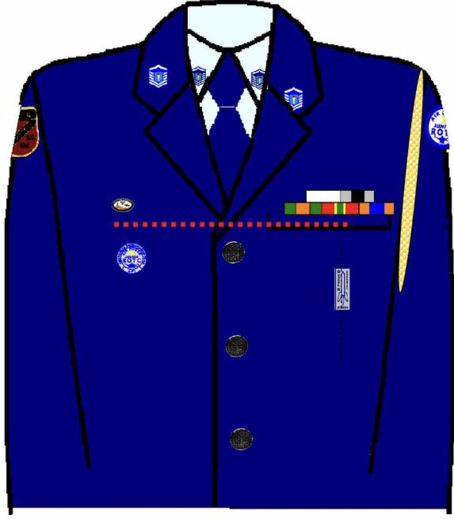
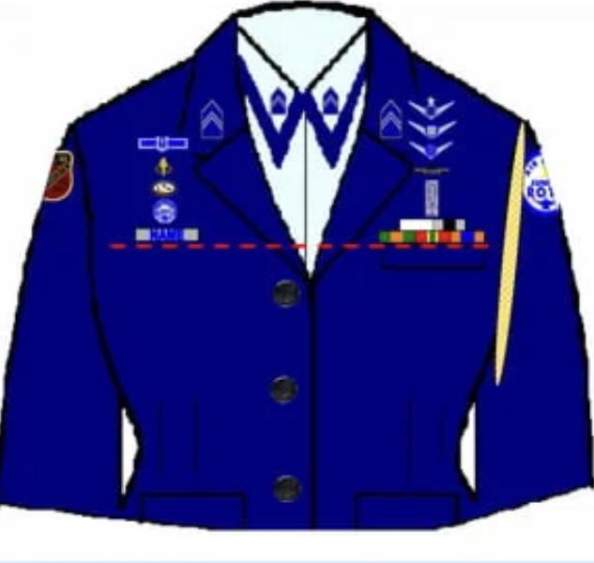
Weekly Uniform Reminder
Silver Name tag are worn centered on the wearer’s right between the sleeve seam and lapel and the bottom of the name tag will be parallel with the bottom of ribbons.
Ribbons are worn centered on the wearer’s left pocket resting on but not over edge of welt pocket.

Slide 14
Inspection Marching Team
We need 2nd years and some exceptional 1st years to march the 30 count for inspection. If you’re on this list, you’ve stood out in your drill skills and we want to help you get better to do good in marching for inspection;
Motta, G., Sanchez, Borgeson, Dalton, Walker, Vargas, Tolbert, Chuidian, Le, H., Johnson, Nguyen, Tawil, Bouknight and Wisdom.
If you can stay after school to practice the 30 count you will earn the achievement ribbon!
For any questions or concerns contact Cadet Agrafena Ritz at (386) 344-9452

Slide 15
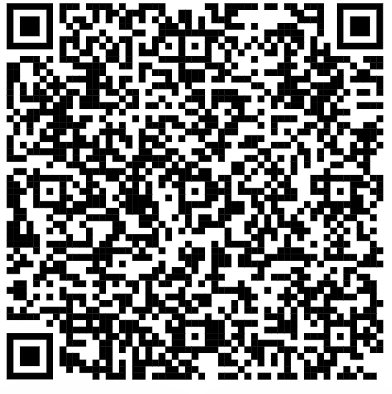
Inspection Marching Team (contd.)
Fill out this form for when you can practice after school (even if it’s never):
If you’re a 2nd or 1st year cadet and you weren’t on the last slide but you feel your drill skills are up to par for inspection-feel free to also fill out the form to be considered for the 30 Count Inspection Team!
For any questions or concerns contact Cadet Agrafena Ritz at (386) 344-9452

Slide 16
Military Knowledge
Which state was the last to join the Union and when?
Hawaii, 1959

Slide 17
Summary
Upcoming Events
Homecoming Parade (10/10)
Football Parking (10/13)
SOCRGC (10/22)
Maxey Fall Festival (10/26)
Unit Picnic (10/28)
Notes
Recruiting
Athletic Clearances
PT Make Ups
Inspection Marching Team
Weekly Uniform Reminder

Slide 18
Briefing Slides
If you have a slide for the briefing, contact C/ Cruz-Garcia at 4804173126@students.ocps.net
If you want something in the briefing, you must contact C/ Cruz-Garcia by Monday 1700 for the Tuesday brief and Wednesday 1700 for the Thursday brief

